Slide 1
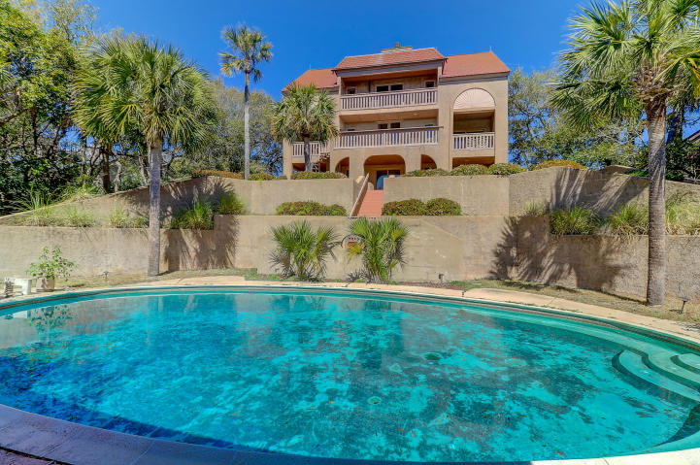
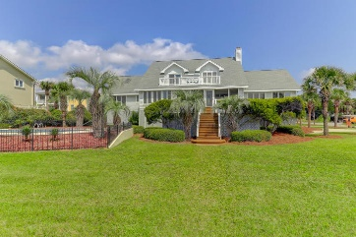
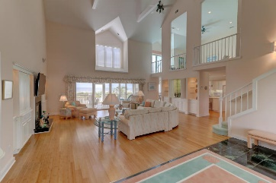
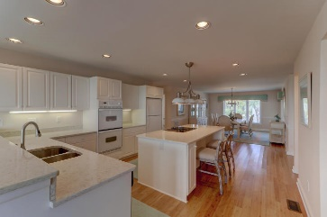
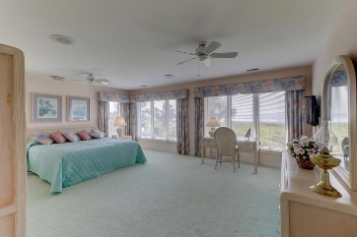
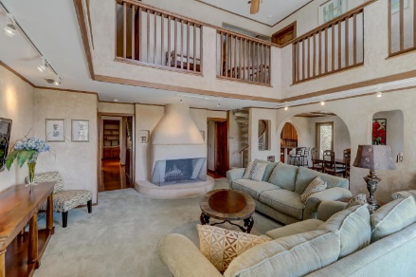
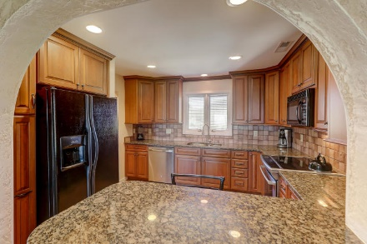
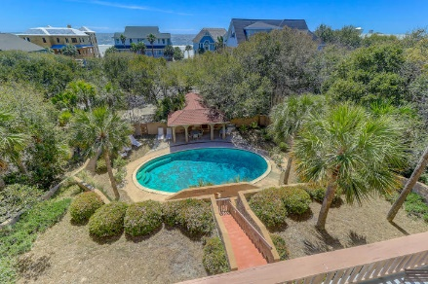
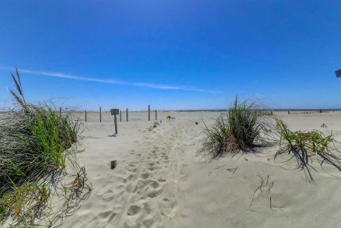
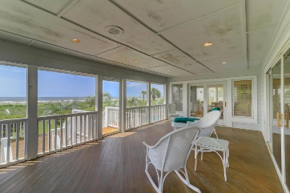


17 W Beachwood West Wild Dunes | Isle of Palms, SC 29451 | MLS# 19009304 | $1,500,000
MOTIVATED SELLER!! REDUCED 300K!
Ocean Views, Pool & Guest House
1 Acre Lot Can Be Subdivided
Into 2 Lots With Conditions
Great Opportunity to purchase Main and Guest House on one of largest lots in Wild Dunes--Stunning Ocean Views and a short walk to the beach. The lot is also one of the highest elevations in Wild Dunes and possibly the highest on the Isle of Palms. A unique property with pool, Guest House, Pool House and more.
The main residence has 8 bedrooms, 5 full baths and 3 1/2 baths, a Great Room, dining area off the kitchen with great views of the Atlantic Ocean! Large pool with bathhouse--an ideal setting for entertaining! The impressive main residence with many grand features has approximately 4100 square feet and the guest cottage over 1000 sq. ft. This home features an updated kitchen with granite counter tops and custom cabinetry. One of a kind in Wild Dunes!
Darlene Smith Office - (843) 886-8110
Mobile - (843) 696-7824
darlenesmith@carolinaone.com
DarleneSmithTeam.com
Carolina One Real Estate
1503 Palm Blvd Ste
Isle of Palms, SC 29451

