Slide 1
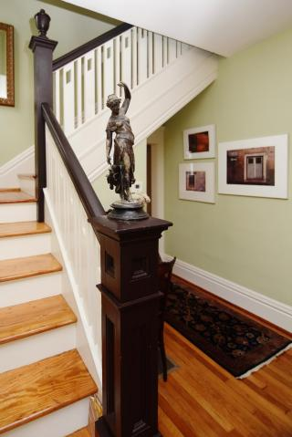
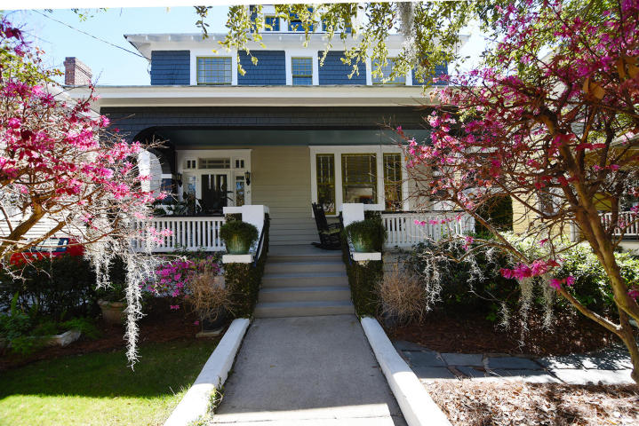
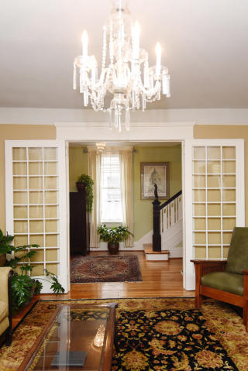
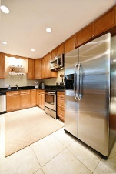
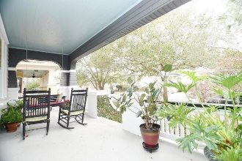
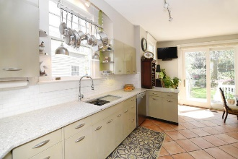
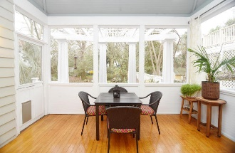
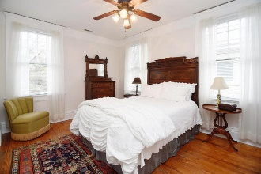
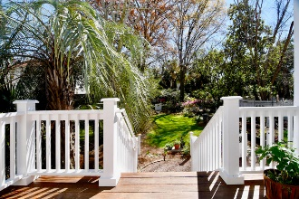
Price Reduction in Harleston Village
17 Bennett Street ~ Charleston, SC 29401
MLS# 18003846 ~ $950,000
Beautiful large historic home in Harleston Village situated on a spacious lot! This meticulously maintained house has only 2 owners since its immaculate construction in 1920. Upon entering the house, you'll notice the abundance of natural light, large windows, beautiful oak and pine floors and tall ceilings that create a feeling of spaciousness. The large lot, that includes a fenced in backyard, detached storage, and off street parking is perfect for gardeners, children and pets alike. The Chef's kitchen boasts top of the line stainless steel appliances and built in breakfast nook. With ample seating areas on the front porch and back screened in porch, you can relax indoors or outdoors all year long. This central location, just blocks from Colonial Lake, restaurants, MUSC and galleries allows you to enjoy all that downtown has to offer!
Trey Morrison
trey@landsouthofcharleston.com
Mobile 843-697-6849
Land South of Charleston, LLC | 180 East Bay St, Suite 300 | Charleston 29401

