Slide 1
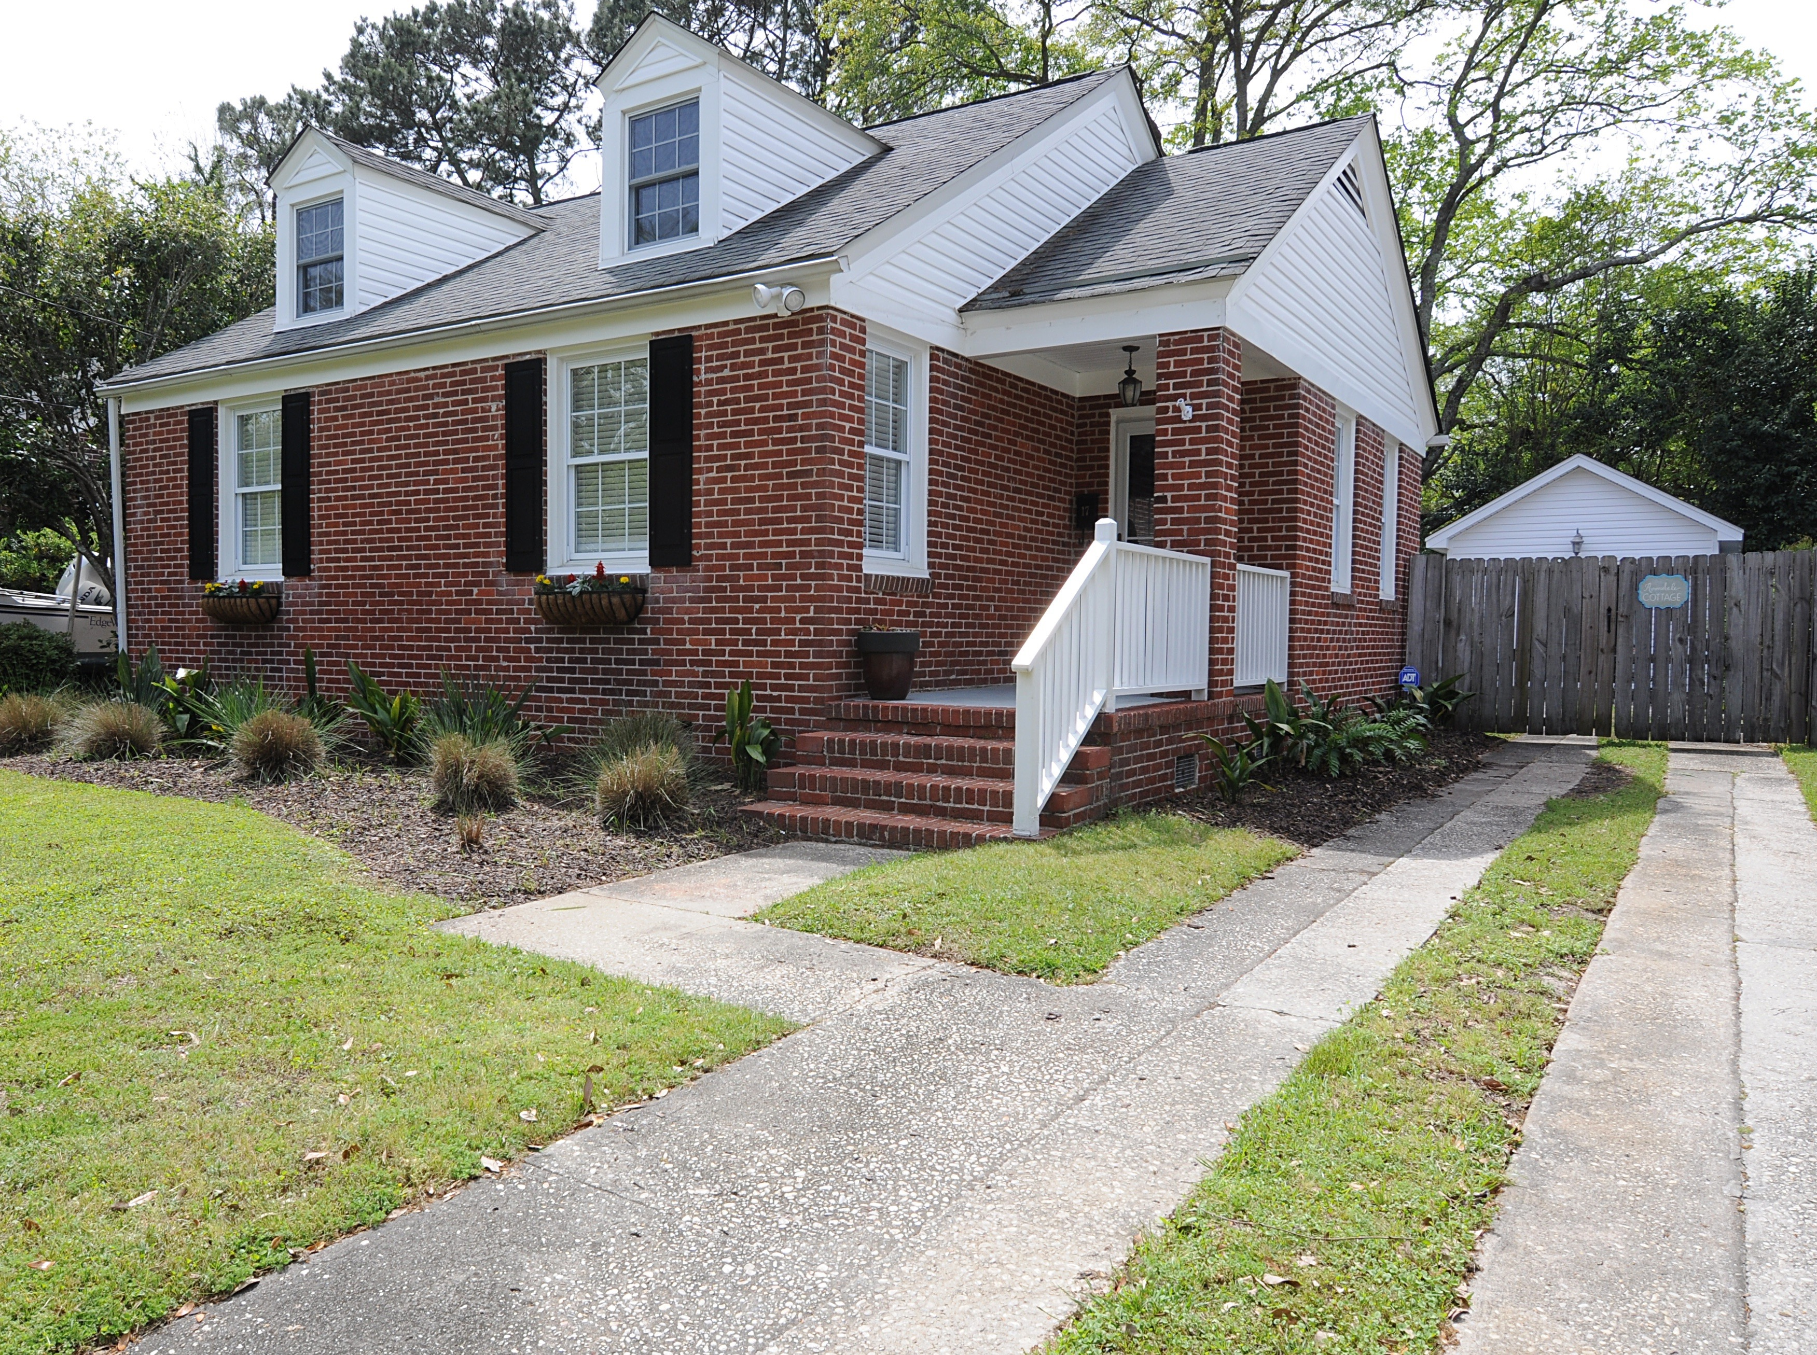
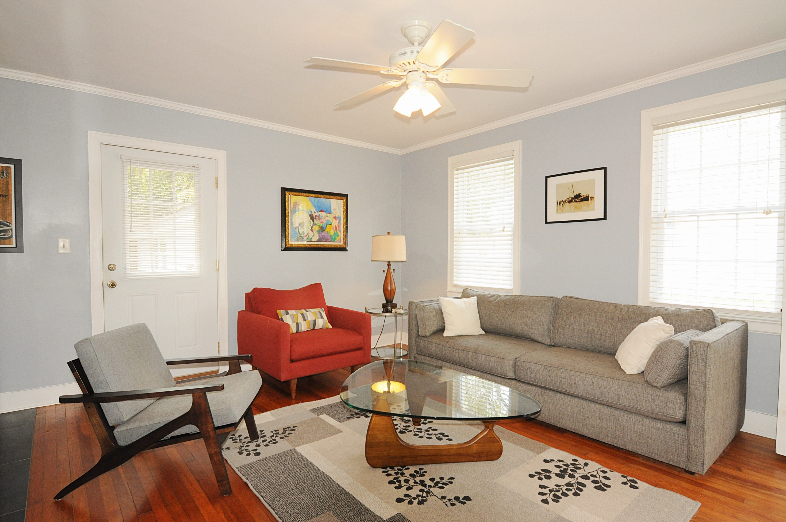
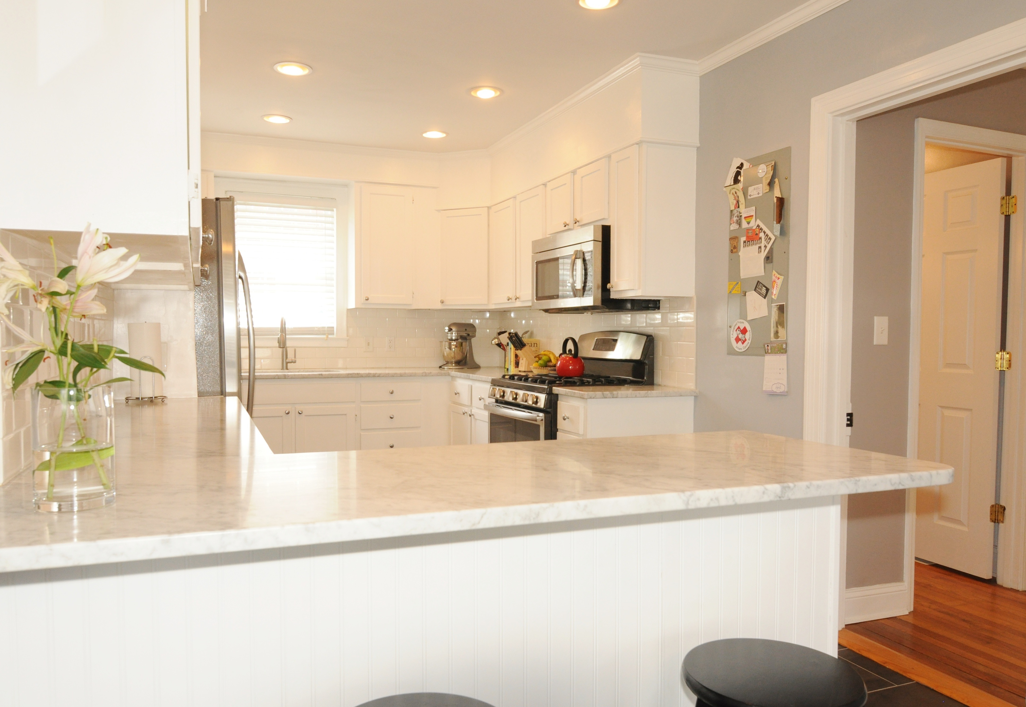
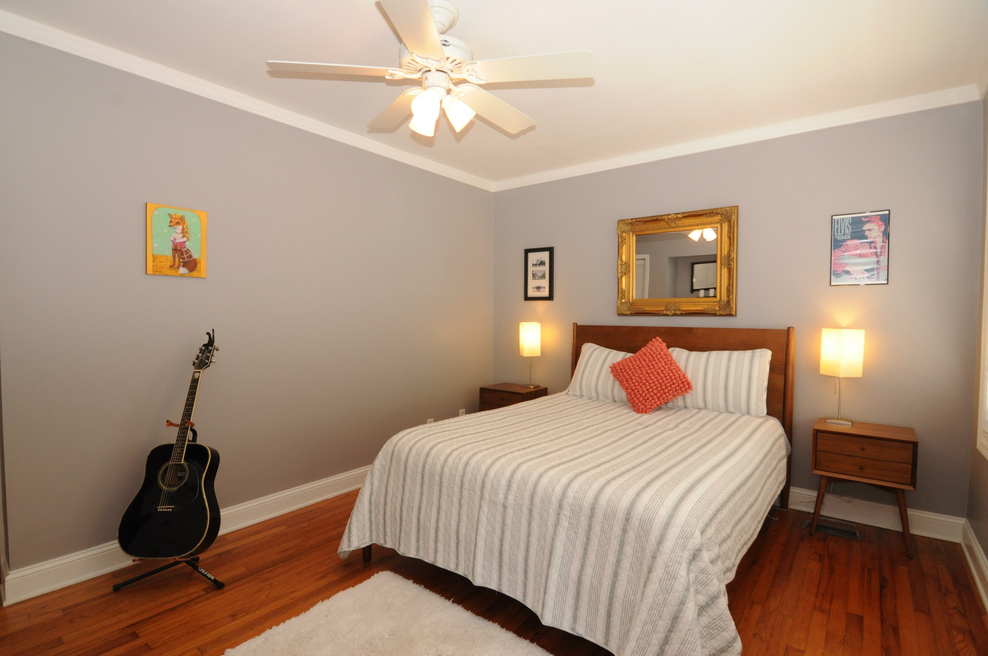
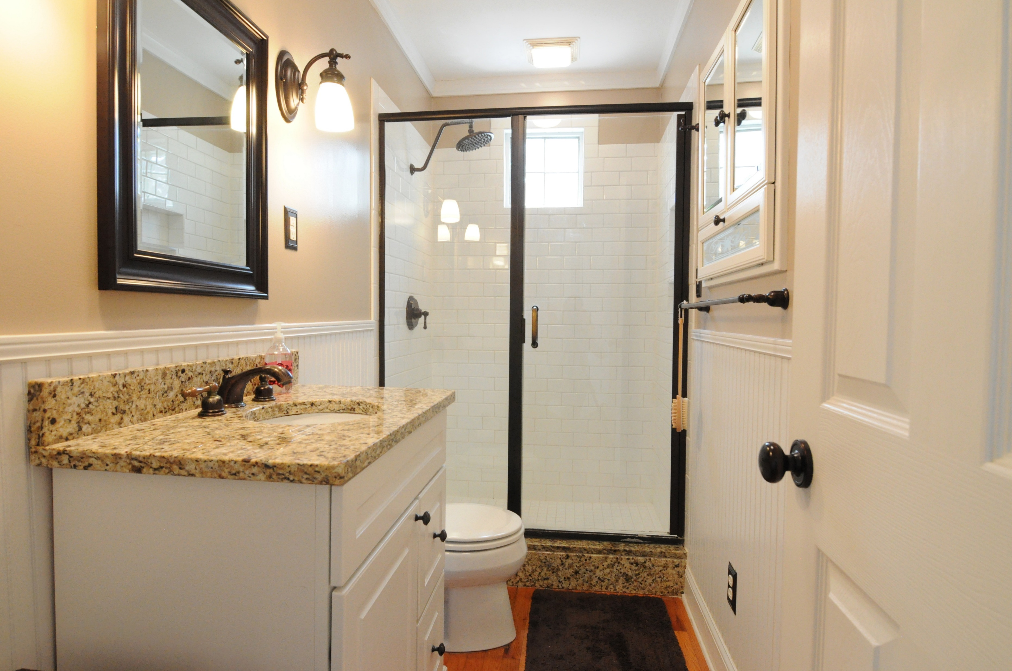
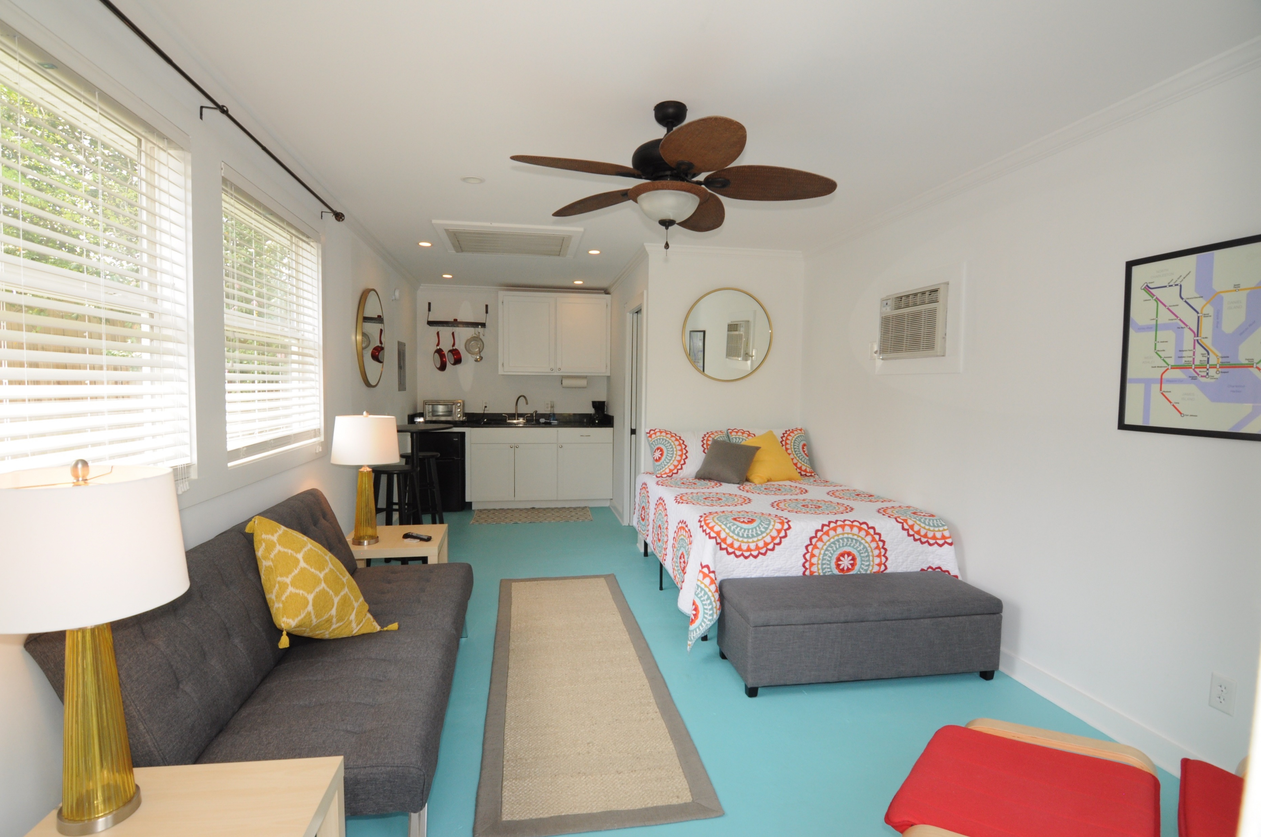


17 Timmerman Drive Charleston, SC 29407
Live for Free in Byrnes Down
Back on the Market
3 Bed / 2 Bath, completely renovated in 2014 with a detached studio cottage that is currently an active Airbnb rental generating $3000/month in income. This immaculate home is located in one of the most sought after neighborhoods in Charleston and has all the upgrades your looking for and more!!! Don't miss out on your opportunity to see a true one of a kind home in the lovely Byrnes Downs.
Showings begin this Saturday, July 16th!!!
Nikki Jones | nikki@petigruproperties.com | (843) 442-5880
Petigru Properties, Inc · 792 Folly Road Suite 5 · Charleston, SC 29412

