Slide 1
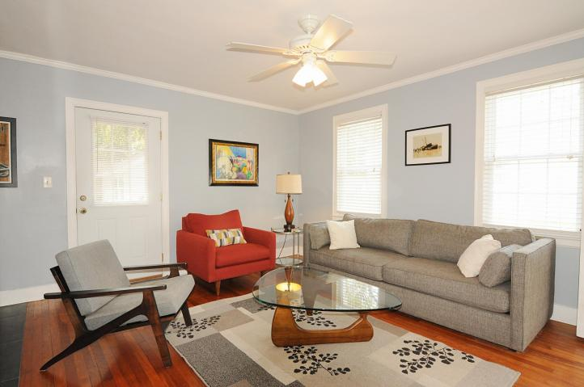
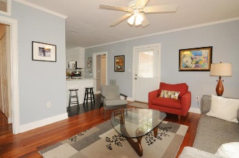
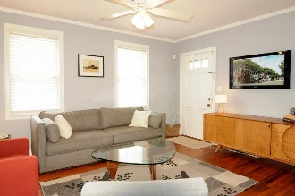
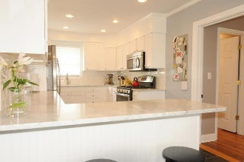
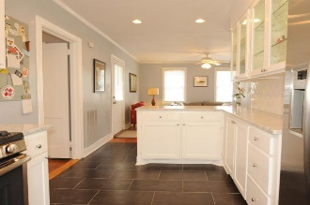
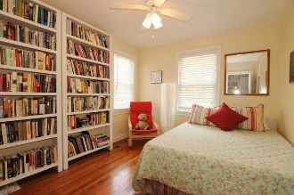
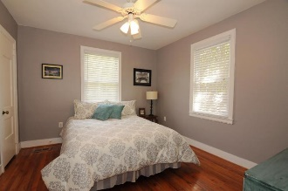
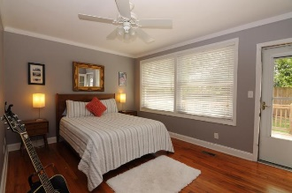
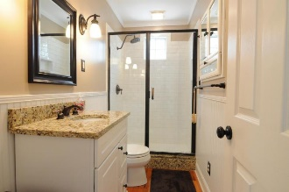
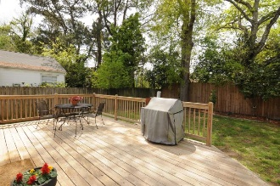
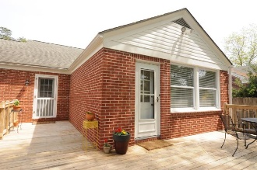


17 Timmerman Byrnes Downs Charleston, SC 29407 MLS# 16022572 · $2,500/mo 3 Bedrooms | 2 Full Baths | 1,233 Sq Dt
Best Rental in the Avondale Area!!!
17 Timmerman Byrnes Downs · Charleston · MLS# 16022572 · $2,500/mo 3 Bedrooms | 2 Full Baths | 1,233 Sq Ft
Available starting November 1st 2016!!!!! Home is available furnished or unfurnished. Flexible rental terms, 3 to 6 months, and up to a year lease. Lawn service is also provided with the property. No Pets allowed. Home has an open floor plan and an updated kitchen with Carrera marble countertops, subway tiles, and stainless appliances. Great layout with spacious master suite on one side of home, and guest bath and two guest rooms on the other side. Energy efficient windows and HVAC are just five years old. There is a large back deck overlooking a private back yard, which is accessible from both the open living/kitchen area and the master bedroom.
Nikki Jones | nikki@petigruproperties.com | (843) 442-5880
Petigru Properties, Inc · 792 Folly Road Suite 5 · Charleston, SC 29412

