Slide 1
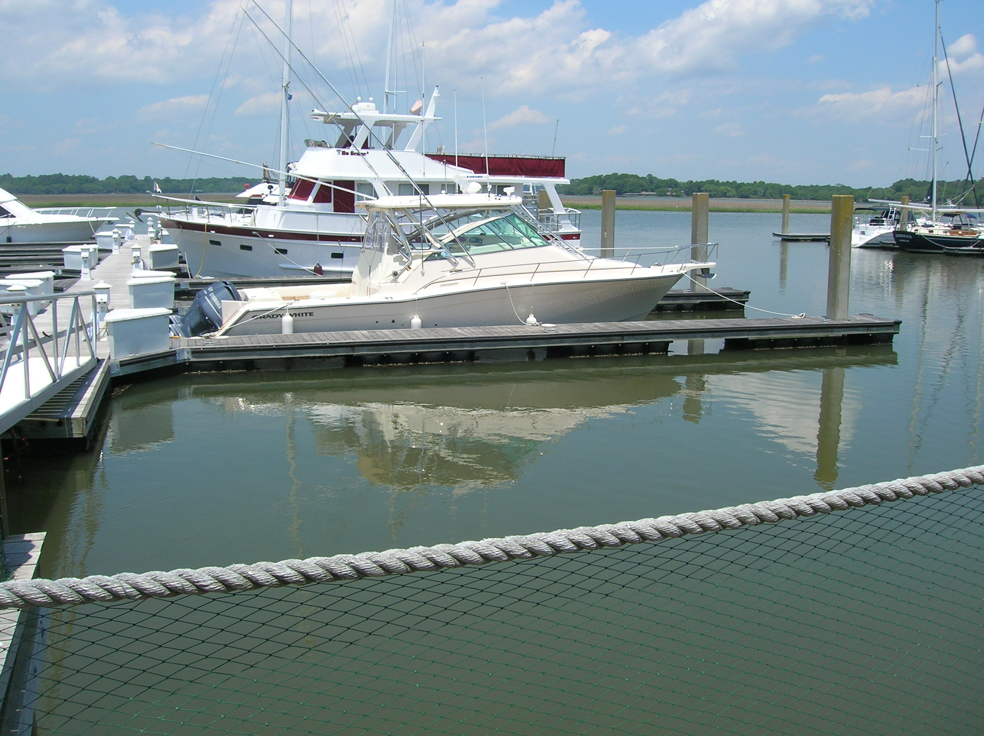
William S. Smith, Broker Hartnett Realty Co., Inc. 134 Meeting St, Chas, SC 29401 wssmith@hartnettrealty.com (843) 723-7222
Bohicket Marina - Slip F1
Johns Island, SC 29455
MLS# 1011030
PRICE REDUCED FROM $99,500 to $70,000!!!
Considered the best boat slip in the marina given its location and size. 55.3 foot length boat slip well-situated on F-1.
This is the largest boat slip available in this attractive marina and it is very sharply priced.

