Slide 1
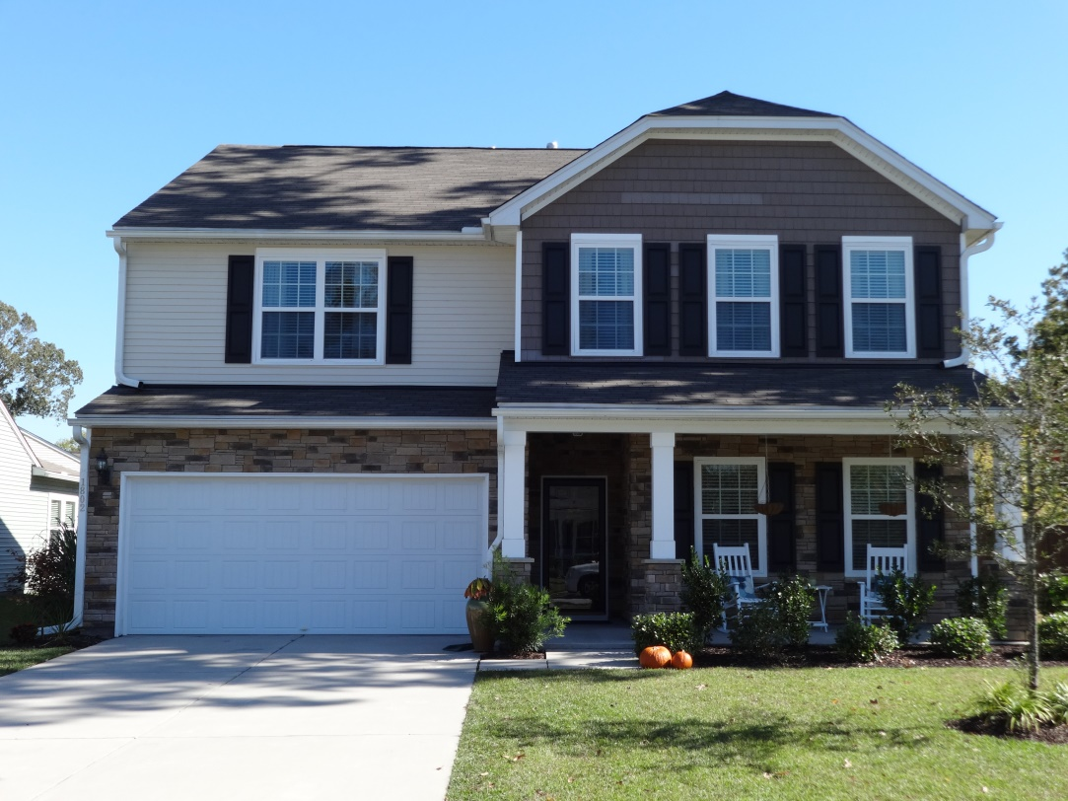
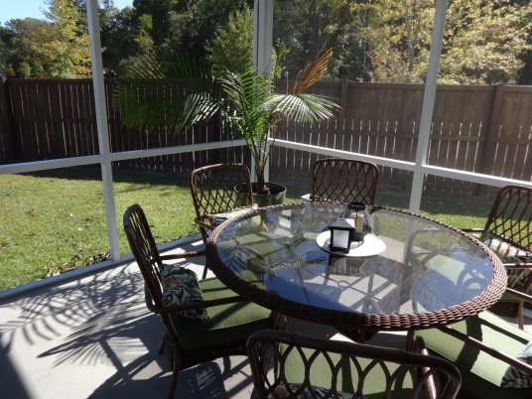
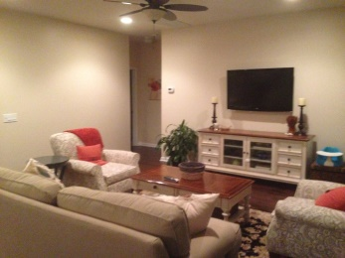
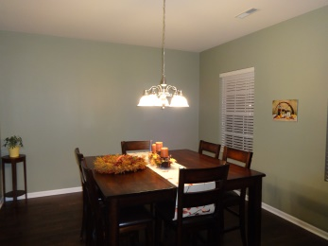
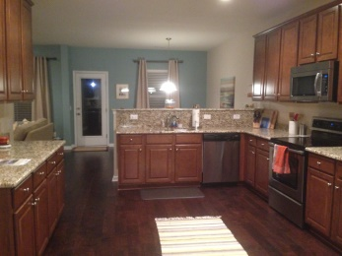
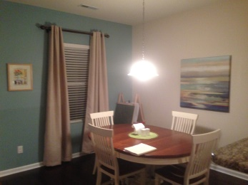
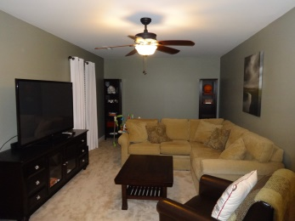
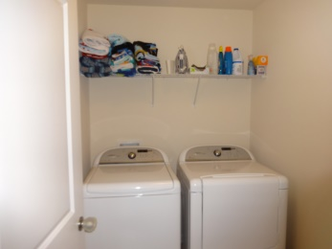
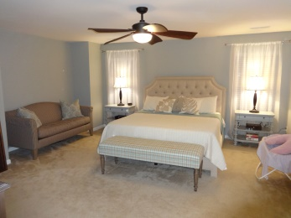
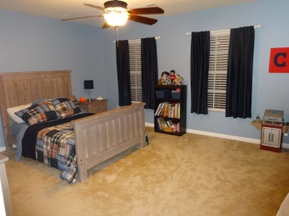
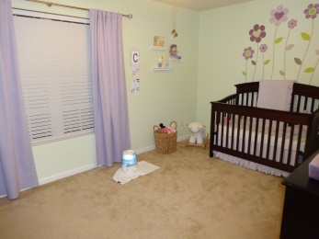
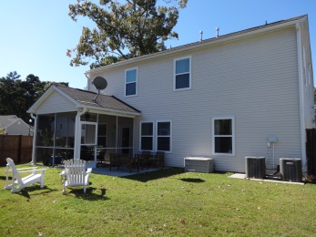



Seller is offering up to $5,000 toward closing costs!
1802 Chickasaw Dr
Carolina Bay | Charleston
MLS# 14028744 | $317,000
4 Bed | 3 Baths | 3,093 Sq Ft
Location…
Location…
Location!
Charming & Comfortable Living
Beautiful home in Ricefield at Carolina Bay is ready NOW! You do not have to wait to build to get what you want. This great home has many of the upgrades to include Hardwood floors through most of the first floor and granite countertop in kitchen. Three bedrooms and the laundry room with washer and dryer connections and open family area are on second floor. Fourth bedroom and large family room on first floor. It has a matured lawn with landscaping and sprinkler system. This is one that you do not want to wait to see. 10 Year Builder warranty transfers to new owner. “Lender paid closings costs of .5% of the loan amount, redeemable only at the time of closing when financing is completed by the seller’s preferred lender. Closing costs credit must be mentioned at application and may only be applied to offset actual costs.”
Charles Lent REALTOR, AIC
843-864-6426
charles.lent@agentownedrealty.com
www.charleslentrealty.com
AgentOwned Charleston Group | 902 Savannah Hwy | Charleston, SC 29407-7802

