Slide 1

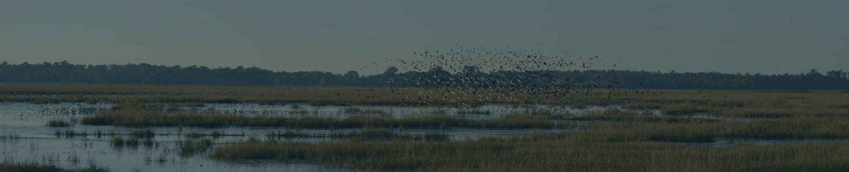

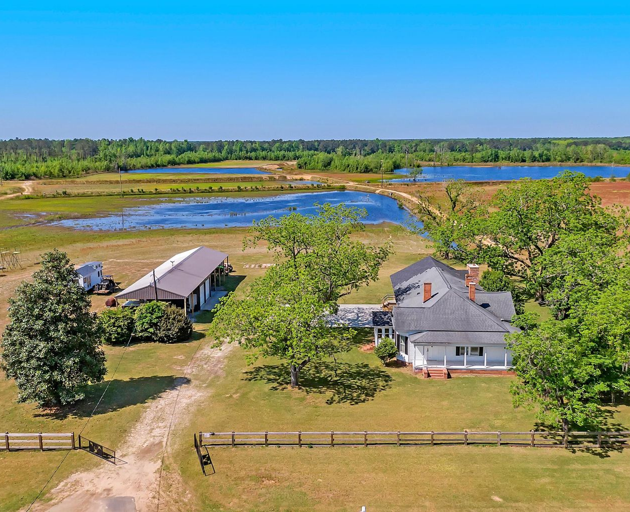
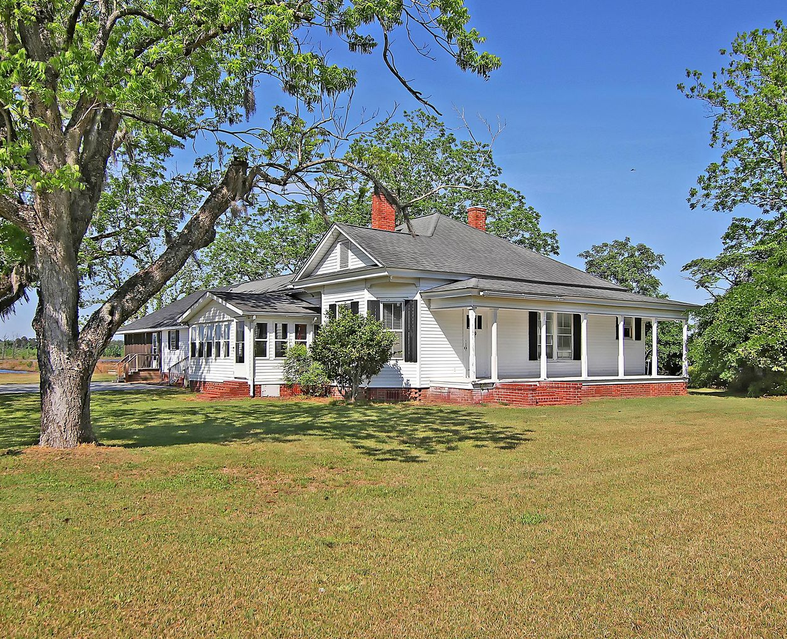

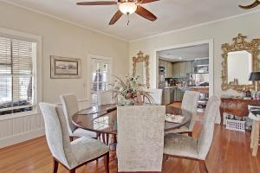

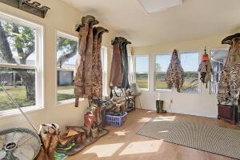
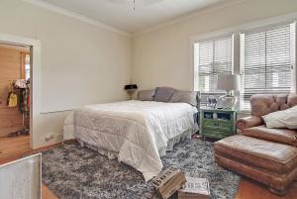
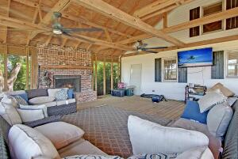
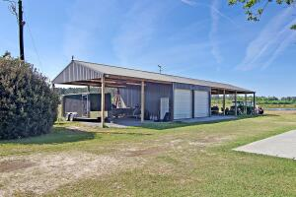
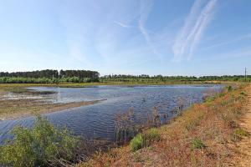
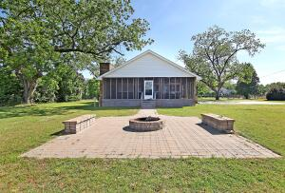
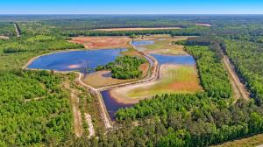
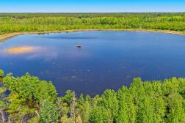
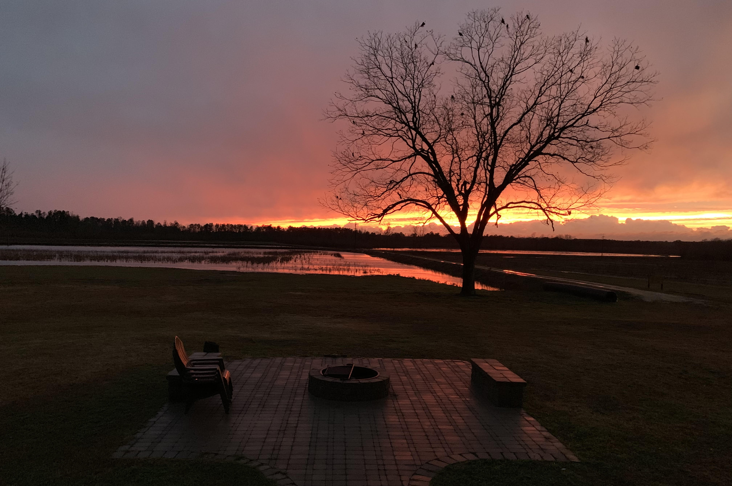
DOUGLAS CUTTING
(843) 534-3911
dcutting2@gmail.com
bluewingproperties.com
1802 Nesbit Road
Manning, SC 29102
MLS# 21013915 ~ $1,700,000
Deep Creek is a finished 275 acre hunting property located a few minutes east of Manning. The four bedroom farmhouse was recently renovated and sets up nicely for a family and friend hangout with a modern kitchen, screen porch, mudroom and more. The farm also has a new barn, dove field, and 70+ acres of fenced duck impoundments on which at least 8 species of ducks have been seen or harvested.
Video Tour: https://vimeo.com/543444566

