Slide 1

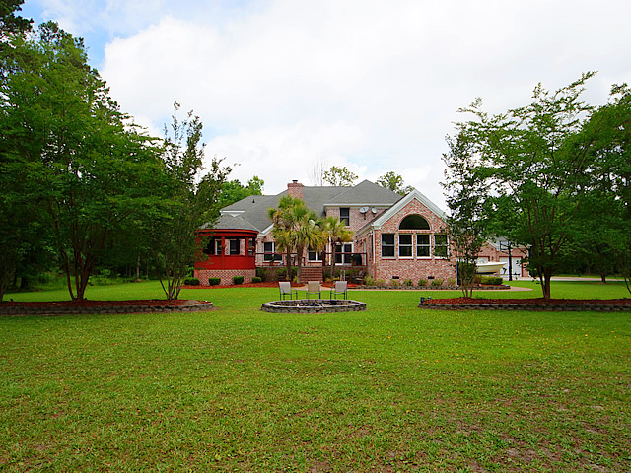
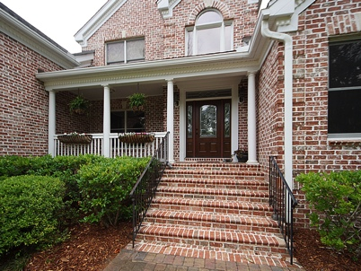
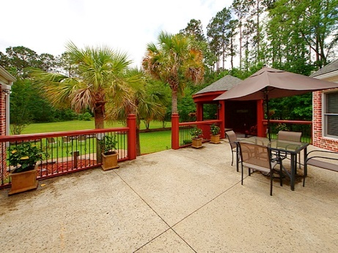
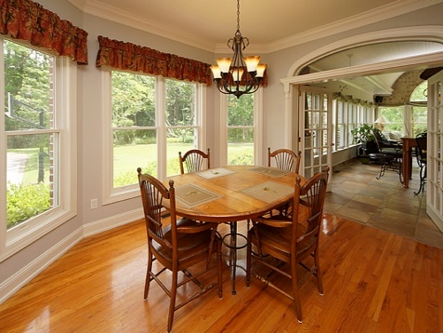
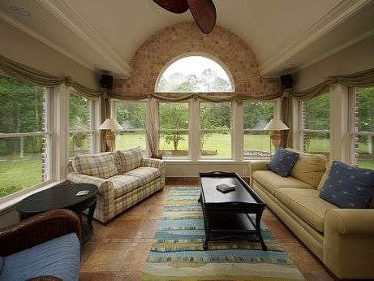




JUST LISTED Dunes West
Brick Home On Estate Sized Lot With 2+ Acres & 5 Car Garage
1804 Cherokee Rose Circle, Mount Pleasant, SC 29466 - $995,000
HARD TO FIND 2+ ACRE ESTATE WITH 5 CAR GARAGE – PEACEFUL AND PRIVATE!
BEAUTIFUL BRICK HOME with 5 Bedrooms and 5 CAR GARAGES great for woodworking/in-law suite/or car collector! Options are limitless! Impress your clients as they as they fall in love with this fabulous 5BR custom built brick home situated in desirable gated community of Dunes West. Seller spared no expense creating this ''private retreat'' including an outdoor gazebo area with extensive decking, patio area & grilling station. As you enter, notice the attention to detail including custom built-ins, solid hardwood flooring, extensive trim work as well as upgraded lighting fixtures. The gourmet eat-in Kitchen is a cook's delight with beautiful cabinetry, and granite countertops. The Family Room is spacious and boasts high ceilings centered by a beautifully trimmed fireplace! Call showing time for an appointment today!
Margaret Hekker
BIC/REALTOR
843-296-7520

