Slide 1
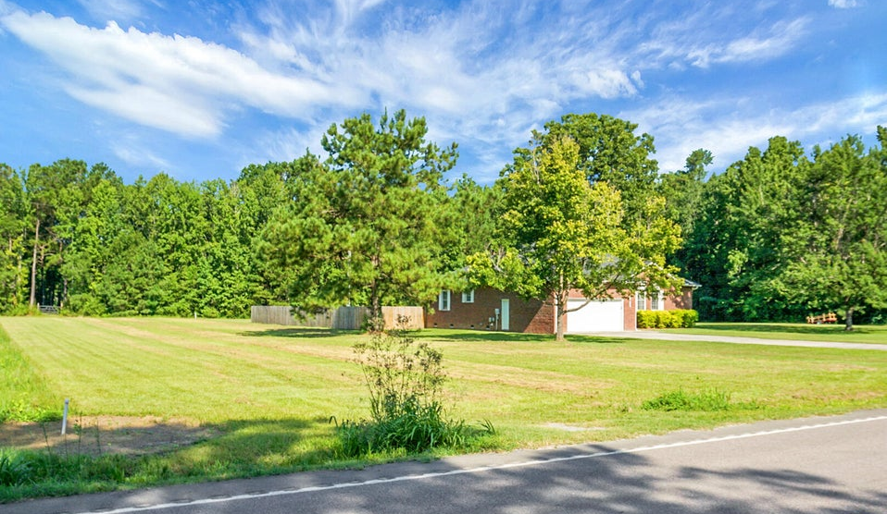
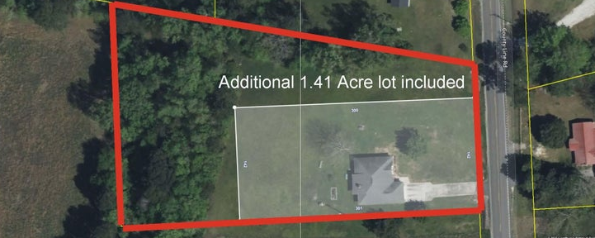
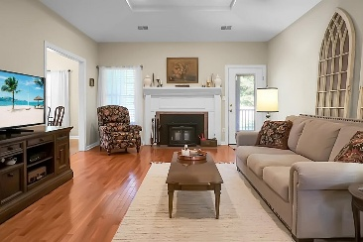
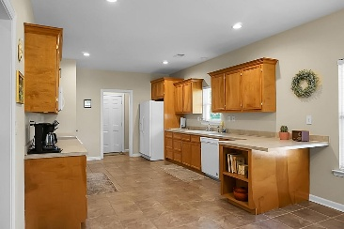
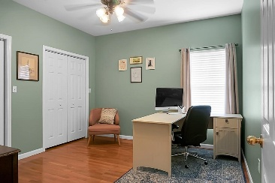
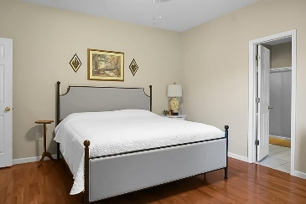
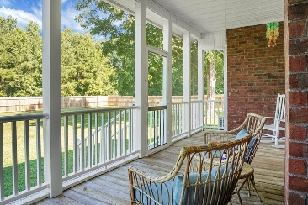
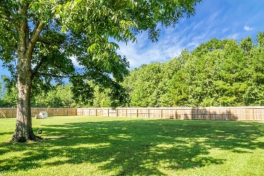

1804 County Line Road Cross, SC 29436 MLS# 25020149 $438,000
Bring Your Boat
Reduced $32,000
Country Living with Modern Perks - 4 Beds on 2.4 Acres! If you're looking for space, peace, and a place to call home, this one checks all the boxes! Sitting on 2.4 acres in a quiet, rural setting, this home offers 4 bedrooms and 2 baths, with a brand new roof and newly available fiber internet — so you can enjoy country life without giving up speed online. The primary suite has plenty of room with two walk-in closets, dual vanities, and a private bath. The spacious kitchen features wood cabinetry, tons of storage, and lots of counter space — perfect for cooking or gathering. You'll love the 9 ft ceilings, especially the tray ceiling in the living room, and the wood-burning fireplace with a stove insert for cozy nights.
Floors are hardwood throughout the main spaces, with tile in the kitchen and baths. The hall bathroom even has a jetted tub for extra relaxation.
Outside, you'll find a screened-in porch to enjoy sunset views, a 6 ft privacy-fenced backyard, and a 2-car garage for all your storage needs. Located 12 Miles from Volvo
Gerri Sandford
(843) 817-8762
gsandford29455@gmail.com
Anchor Line Realty LLC
1619 Samuel Rd
Charleston, SC 29412

