Slide 1
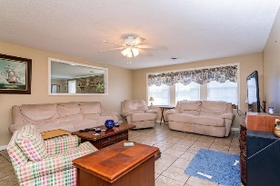
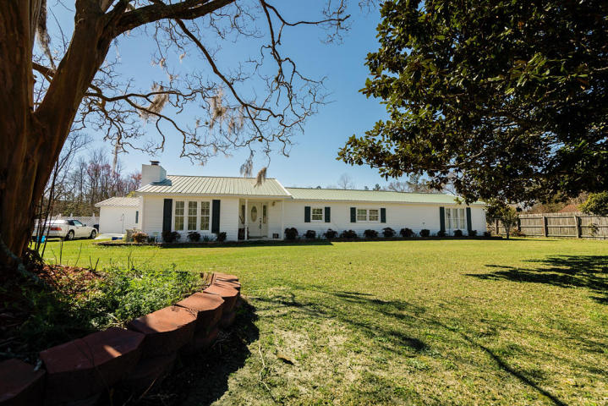
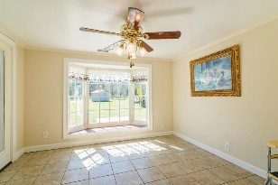
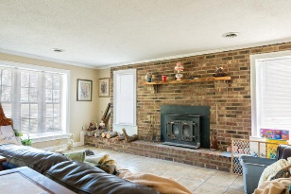
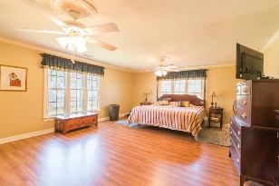
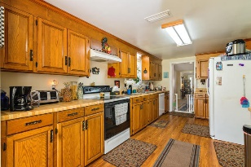
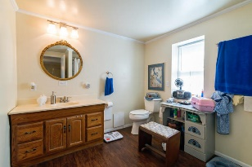
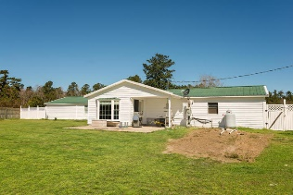
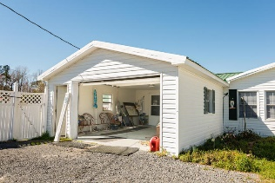
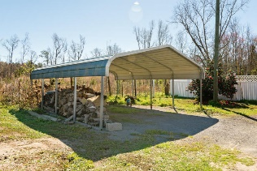
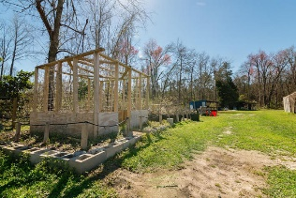
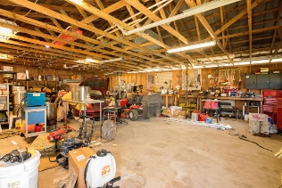


Price Reduced
1805 Fish Road
Lebanon Area ~ Ridgeville, SC 29472 ~ MLS# 17005474 ~ $279,900
Quiet country living at its best. Spacious 4 bedroom 2 bath house with lots of charm sitting on 2.53 acres. Entering through the front door you are greeted by the wood burning stove with a rustic brick wall backdrop. Pass through the large living room into the kitchen that has lots of counter space and cabinetry. Enjoy the view looking through the bay window out into the fenced backyard with the flowering trees and vegetable garden area. Large 16x9 laundry/mud room is located off of the kitchen.
Separated from the other 3 bedrooms is the large private 350sq.ft master bedroom with attached master bath and large walk in closet with built in storage/shelving, bedroom addition was built in 1991.(Included in sq.ft. in tax records) Ceramic tile throughout most living areas and dining room. Laminate wood flooring in the kitchen and 3 of the bedrooms . Crown molding throughout the house, except laundry room.
Long expansive driveway, one car attached garage and carports provide plenty of parking for your cars and any visiting guests. Huge 1008sq.ft detached four car garage and workshop provides extra storage for toys, machinery and equipment. Vinyl windows and exterior doors help with energy efficiency. Septic drain lines are only 1 year old. Drain line to washer was replaced in Feb 2017. Motor on the submerged well pump is 5 years old and has a 25yr warranty.
Lots of features, too many to list. A must see! Schedule your viewing now!
Jacqui Swain
O (843) 871-1710 | M (843) 295-9484
jacquiswainc21@gmail.com
www.JacquiSwain.c21.com
Century 21 Expert Advisors | 100 Seven Oaks Lane | Summerville, SC 29485

