Slide 1
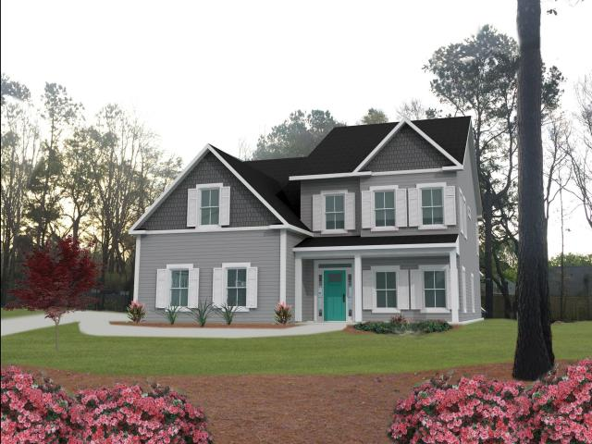
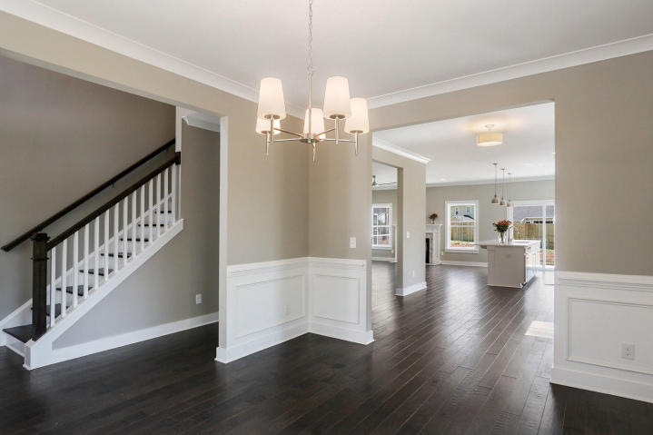
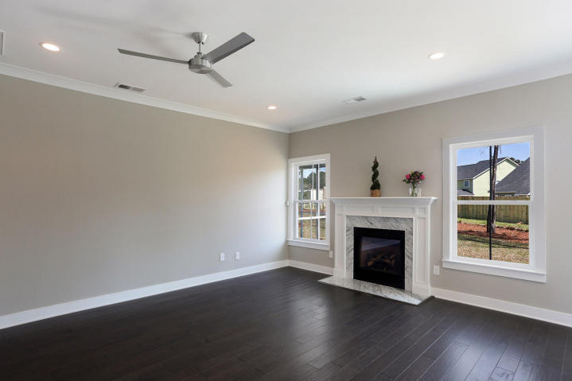
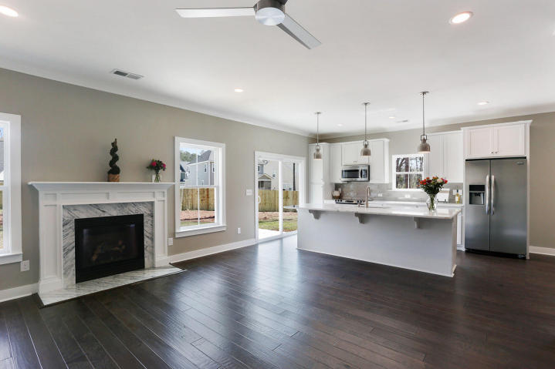
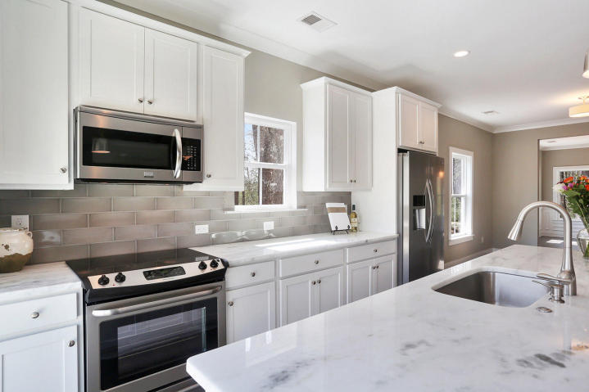
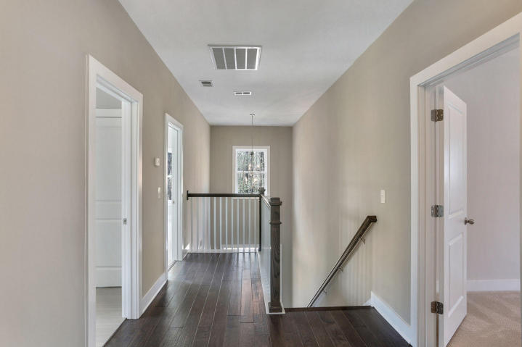
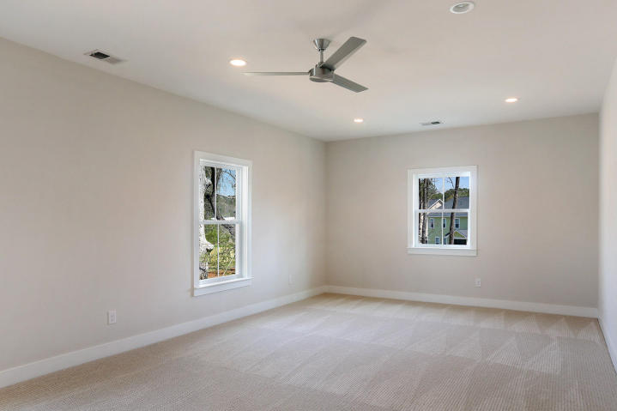
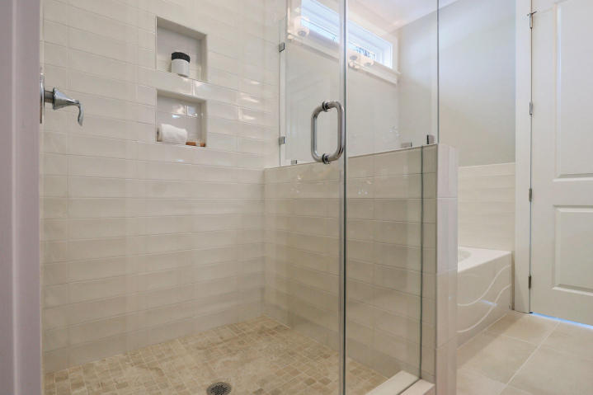
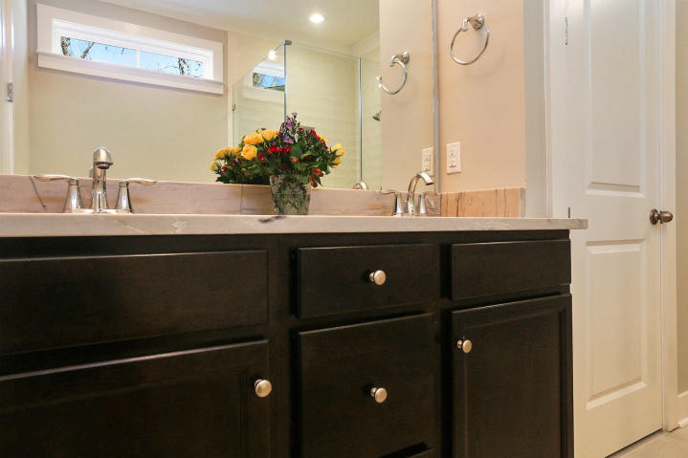
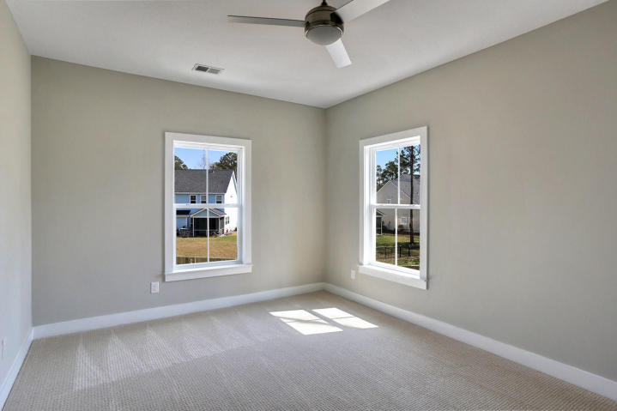

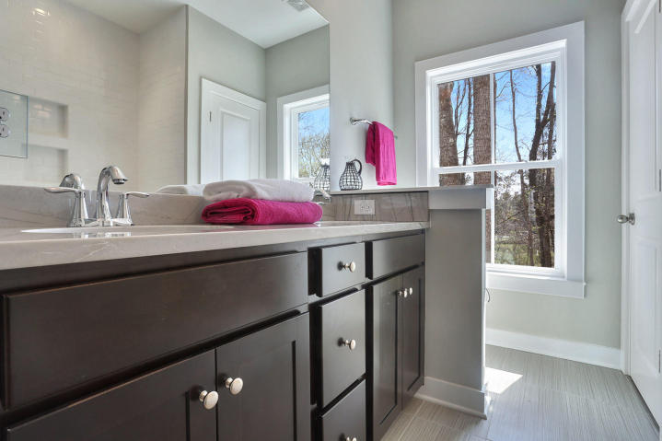

High Quality New Construction
in South Mt Pleasant
1805 Rifle Range Road
Mt Pleasant ~ MLS# 17009113 ~ $544,900
Brand New Construction – Ready in June! At 3,237 sf, this 5 bedroom, 3 ½ bath carefully crafted home on estate-sized wooded home site is the epitome of Mount Pleasant style and luxury with over $50,000 in extras – IT’S ALL INCLUDED! Located inside the Isle of Palms Connector and just steps from Seaside, it is minutes to the beaches and easy access to Downtown. Extraordinary attention in planning and detail has been given to this custom residence which boasts DUAL MASTER SUITES with opulent shower and baths; downstairs and up, and offers multiple options for flexible living and a thoughtful open floor plan. A few of this home’s luxury finishes are:
Side-Entry Garage
Hardiplank Siding
Andersen Silverline Impact Rated Low-E Windows
Deluxe Trim Package
High Ceilings and 8’ Interior Doors on First Floor
Fireplace with Stone Surround
Beautiful Hardwoods Downstairs
Custom 42” Shaker Cabinets with soft-close features
Granite Countertops in Kitchen and Baths
Upgraded Tile Floors and Showers in All Bathrooms
Screened Porch AND Patio
Downstairs Master Suite Easily Converted to Legal Guest Suite
Wooded, Sodded, Fenced Yard
See more floorplans at www.riflerangehouses.com
Photos are of a similar home for representational purposes only.
Wilcat Realty
PO Box 897
Mt Pleasant, SC 29465
Carrie Newbern
(843) 557-9001
carrienewbern@gmail.com

