Slide 1

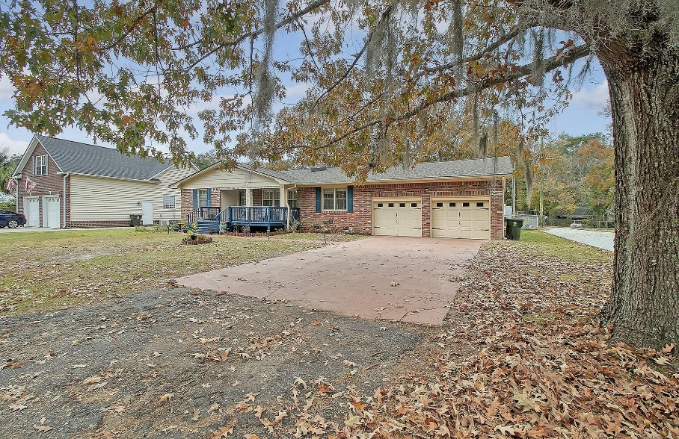
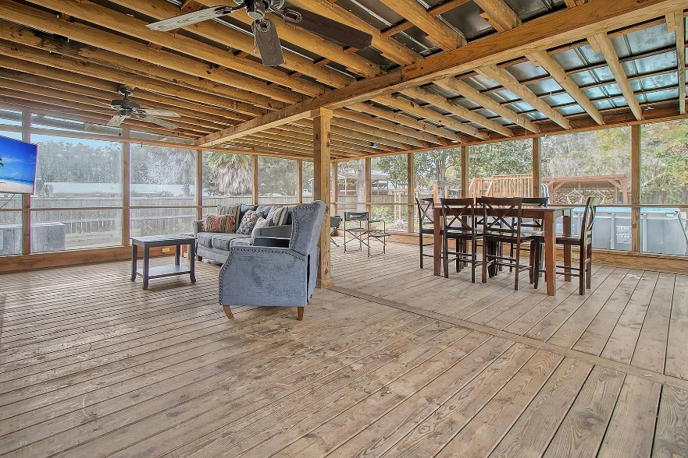
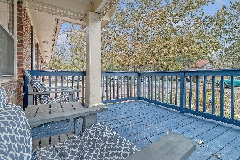
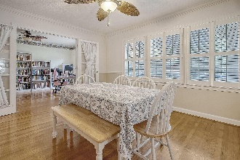
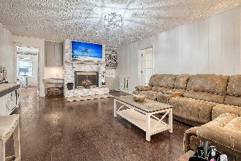
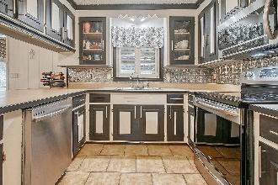
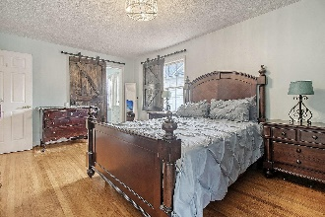

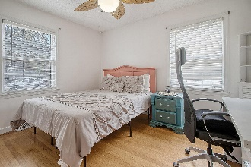
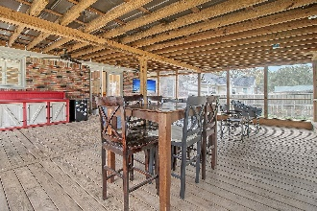
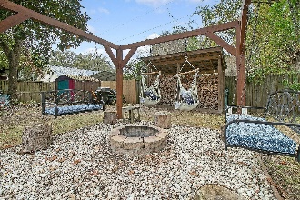
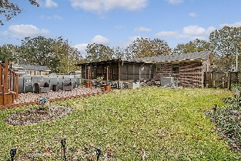
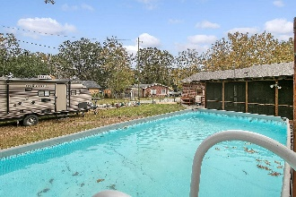
Open House Saturday
Feb. 17th from 10:30-12
Debbie Cromer
ABR, RSPS, REALTOR, CRS
(843) 437-6342
debbie@debbiecromer.com
www.debbiecromer.com
1805 Fishing Island Road
Pimlico | Moncks Corner, SC 29461 | MLS# 23026184 | $395,000
Welcome to your dream home in the heart of Pimlico! This river-adjacent gem offers a delightful blend of comfort and elegance. Step inside to discover gleaming wood floors and a sun-soaked formal dining room. The adjacent flexible space is the perfect third bedroom or home office. The great room, with its cozy wood-burning fireplace, invites relaxation and warmth. The kitchen features ample storage and a convenient breakfast bar. The spacious master bedroom is a sanctuary with three walk-in closets and a serene sitting area. The guest bedroom at the front offers quiet comfort. Outside, the massive screened porch provides a tranquil outdoor living space overlooking the above-ground pool, deck, charming fairy garden, and handy storage shed in the expansive backyard.
The 2-car garage boasts a workroom and extra storage. Don't miss the community dock and boat ramp. This home truly caters to every need, making it an ideal haven for anyone seeking comfort, convenience, and natural beauty.
Video Tour
Century 21 Properties Plus | 1090 Park West Blvd; Ste 103 | Mount Pleasant, SC 29466

