Slide 1
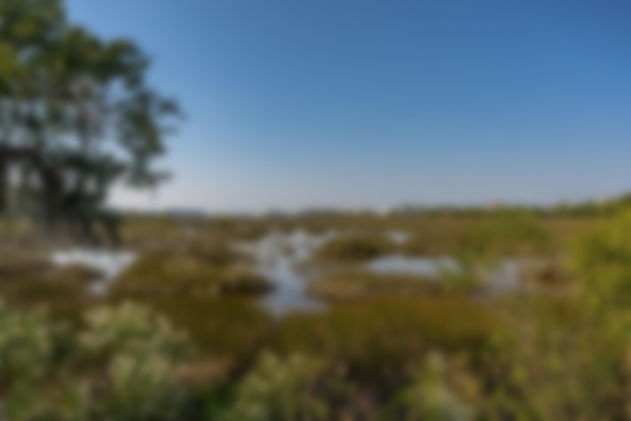
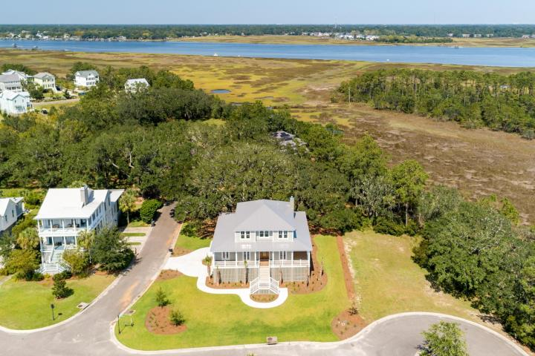
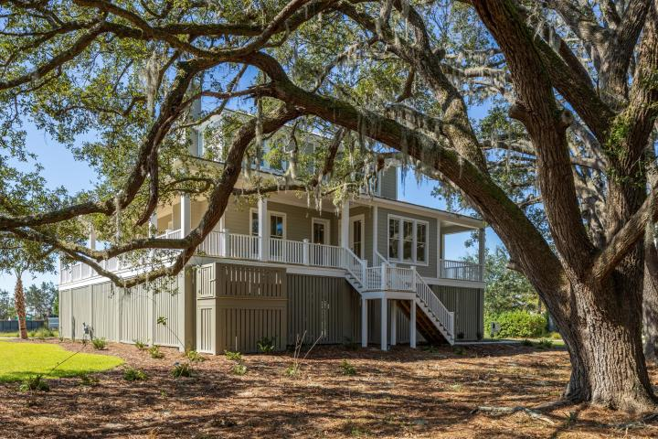
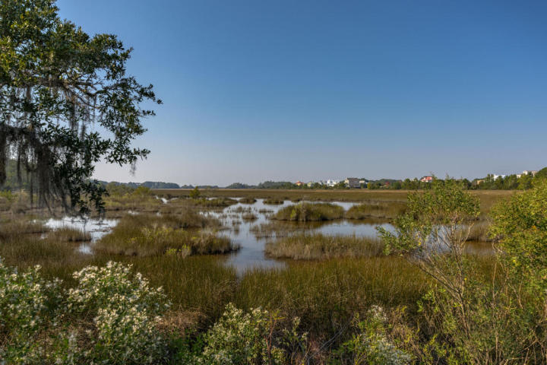
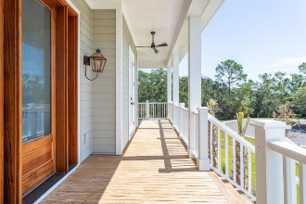
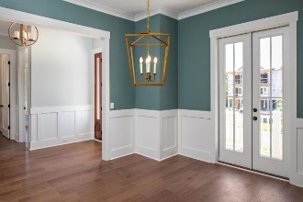
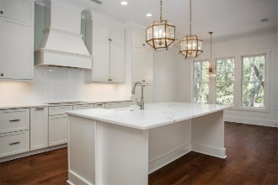
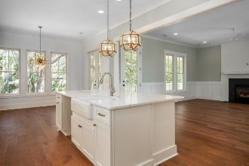
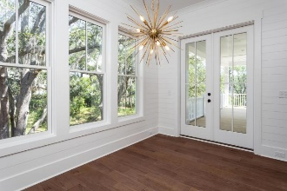
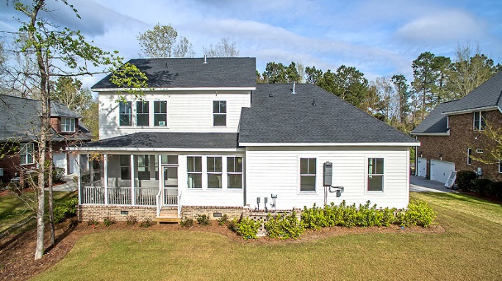

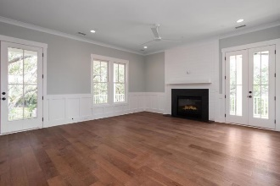
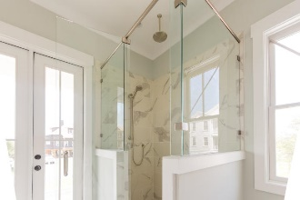
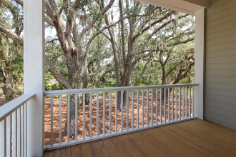
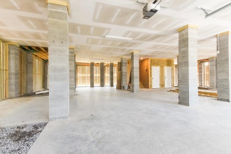
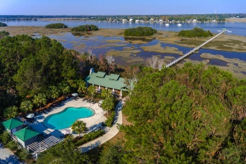
1806 Rushland Grove Lane Rushland Plantation :: Johns Island, SC 29455 MLS# 19000379 :: $899,990
Ready Now!
New Price!
Unique Opportunity to Own a Brand New Custom Home with tons of features and upgrades. This Marsh Front Residence boost elegance and incredible curb appeal with a Full Front Porch that wraps around to the side of the residence. The Front Porch is great for Rocking Chairs and/or a swing. The Metal Roof adds to the Southern Charmed exterior that you will fall in love with. The Screened Porch and Rear Deck have an amazing Marsh view and a view of the Stono River as well. The Interior Features include 5'' Hardwood Floors, Tile in the Bathrooms, Wainscoting in the Foyer, Judges Paneling in the Dining Room, Custom Trim Paneling in the Great Room, The Appliances included are an Over the Range Hood, Drop-in Stove, Built-in Double Oven, Dishwasher and Built-in Microwave in the Island. Get in early to make your Selections for this New Home. Rushland Plantation is a 500-acre neighborhood with home-sites. The Rushland community has set aside a considerable amount of land for natural wildlife habitats. Expansive marsh views is the trademark of this Community. The Community Dock is on the Stono River which gives you deep water access. Rushland Plantation is located off of River Road, less than a mile from Maybank Highway. Local Restaurants include Maria's Mexican Grill, The Fat Hen, and Wild Olive are within a few minutes drive. Downtown Charleston is about 15 minutes away, and Folly Beach is about 20 minutes.
Chris Eller
EPRO, GRN, SFR, REALTOR, CRS
(843) 343-3359
Chris@GallowayFamilyHomes.com
GFH Realty, LLC
498 Wando Park Blvd Suite 1125
Mt. Pleasant, SC 29464
www.gallowayfamilyhomes.com

