Slide 1
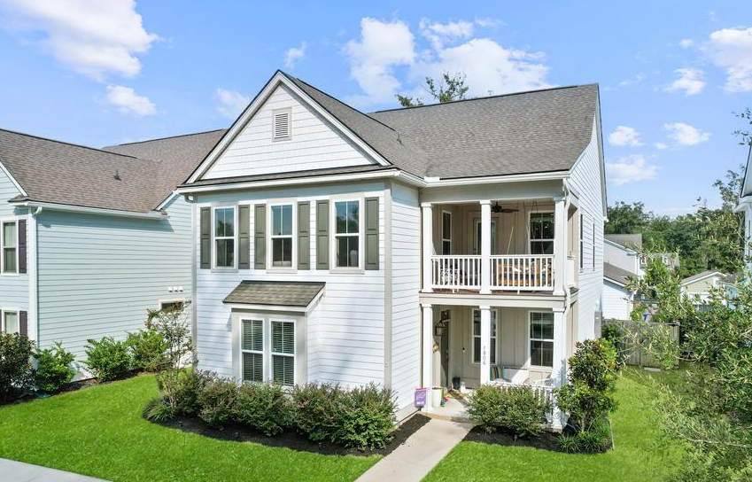
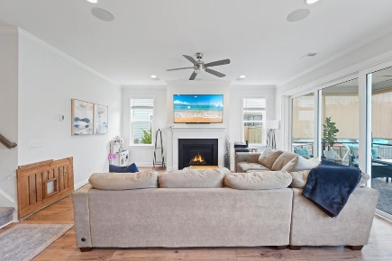
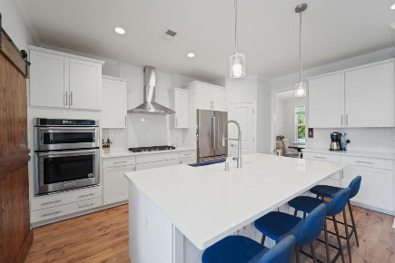
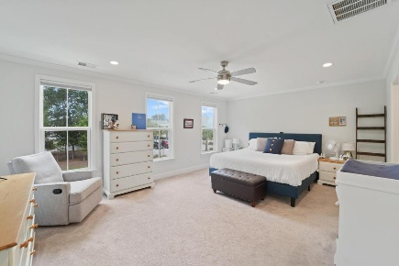
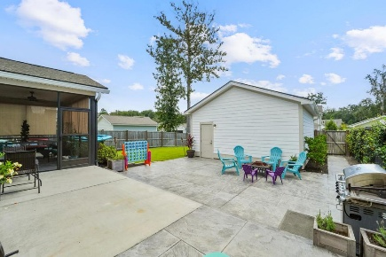
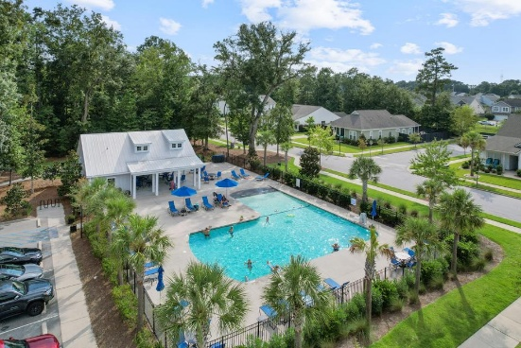






1806 Swing Lane
Offering at $789,900
The Villages In St Johns Woods · Johns Island, SC 29455 · MLS# 26006753
PROPERTY FEATURES:
4 Bedroom 3½ Bathrooms
2,830 Sq Ft
Welcome to 1806 Swing Lane! This stunning 4 Bed/3.5 Bath Ravenwood floor plan property offers 2,830 sq ft of turn-key living space and is perfectly positioned on a spacious lot in the highly sought-after Villages in St. Johns Woods community on Johns Island. Wonderful indoor/outdoor living spaces, an open and functional floor plan, DUAL PRIMARY BRs, huge loft upstairs which is perfect for a second Living Room/Movie Room/Playroom, etc, fenced backyard, 2 car detached garage with an additional parking pad, screened porch/oversized patio, dual front porches, and a meticulously maintained interior make this home truly turn key move-in ready! This one has it all! Schedule your private showing today!
HAYNES JOHNSON
843-864-8159
haynes.charlestonproperties@gmail.com haynes.findhomesforsaleincharleston.com

