Slide 1
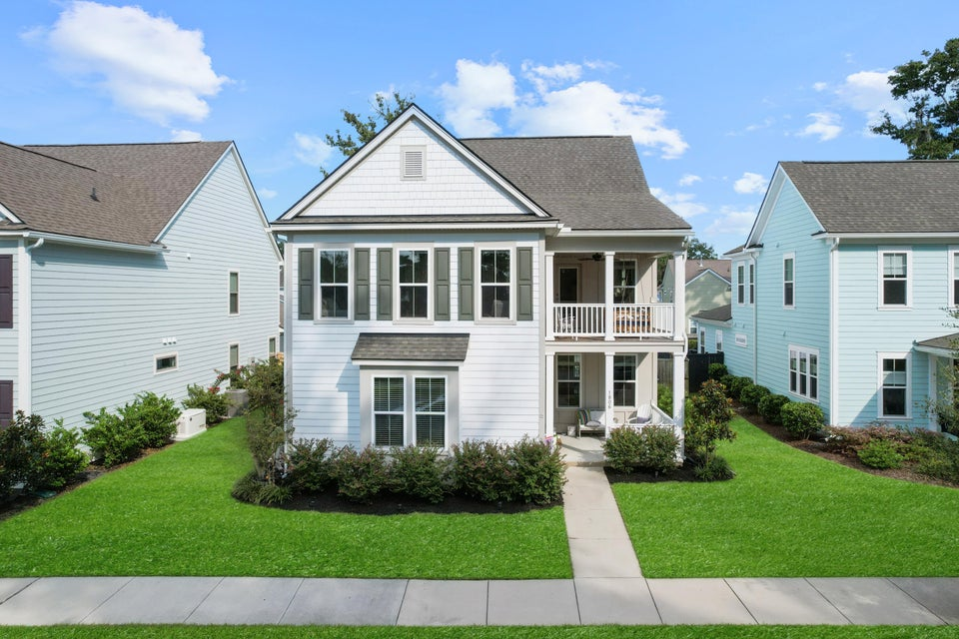
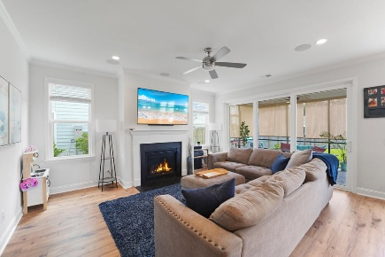
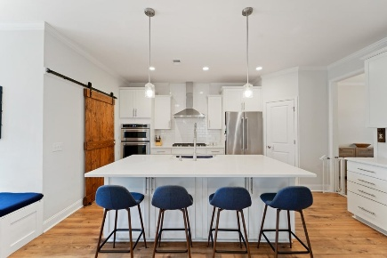
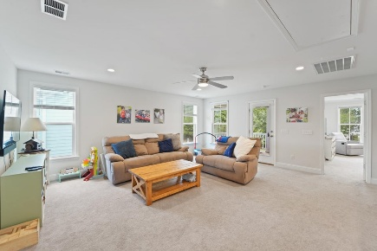
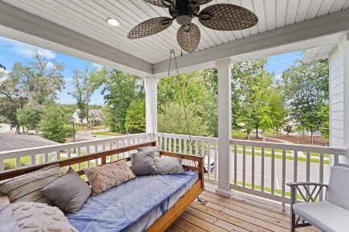
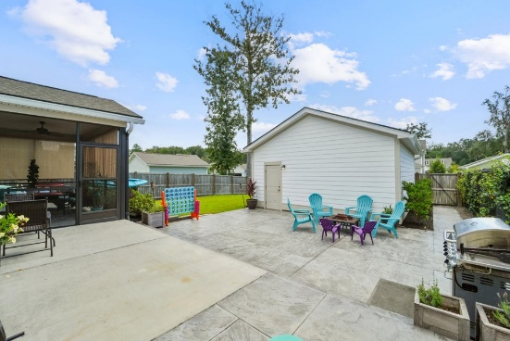






1806 Swing Lane
$799,900
The Villages In St Johns Woods · Johns Island, SC 29455 · MLS# 25023177
PROPERTY FEATURES:
4 Bedroom 3½ Bathrooms
2,830 Sq Ft
Welcome home to this lovely updated Pulte Home located directly across the street from the community pool/playground/fire pit. This is a large fenced in lot that is perfect for entertaining, pets, kids, etc! The double front porches (w/ the day bed swing upstairs) accent the Charleston lifestyle & architectural feels. Updates galore in this versatile floor plan w/ DUAL Primary En-suites on each floor, an amazing screened porch and Living Room downstairs (accented w/ a gas fireplace and open concept to the oversized kitchen island). Upstairs is an amazing Loft Area that is perfect for a second living area, play room, theatre room, home gym, etc, etc. The owners added the privacy fence, custom pantry, 2'' plantation blinds, extended driveway pad for added parking, & a barn door slider!
HAYNES JOHNSON
843-864-8159
haynes.charlestonproperties@gmail.com haynes.findhomesforsaleincharleston.com

