Slide 1
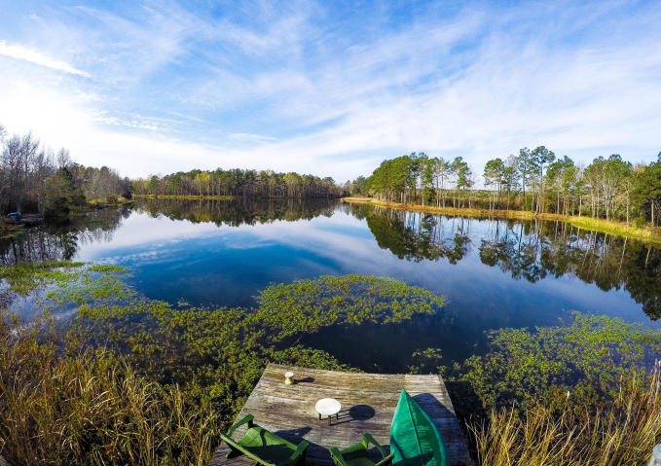
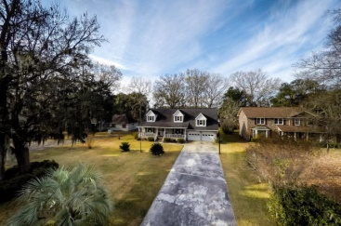
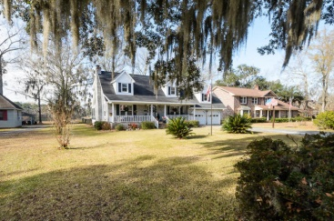
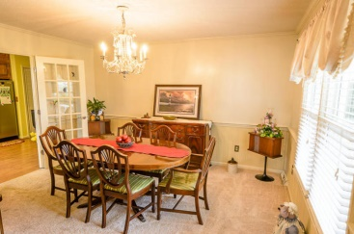
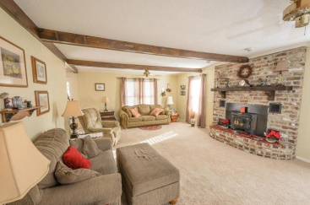
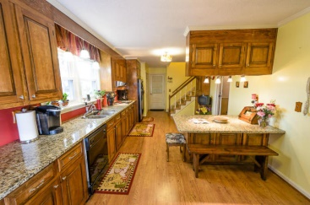
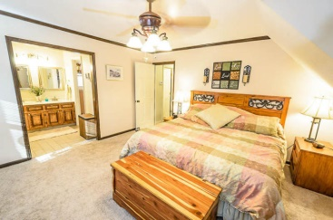
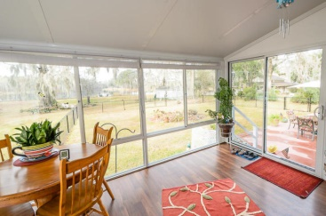
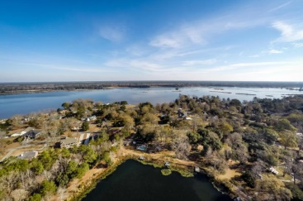
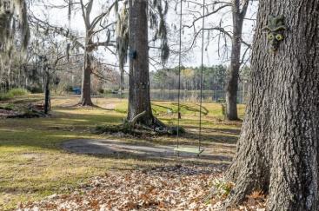
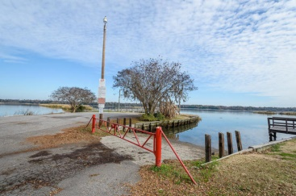


Serenity on Lake Hastieon
1807 Albert Storm Avenue
Pimlico - Moncks Corner, SC 29461 - MLS# 15000057 - $339,899
Delightful Lake Hastie home in Pimlico subdivision, Moncks Corner. Across the river from Mepkin Abbey, 15 min. to Bushy Park and Tail Race Canal. Impeccably cared for home with delightful sun room, spacious frog, formal dining room, big kitchen overlooking lake, and extra Great room featuring a beautiful fireplace made from historic local rice plantation bricks. Walk out the sun room or the garage onto the large patio. Part of the yard is fenced in for dogs and kids, there are mature trees, and a shed with a workshop. Stroll down to the dock where you can relax, fish or put your kayak/canoe in for a ride. The neighborhood has a small community park, and boat launch onto the river.
Holly Wagner
843-408-1505
holycityholly@gmail.com
Keller Williams Realty | 496 Bramson Ct Ste 200 | Mt. Pleasant, SC 29464

