Slide 1
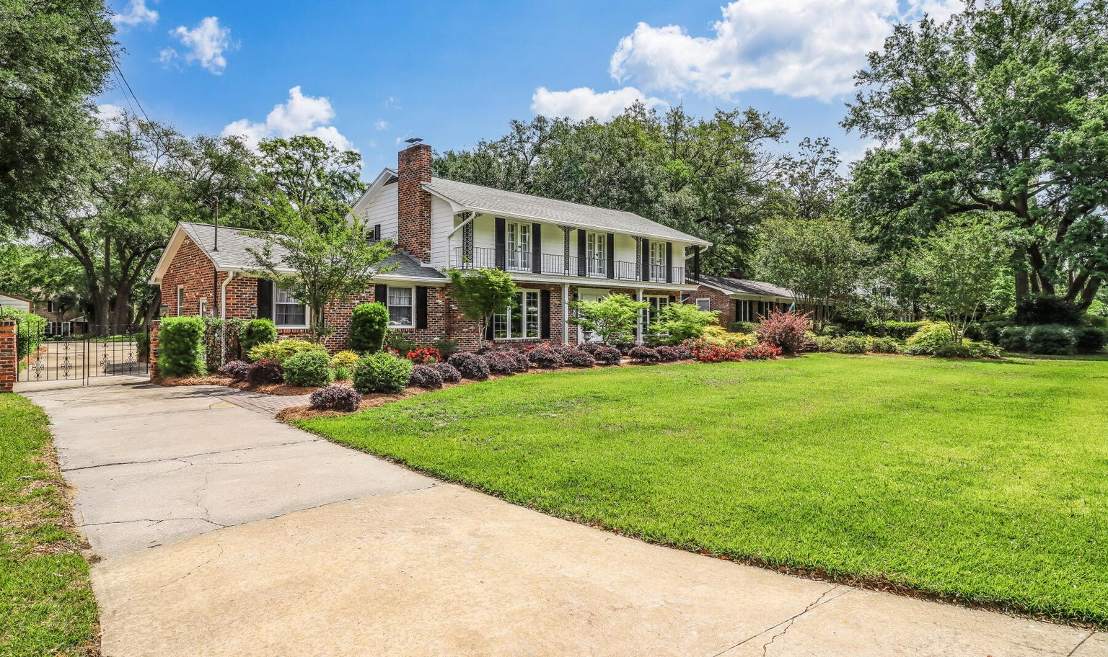
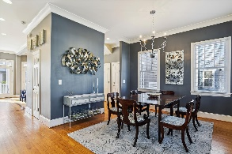
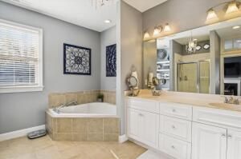
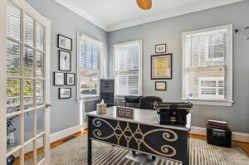
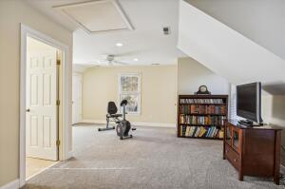
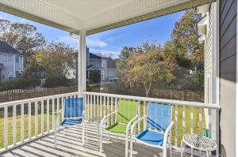
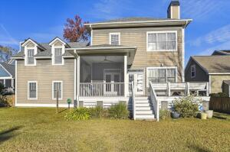
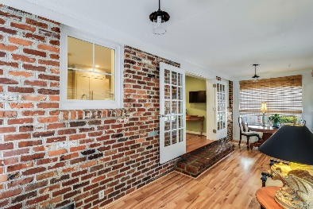
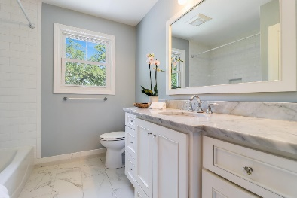
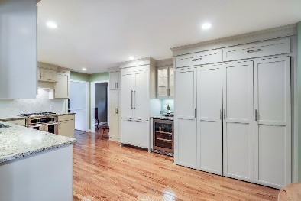
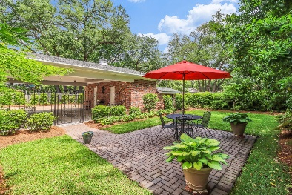


1808 Huntington Drive Huntington Woods • Charleston, SC 29407 • MLS# 23010340 • $1,150,000
Agent Open House
Wednesday, July 12th from 12-2pm
Light lunch will be provided + raffle for $50 VISA gift card
*** Welcome Home to 1808 Huntington Drive.*** This beautifully maintained home has remained within the family since its construction in 1965 and is located in one of West Ashley's most centrally located and desired neighborhoods. Homes rarely come for sale in this small neighborhood tucked away on the Ashley River and surrounded by marshes. This listing is unique as it contains TWO SEPARATE PARCELS (TMS# 352-09-00-009 and TMS#352-09-00-124) connected to each other to form one large half acre estate. Both lots/parcels will be sold together and will not be sold separately. Front door of residence is located on Huntington Drive and connected second parcel extends to Parkshore Drive in the rear. As you walk up the paver walkway to the front door of this home, you will notice the lush landscape designed and installed by award winning Brownswood Nursery & Landscape complete with irrigation system in both front and back courtyard. Gleaming hardwood floors are throughout this traditional home with Charleston brick surround gas fireplace complete with 4 bedrooms and 3.5 bathrooms. Owners have maintained the original design and integrity of the home while renovating the home with superb quality and finishes. Kitchen was renovated with Thermador appliances to include new cabinetry, granite countertops, stainless gas range and beverage/wine refrigerator. Dishwasher and built-in refrigerator are paneled covered to give the kitchen a seamless, sophisticated appearance. There is a bright, inviting sunroom located off of the kitchen with access to the rear of home. In addition to the kitchen, you will find a family room/den, formal living room, dining room and half bathroom with pedestal sink located off kitchen. Upstairs you will find the master bedroom, three guest bedrooms and two full bathrooms. Master suite is complete with walk-in closet, balcony access and fully renovated bathroom with dual sinks, walk-in shower, tiled floors and marble countertops. The guest bathroom upstairs is also renovated with tub/shower combo, tiled floors and marble countertops. In addition to the attached two-car garage, there is a two-car carport with workshop and separate full bathroom (former pool bathroom). There is a beautiful iron-gate enclosed courtyard with paver patio, which formerly contained an inground swimming pool (which since has been filled-in). With current owners utilizing both individual/separate parcels, there is a massive extended driveway with plenty of room for multiple cars, RV, boat and trailer storage. Attached parcel boasts mature oak trees and connects to the frontage on Parkshore Drive. Home has new energy efficient windows, hot water heater replaced in 2014, a roof gutter system, HVAC systems replaced 2017 and 2019 and irrigation system. You can apply for Ashley River Creative Arts Elementary School in West Ashley, Buist Academy Downtown & Orange Grove Charter School in West Ashley (Huntington Woods is in their neighborhood Preferred Attendance ZONE) which are some of the top schools in the Charleston Area. The location is amazing... just minutes from I-26 to downtown, MUSC, College of Charleston, The Citadel, Park Circle, Boeing, airport. Shopping, grocery store, local gym and restaurants near by too. This home is move-in ready and won't last long!
Megan Schwerin
843-478-5867 | mkschwerin@gmail.com
Elaine Brabham and Associates, LLC • 1890 Sam Rittenberg Boulevard, Suite 217 • Charleston, SC 29407

