Slide 1
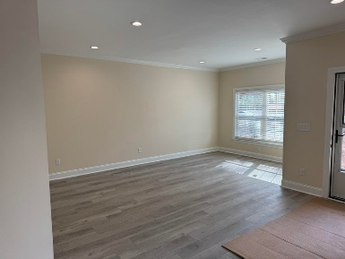
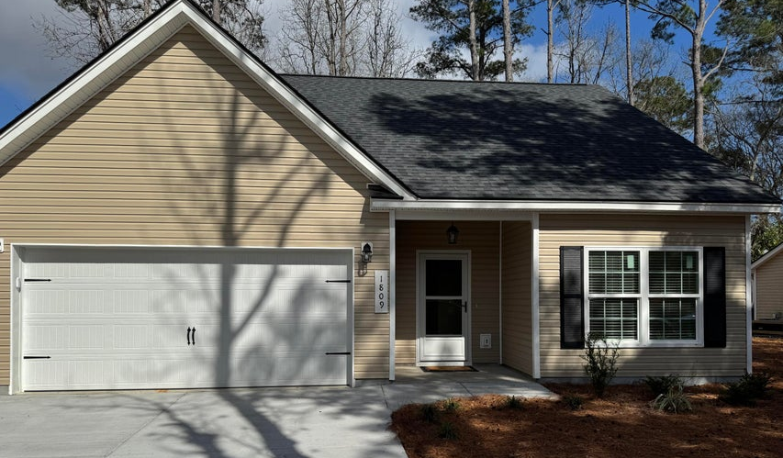
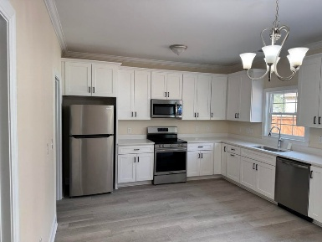
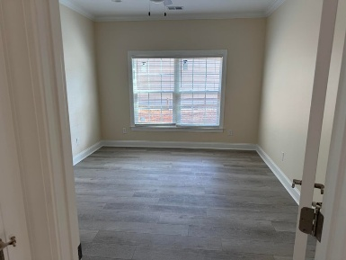
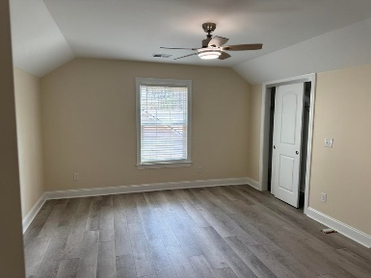
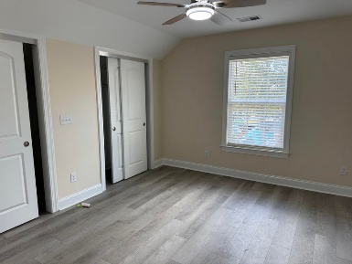
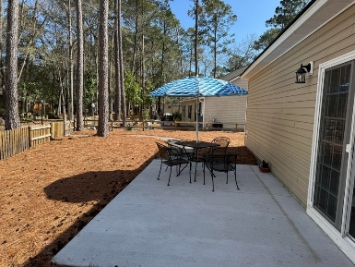
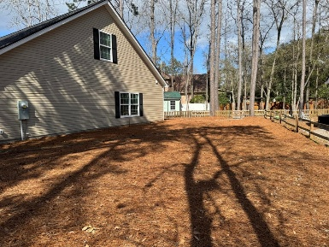


1809 Zelasko Drive The Enclave · Johns Island, SC 29455 · MLS# 26007237 · $2,750
Brand New Home Available for Rent in 55+Community
Welcome to Enclave Park, a 55+ Community located right in the center of Johns Island. This community includes 7 homes and each home backs up to a small community park for all residents to enjoy. The home features a downstairs primary bedroom with a large walk in closet and en suite bathroom. The family room is spacious and can accommodate both living room furnishings as well as a dining area. The kitchen is light and airy and has a lot of natural light. It is large enough that someone could add an island for extra storage. There is ample counter space and it boasts white cabinetry, quartz countertops and stainless steel appliances. Upstairs are two guest bedrooms with a shared bathroom.
The outside of the home features a large yard and a nice patio space that overlooks the community park. The community park features a small gym, horseshoes, fire pits, bench swings, a two story pergola and a covered picnic area. This home is brand new and is move in ready!
Carey Nikonchuk
843-276-1701
cnikonchuk@gmail.com
www.brennamangroup.com

