Slide 1
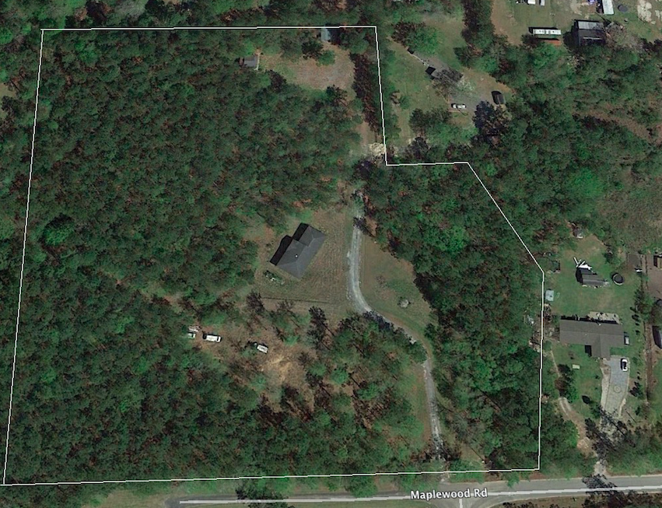
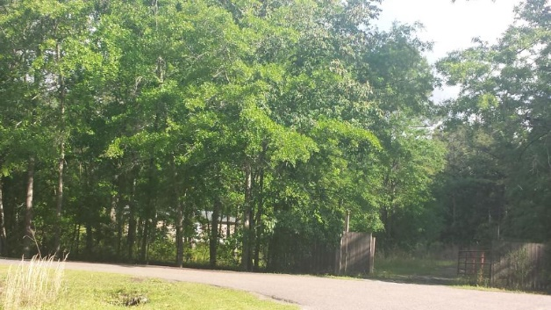

Perfect Place To Build Your DREAM Home! 8.79 Acres!
180 Big Creek Drive
Moncks Corner, SC 29461 :: MLS# 19015171 :: $279,900
Quiet residential location close to Moncks Corner and approximately 15 minutes from Goose Creek.
Bonus - approximately 2,000 sq. ft. unfinished house on site and comes with land. "AS-IS" - not connected to utilities.
Also, small pavilion/picnic area in the rear of parcel. Well on site. Berkeley County Flex 1 zoning
Heather Spraker
843-475-2624
heather@armadarealestate.org
Kim Adinolfi
843-452-9923
kim.adinolfi@yahoo.com
Armada Realty Group 7301 Rivers Ave. Ste 182
N Charleston, SC 29406

