Slide 1
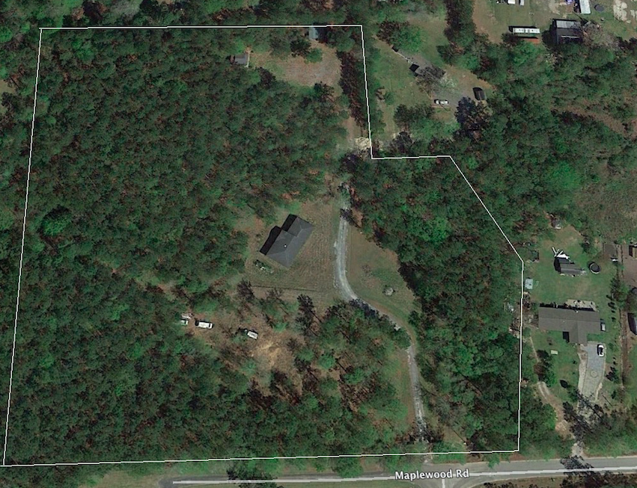

Perfect Place To Build
Your DREAM Home!
8.79 Acres!
180 Big Creek Drive
Moncks Corner, SC 29461 :: MLS# 18011854 :: $307,650
Quiet residential location close to Moncks Corner and approx. 15 minutes from Goose Creek.
Approx. 1,800 sq. ft. unfinished house that is placed on this site and comes with land ''AS-IS''- no connected utilities.
Also, small pavilion/picnic area on site.
Heather Spraker
843-475-2624
heather@armadarealestate.org
Kim Adinolfi
843-452-9923
kim.adinolfi@yahoo.com
Armada Realty Group
7301 Rivers Ave. Ste 182
N Charleston, SC 29406

