Slide 1
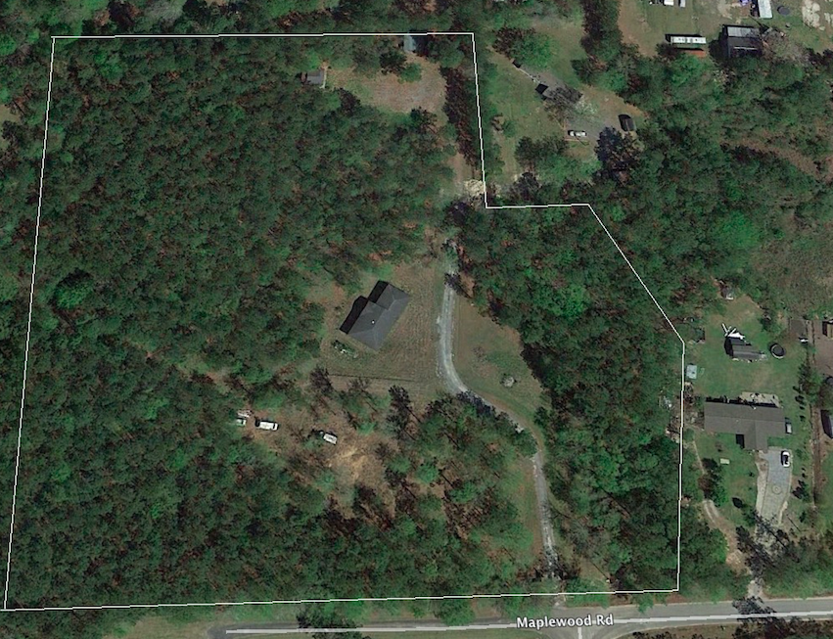

Perfect Place To Build Your DREAM Home! 8.79 Acres!
180 Big Creek Drive
Moncks Corner, SC 29461 :: MLS# 17020498 :: $307,650
Quiet residential location close to Moncks Corner and approx. 15 minutes from Goose Creek.
Approx. 2,000 sq. ft. unfinished house, that is uninhabitable (but can be refinished), placed on this site and comes with land ''AS-IS'' - not connected to utilities.
Also, small brick pavilion/picnic area on site
Kim Adinolfi
843-452-9923
kim.adinolfi@yahoo.com
Heather Spraker
843-475-2624
heather@armadarealestate.org
Armada Realty Group | 7301 Rivers Ave. Ste 182 | N Charleston, SC 29406

