Slide 1
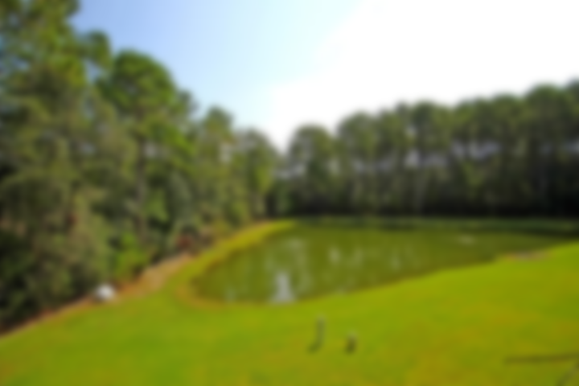
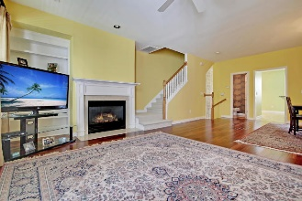
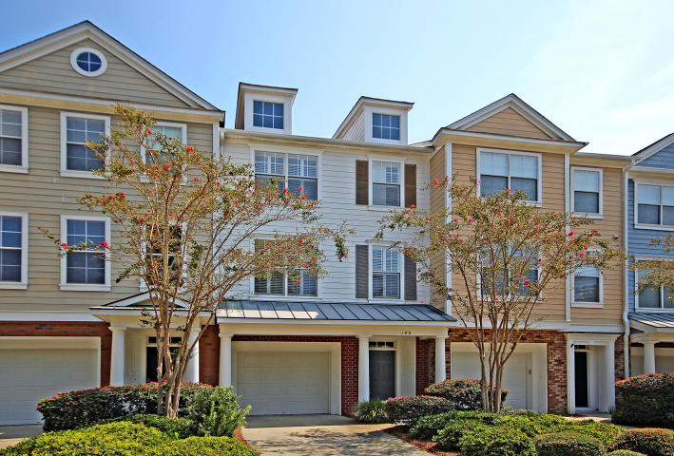
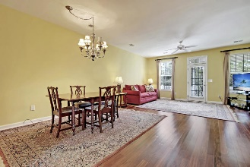
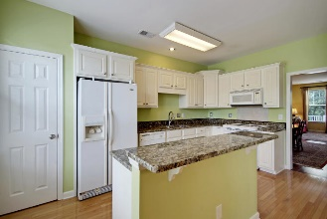
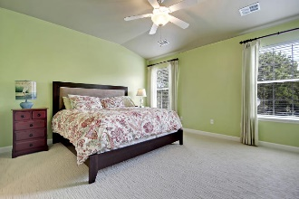
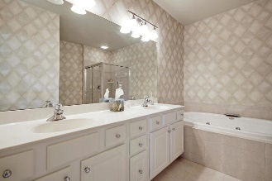
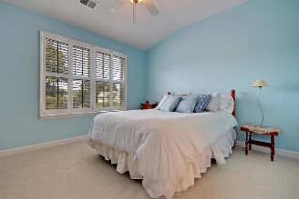
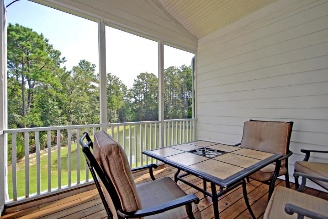
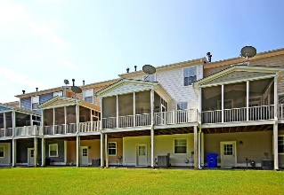
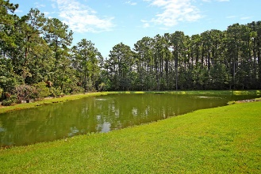


180 Fair Sailing Road
Dunes West | Mount Pleasant
MLS# 19023650 | $280,000
New to the Market!
Asking $1,200,000
MLS# 17023051
3,692 SqFt
4 Bed/3½ Baths
Short Drive to Historic Downtown Charleston & Beaches
Well taken care of townhome in Dunes West. Home overlooks a nice pond from the screen porch, deck and master bedroom. Bright colors welcome you with an open floor plan and roomy kitchen with granite and whirlpool appliances. The eat in kitchen is large and also has a place for bar stools. The beautiful hardwood floors in the spacious family room leading to the screen porch and deck are in great condition. Grilling on your deck watching wildlife will bring relaxation to the end of your day. Upstairs are two good sized bedrooms each with their own baths. The master has a large soaking tub, separate shower & generous closets. A large laundry room rounds out the second floor. The tandum garage fits 2 cars and tons of storage. Location is convenient to shopping, hospital, restaurants & beaches.
Gay Slough
(843) 452-9708
gslough@carolinaone.com
Carolina One Real Estate • 195 W Coleman Blvd • Mount Pleasant, SC 29464
www.gayslough.com

