Slide 1
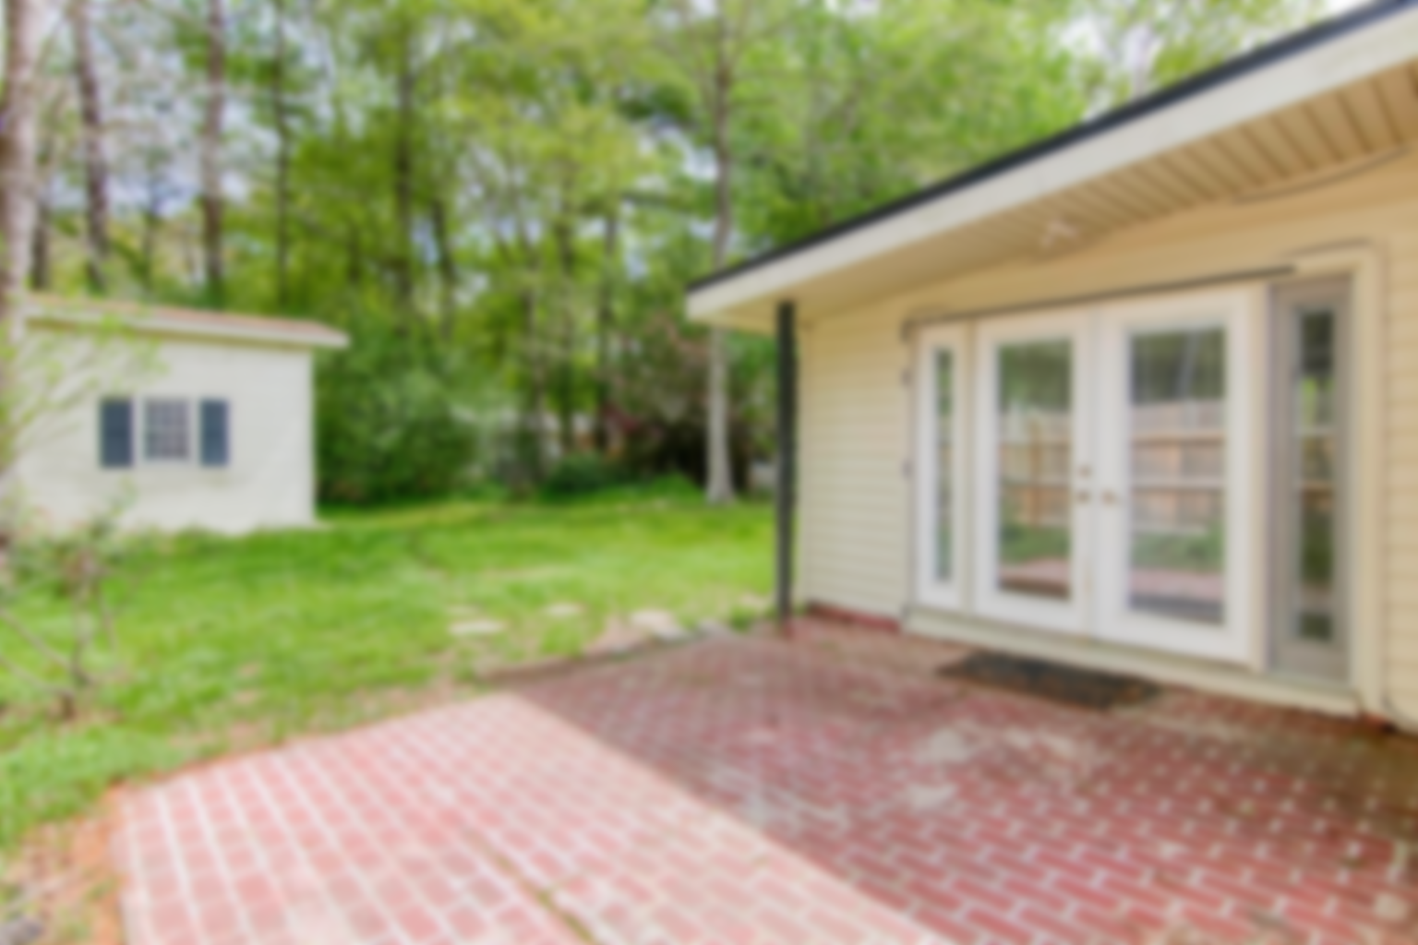
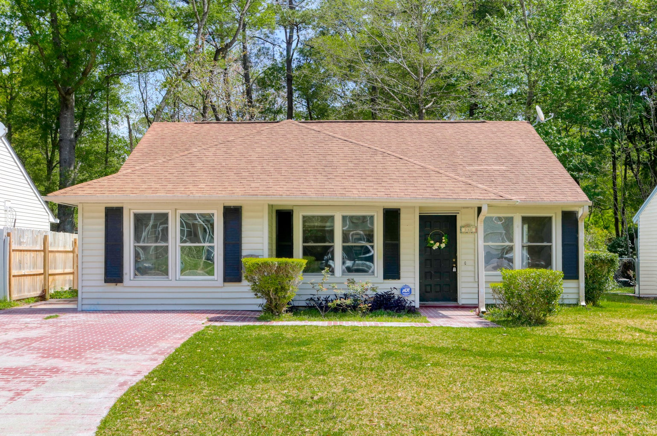
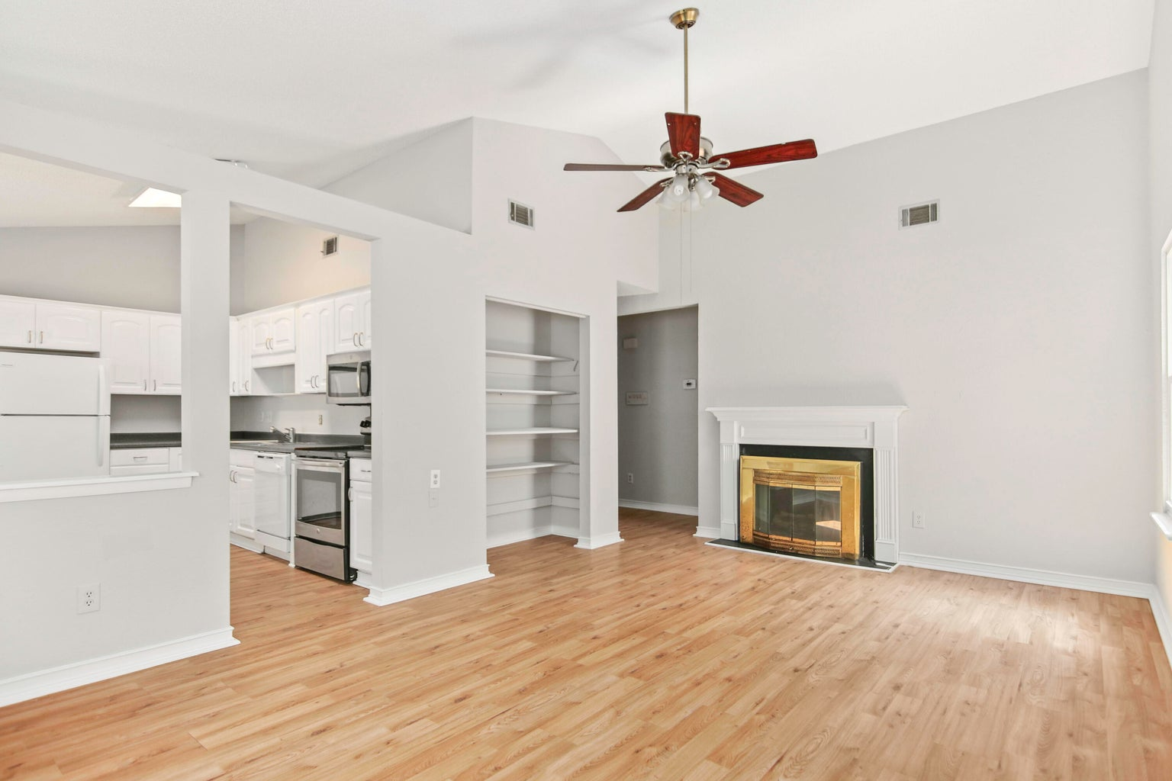
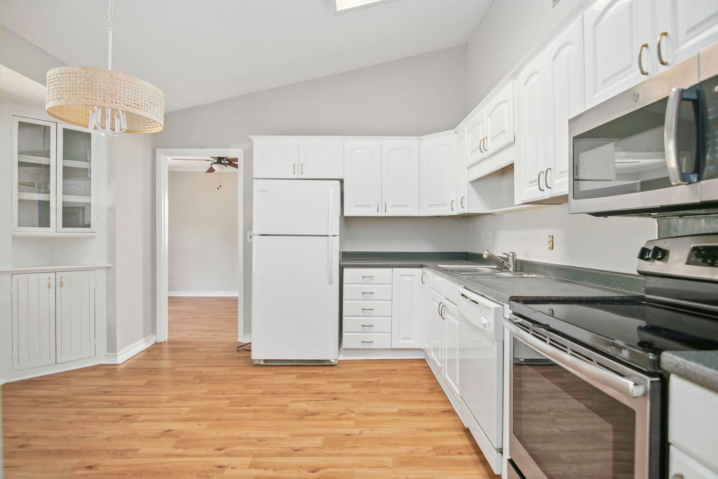
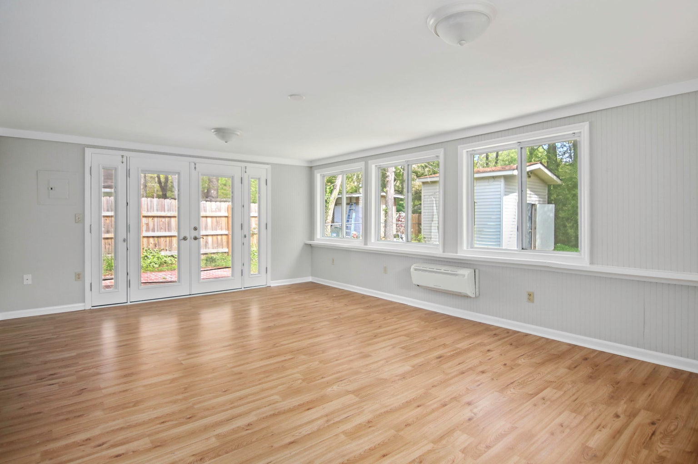

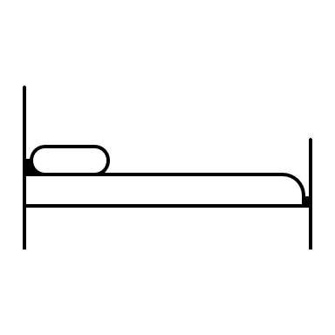


EASILY AFFORD
COMFORT & STYLE
180 Mickler Drive
Moss Point | Ladson, SC 29456
MLS# 24007562 | $285,000
Welcome to this beautiful family home in Moss Point, freshly updated with new paint and fixtures to offer the perfect blend of comfort and style. Situated at 180 Mickler, the entrance ushers you into a spacious living room with high ceilings, immediately setting a tone of openness and warmth. To the left, discover a contemporary kitchen, seamlessly connected to a versatile room with laundry. This space is ideally suited for a home office, providing a quiet retreat for work or study. As you explore further, the layout offers abundant living space. The new den enhances the home's flow, offering distinct areas for relaxation and entertainment, emphasizing the home's thoughtful design. To truly appreciate the charm and potential, it must be experienced in person.
Peter Stanley
843-300-8251
petermstanleyjr@gmail.com
1,606 SF
3 BEDS
2 BATH

