Slide 1
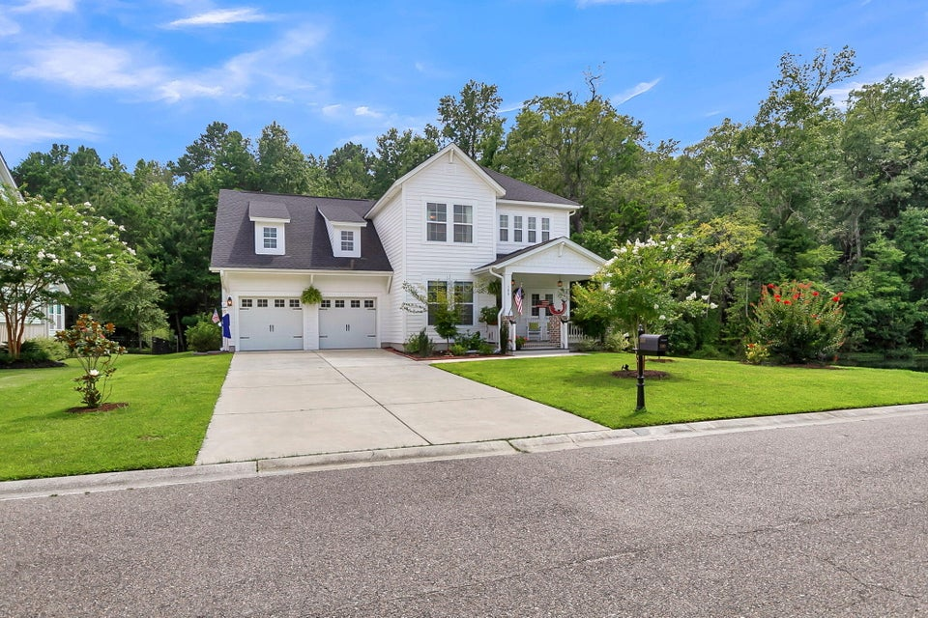
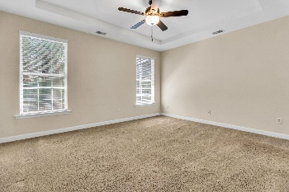
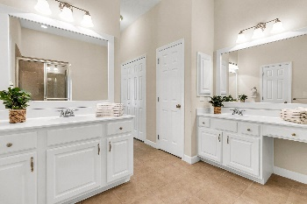
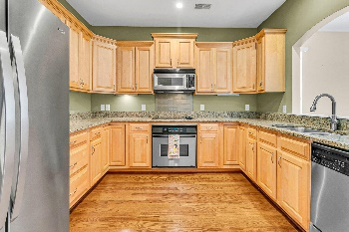
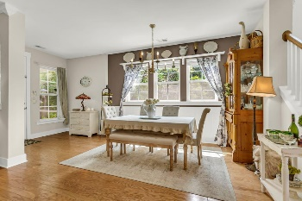
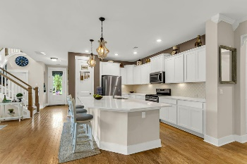
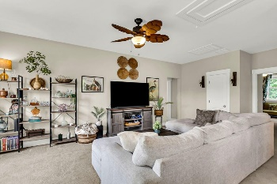
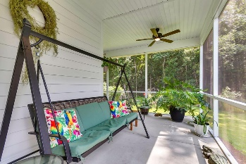
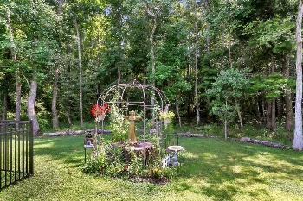

180 Silver Cypress Circle
Legend Oaks Plantation · Summerville, SC 29485 · MLS# 24021641 · $669,000
Just Listed Gated Legend Oaks Plantation
Beautiful 4 bedroom 3.5 bath home with wonderful curb appeal and fantastic .28 acre pond lot that back to woods in the desirable gated section of Legend Oaks Plantation-The Club. Built in 2021 this stunning home is the newest home in The Club. Upon entering the home you are greeted with handsome wood floors, 9 foot ceilings, 8 foot doors, open floor plan, crown molding, wainscoting, high-end finishes, custom wallpaper, upgraded light fixtures and an abundance of natural light. To the left is a flex room that could be a formal living room, dining room, or office. To the right is a quaint powder room with gorgeous wallpaper. Next is the chef-inspired gourmet kitchen with HUGE island, white cabinets, white quartz countertops, tiled backsplash, gas range, stainless steel appliances, pendant lights and deep single bowl sink. This kitchen was designed for entertaining! The kitchen has an eat-in area that leads to the oversized screened-in porch that has space for a sitting area and separate area for a table that is perfect for outdoor entertaining of family and friends. Continuing in is the family room that is open to the kitchen and overlooks the serine, private wooded backyard. The grand primary bedroom suite is located on the main level and features a tray ceiling, wall of windows, custom wainscoting, and a spa-like ensuite bath with relaxing soaking tub, frameless glass door shower with floor to ceiling tile, massive walk-in closet, and dual sink vanity. The second level has a large loft ideal for a second living area, or playroom. There are three bedrooms upstairs one with a private ensuite bath and two additional nicely sized bedrooms that share a full bath. The home also has a finished attached 2 car garage with shelves and workbench and a laundry room. The large private backyard is partially fenced and backs to woods. This backyard is a natures lovers paradise! Call today for a showing, this home will not last!
Stan Huff
843-670-2835
stan.huff@agentowned.com
Jill Marcacci
843-297-5590
jill@agentowned.com
www.agentownedrealty.com
AgentOwned Realty Co. Preferred Group, Inc. | 824 Johnnie Dodds Blvd | Mt Pleasant, SC 29464

