Slide 1
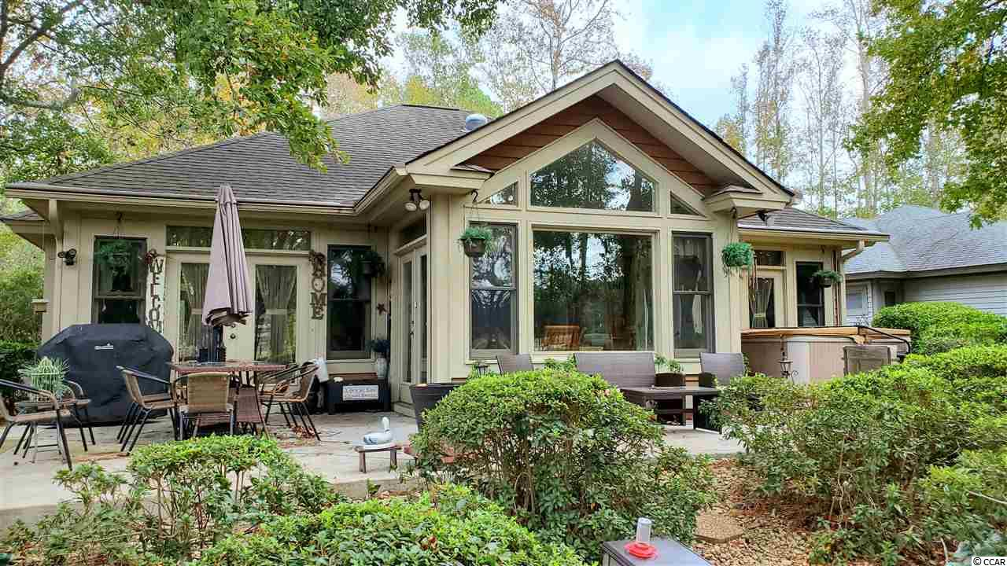
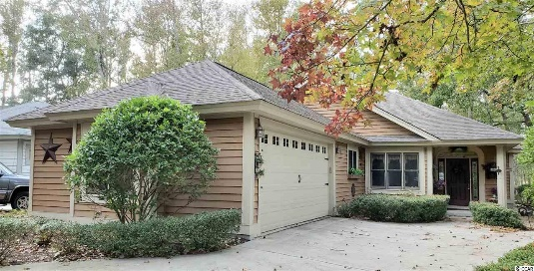


1810 Topsail Ln
Tidewater Plantation Resort
North Myrtle Beach, SC 29582
MLS#: 1924604 ~ $289,500
Unique & wonderful details define this well-loved cottage-like home, surprisingly spacious with 3 bedrooms -- one used as a study -- with over-sized master, all on one level, along with one upgraded en-suite-bath and a second for family & guests. This charming, comfortable low-country-inspired home is in the signature Tidewater Plantation neighborhood on iconic Topsail Ln. Homes in the Plantation have low HOAs with rich amenities and may be rented on both a short- and a long-term basis. This well-priced flex floor-plan home is the perfect candidate for such an investment. This amazing lakes- and golf-course-front beauty has BIG value wrapped in a livable, about 1,800-heated-square-feet of never-ending water and fairway views! Plenty of windows and French and patio doors enhance the breath-taking panorama of more than 1/3-acre of extraordinary scenery. A long front driveway leads to a side-load double-car garage and to a set-back, welcoming entry with leaded glass accents and decorative niches. Linger there admiring the private, mature landscape or come on in to the heart of the home: living-room with tray ceiling and FIREPLACE, lots of light from those windows and doors and an adjoining magnificent kitchen and casual dining-gathering area, complete with a huge picture window framing the natural enclave, the perfect spot for enjoying fun for the family & for entertaining. The free-flowing layout is perfect, too. The kitchen has good work space and lots of cabinets and storage, including pantry. This Charleston-style ranch-house is kinetic and interesting, featuring a seamless transition from living/kitchen/dining-gathering space to the outdoors and to those AMAZING VIEWS! The landscaping is robust and compliments the magnificent natural environment. There are birdbaths in the back and front yards, along with numerous feeders. Wildlife abounds. There is even opportunity for a hot tub, located off the master bedroom and accessible from the bedroom or from any of three other doors leading to a wrap-around backyard patio! Come back inside, though, and check out ceiling treatments, shelving, sinks and doors. Surprises will astound you. The master suite has a patio door to that hot tub and to the back patio, tray ceiling with ceiling fan, large walk-in closet and ease of access to the en suite featuring ceramic tile wood-like flooring and BIG walk-in shower! The laundry area has the washer/dryer, a utility sink and storage cabinets and leads to a second spacious guest bedroom and egress to the garage. The BIG double-car garage has a shop bench, build-in storage cabinets and a separate door to the outside. There is a third bedroom/study with closet to the right of the bedroom hallway that leads back to and overlooks the great/living room. It has a large closet and double-door entry. Airy fans, special touches and unexpected design delight throughout. Most appliances are newer; none-the-less, an Old Republic Platinum Home Warranty with HVAC is offered. The best of easy beach-cottage living, this house is a rare find! Moreover, with the proven value of Tidewater, this home is appealing for a permanent residence, vacation home or excellent investment property. Tidewater is minutes from the beach, shopping, medical services, entertainment and access to major highways. Amenities include an owners' oceanfront beach cabana with open/screened porches, bathrooms, showers & kitchen. Residents enjoy the use of several pools/hot tubs. Other amenities are a driving range, golf shop, clubhouse with bar/dining & event facilities, clay and hard-surface tennis courts, pickle ball court, fitness center, bocce courts & amenity center. Tidewater is manned, gated & has a gated storage yard for boats, jet skis, etc. The resort reflects the luxury and comfort of a beach/golf lifestyle. And, in Tidewater, BIG value often comes in surprising packages as well, such as this unforgettable cozy and desirable cottage at one of the lowest prices in the community.
Deborah Collins
843-424-9013
dctidewater@yahoo.com
Connie Ross-Karl
702-306-2643
conniesross@aol.com
NEW WAY PROPERTIES MYRTLE BEACH

