Slide 1
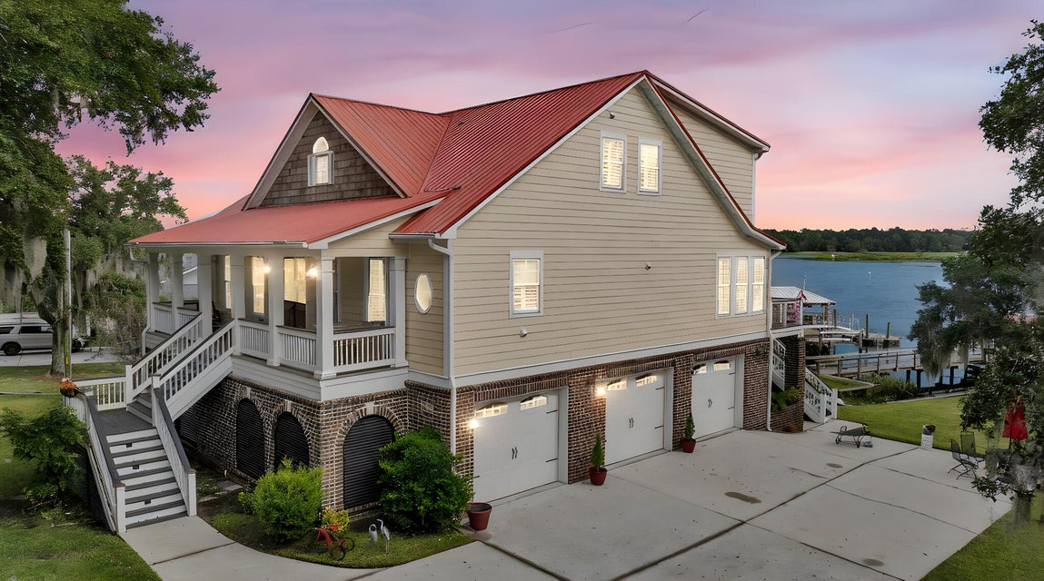
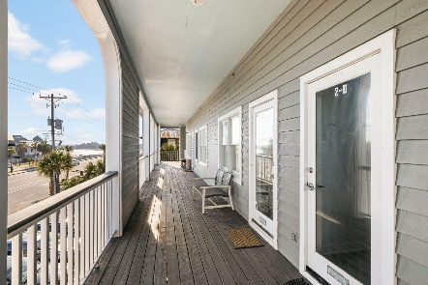
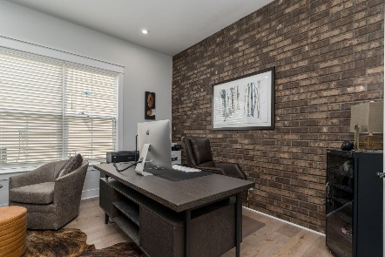
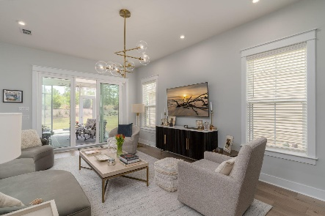

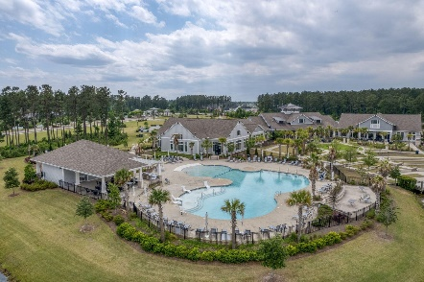
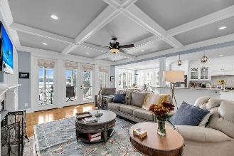
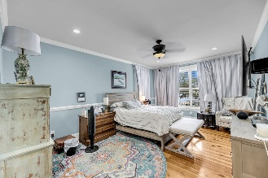
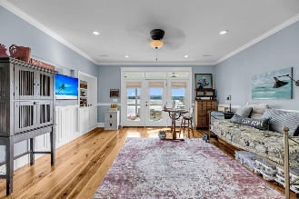
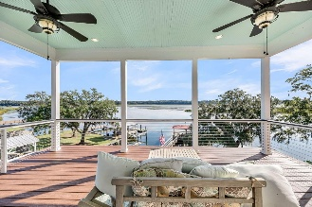
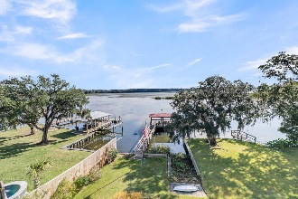
1811 Teal Road
Pimlico | Moncks Corner, SC 29461 | MLS# 25027988 | $1,600,000
Darrell Creek Elevated Home With Elevator & Salt Pool
Broker Open House - Friday October 24, 1-3 pm
Co-sponsored by
Welcome to unparalleled waterfront luxury! This stunning four-bedroom, three-full-bathroom, two-half-bath, drive-under home is a masterclass in unique design and modern convenience, offering both elegance and functionality. The interior showcases extraordinary finishes, including a striking coffered ceiling in the living room that serves as a dramatic focal point. Warmth and coastal elegance flow throughout with beautiful Knotty Pine floors in all main areas. The primary suite offers a retreat with elegant crown molding, and every window features high-end Roman shades or plantation shutters. Enjoy unmatched convenience with a full house generator and a private elevator accessing all three floors. The true highlight is the outdoor living and deep water access.
The property features a brand-new seawall (October 2024) and an exceptional 2020-built dock and floater, complete with dedicated water and electricity perfect for boating enthusiasts. Both the back porch and upper deck feature durable, low-maintenance Trex decking with a 25-year warranty.
Additional features include a sprinkler system and a buried dog fence in both the front and back yards.
This meticulously maintained home offers a luxurious, worry-free waterfront lifestyle. Schedule your private viewing today! A full list of features is located in Documents.
Offering $3000
Lender Credit
Rochelle Rennert
843-847-9694 | rochellesellscharleston@gmail.com | www.RochelleSellsCharleston.com
AgentOwned Premiere Group, Inc. | 219 N Highway 52 Ste A | Moncks Corner, SC 29461-3926

