Slide 1
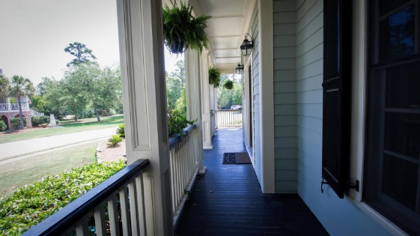
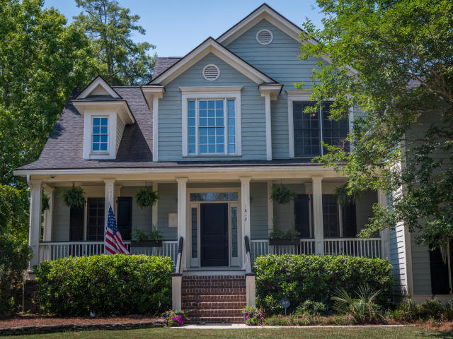
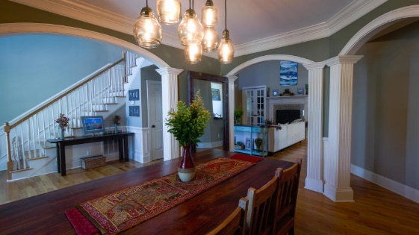
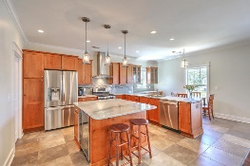
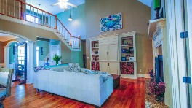
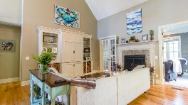
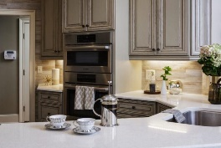
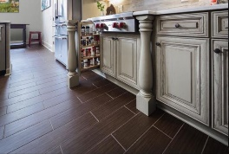
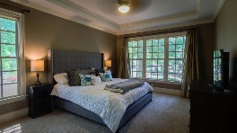
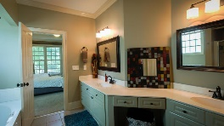
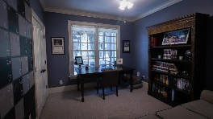
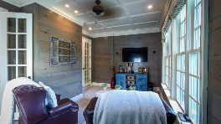
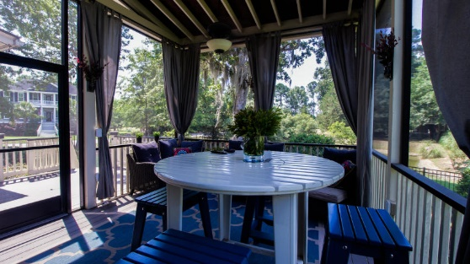
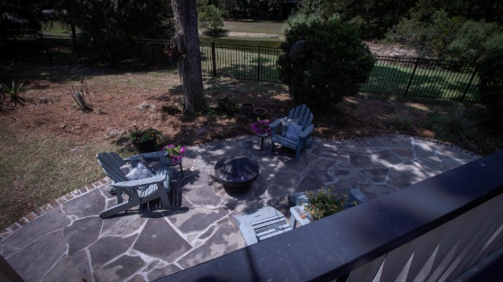

PRICE REDUCED! OWNER SAYS SELL!!!
1812 Greeley Road
Park West ~ Mount Pleasant, SC 29466
MLS# 19015896 ~ $598,000
Welcome home to this updated, lovely 4 bedroom, 3 bath home perfect for the entertainer in you! Amazing open floor plan with tons of upgrades throughout the home, which include gleaming hardwood floors; brand new kitchen with high end appliances; new screened outdoor living/entertainment area; oversized, custom built-in cabinets, massive wood burning fireplace, heavy crown moulding, coffered ceilings and driftwood shiplap walls just to name a few. The oversized master bedroom is located opposite from all other bedrooms, for additional privacy, and features tray ceiling, beautiful windows, large master bath and custom walk-in closet. You won't believe the size of the meticulously manicured, fenced backyard which welcomes you, should you want to sit around the fire pit, throw some food on the grill, or just enjoy your backyard oasis of peace and tranquility! This lovely home also features a 2 car garage, sits on a nice sized corner lot and offers a full front porch, perfect for rockers and a glass of iced tea or wine! The intimate feel of the Melrose subdivision is one that you will come to love and appreciate. As a part of Park West, be sure to take full advantage of the community amenities which include two pools, six tennis courts, a playground, and a 59 acre property with multiple sports fields. This move-in ready home and neighborhood can't be beat. The features listed above are just a few of the many wonderful things this home has to offer, so schedule a showing today and come see for yourself!
Deborah Meuli
(843) 822-0133
dmeuli@comcast.net
Wendy Deitsch
(843) 270-0433
wendy@lifetreeliving.com
LifeTree Real Estate, LLC | 3094 Hwy 17 North | Mt. Pleasant, SC 29466 | www.lifetreerealestate.com

