Slide 1
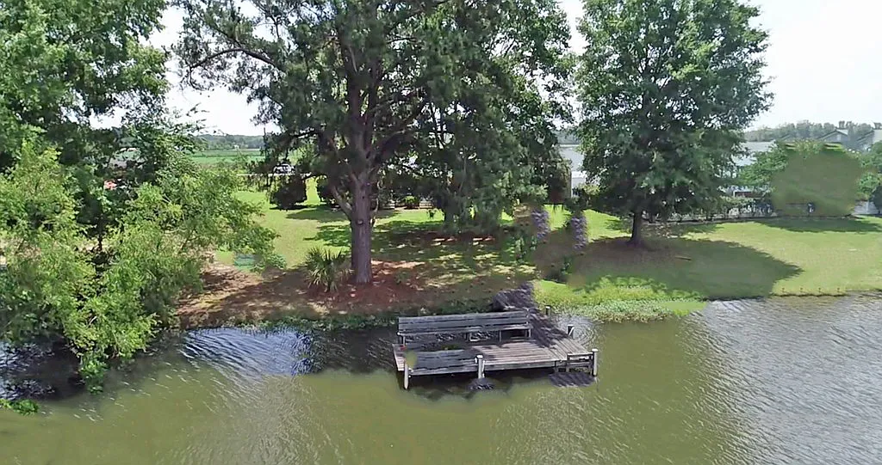
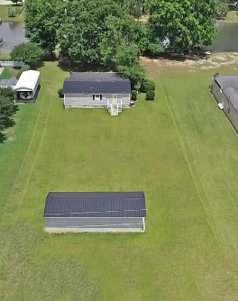
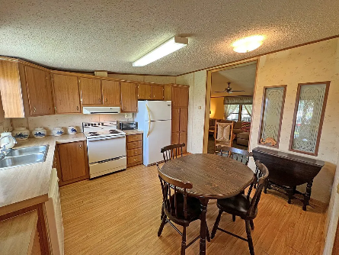
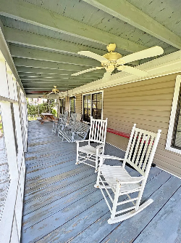
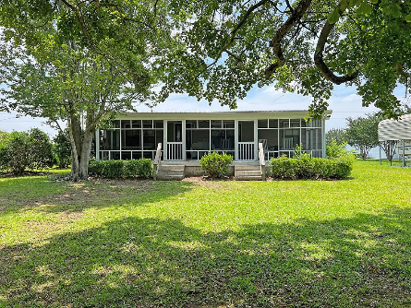
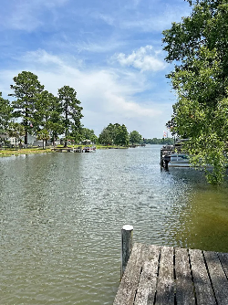

See this before it is Gone!
1812 Ralph Bell Rd
Summerton, SC 29148 ~ MLS# 157290 ~ $280,000
Waterfront on Lake Marion just off the Goat Island area on Ralph Bell Rd. This Mobile Home is ready for your weekend drop spot. Tons of parking for the Boat and the friends to gather. Dock in place ready for you to jump on the boat and sail to Charleston for the day. Beautiful Oak tree for shade on the waterside. Build the Fire Pit for evening smores and fireflies. The screened in porch can host the the picnic table and the swing. Relax here and watch time slow down at the Lake.
Lake Homes Realty, LLC
Elloree, SC 29047
www.SCLakeLife.com
Kristie Anderson
(803) 387-9459
kristie@sclakelife.com

