Slide 1
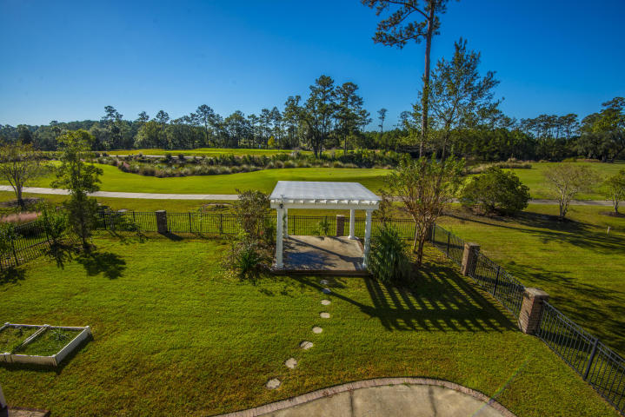
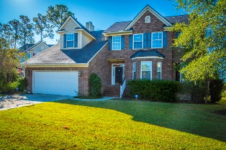
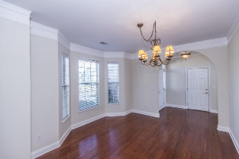
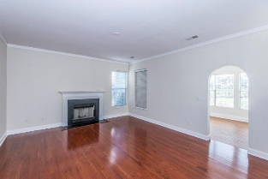
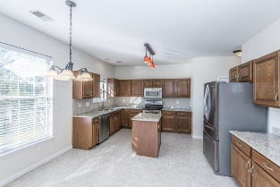
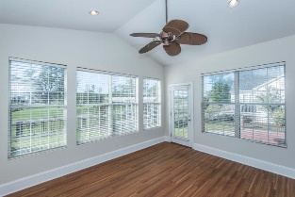
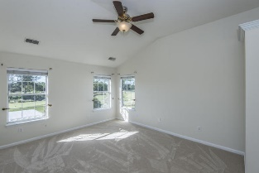
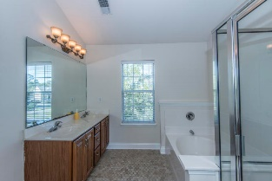
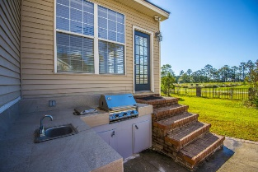
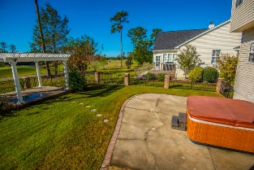
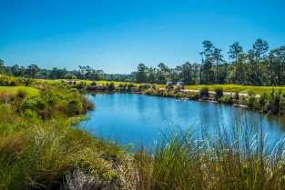


1813 Palmetto Isle Drive Mount Pleasant ~ MLS# 17030546 ~ $465,000
Just Listed In Rivertowne Country Club!
On The Golf Course Under $500,000!
Beautiful 4 bedroom, 2.5 bath home with new roof in exclusive Rivertowne Country Club set near the tee box on the 3rd hole of Charleston’s only Arnold Palmer Championship golf course. This home offers stunning views of the course and the water hazard lagoons from the 2nd floor, particularly from the master suite which is complemented by three very large additional bedrooms each with huge closets and all new carpeting. Downstairs, the homes features newly refinished hardwood floors, an updated gourmet kitchen complete with center island, custom lighting, and ceramic tile floor and a formal dining room with large windows overlooking the front yard. A sunroom at the back of the home leads to a custom outdoor kitchen with built in sink, BBQ grill, pergola, and Jacuzzi hot tub!
Rivertowne Country Club has a newly renovated pool and cabana area, children's park, and basketball and tennis courts and the Club's golf course was awarded 4.5 stars by Golf Digest, has hosted LGPA tournaments, and was named Charleston's Golf Course of the Year in 2015. (NOTE: $1700 credit available toward buyer's closing costs and pre-paids with acceptable offer and use of preferred lender.)
Kristin Schatmeyer
Cell - (843) 697-7370
kristin.schatmeyer@carolinaone.com
www.KristinSchatmeyer.com
Carolina One Real Estate
2713 Highway 17 North
Mt. Pleasant, SC 29466

