Slide 1
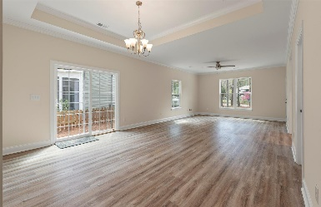
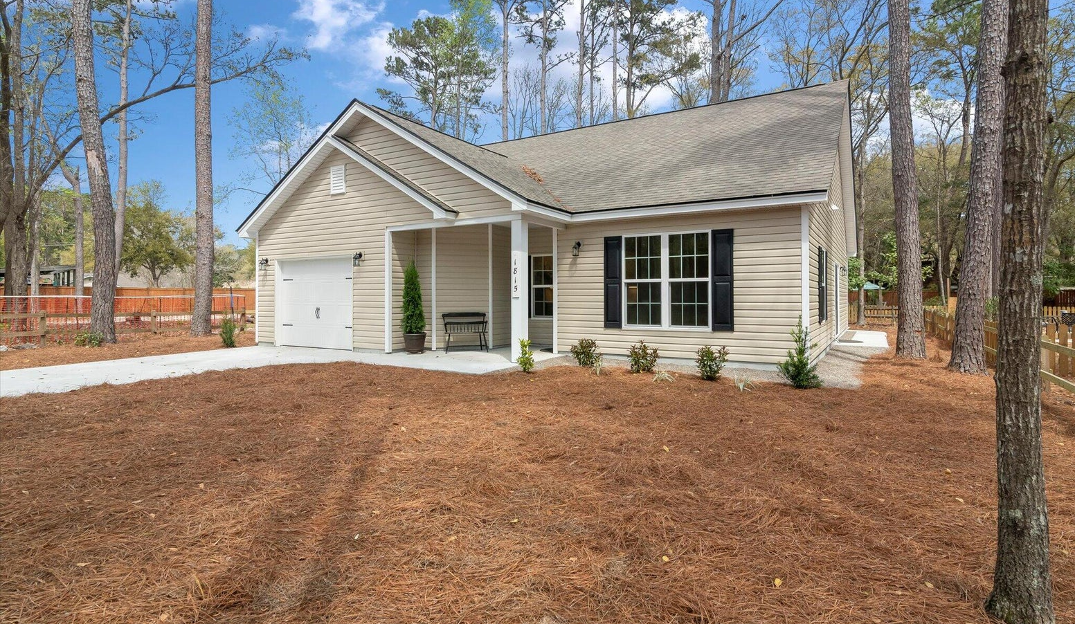
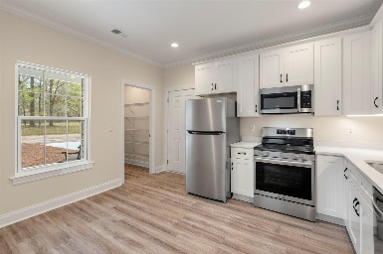
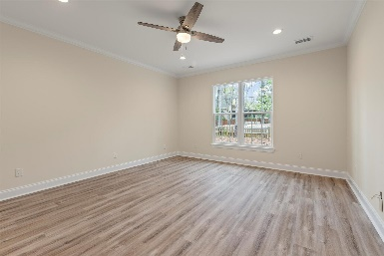
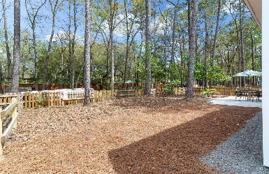
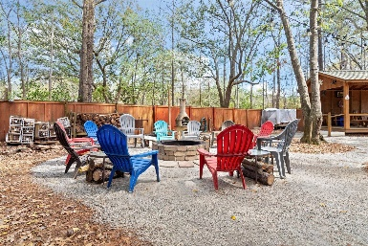
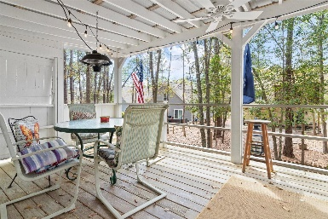
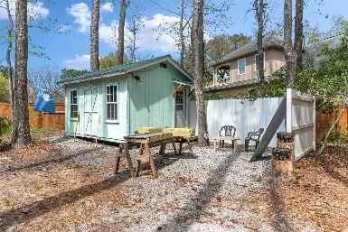


1815 Zelasko Drive
The Enclave | Johns Island, SC 29455
MLS# 24006941 | $439,000
55+Community on Johns Island
Welcome to Johns Island's Enclave Park! This home is located in a unique age 55+, 7 lot pocket neighborhood right in the center of Johns Island. This brand new 3 bedroom, 2 bath home features a bright open kitchen with stainless steel appliances, quartz counter-tops, a walk in pantry and a breakfast nook. The large living room is open to the dining area that boasts a tray ceiling. Next to the dining area and just off of the family room are large sliding glass doors that lead out into the back patio and yard.
Towards the back of the home there are three bedrooms including the large master bedroom that features a nice walk-in closet and an ensuite bathroom. The hall bathroom services the two guest rooms and each has a window that looks out onto the patio. This home also features a 1 car garage as well.
Behind this lovely single story home is the nicely developed Enclave Park, a private park that offers many amenities. These include a picnic shed, a large circular community fire pit, a fountain, a lovely two-story pergola, a gathering space known as "the grove", and a fitness/exercise shed. The entirety of the park and the yard itself have natural landscaping that offers easy maintenance.
The location of this home is central to many of Johns Island's restaurants including Wild Olive and the Royal Tern and it is just a few miles away from downtown Charleston. It's also quite close to the area beaches as well. It is Lowcountry living at its best!
Carey Nikonchuk
(843) 276-1701 M
cnikonchuk@gmail.com
www.brennamangroup.com

