Slide 1
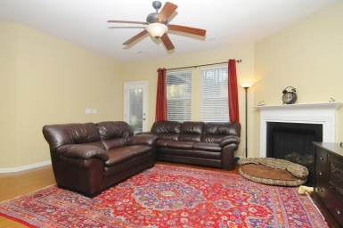
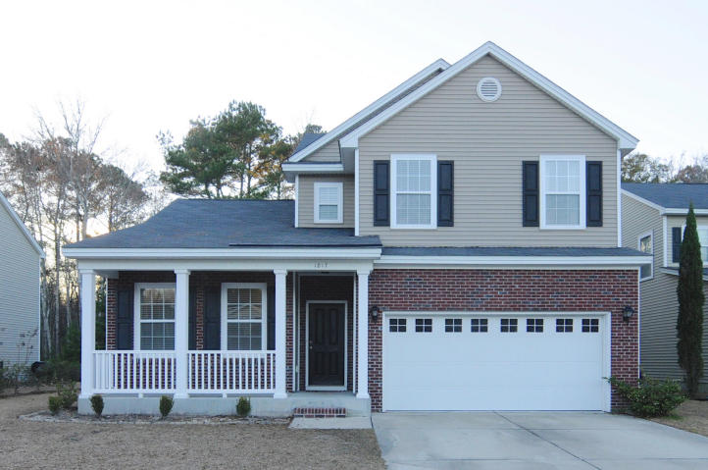
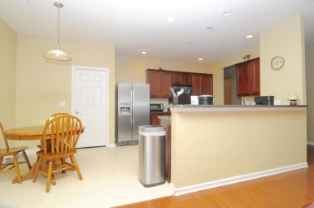
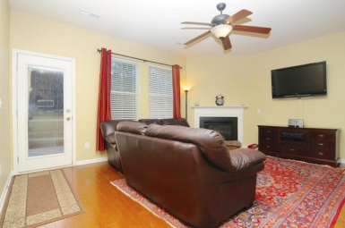
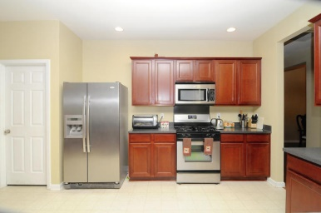
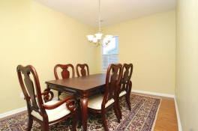
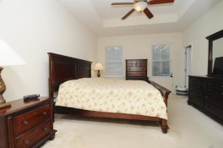
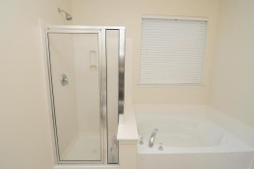
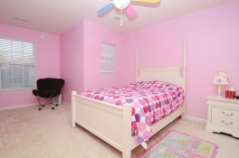
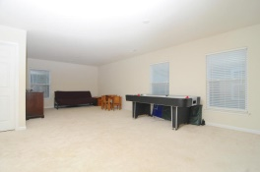
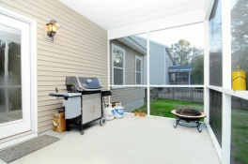
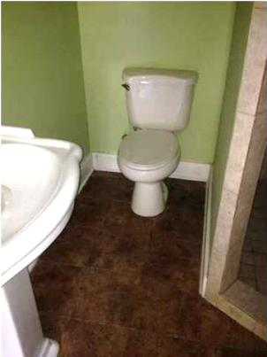
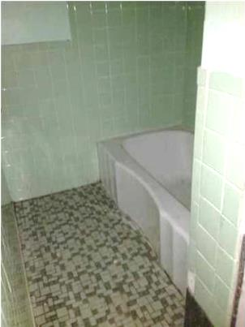
Reduced in Carolina Bay Offering $5,000 Upgrade Credit
1817 Cornsilk Dr ~ Charleston ~ MLS# 15003423 ~ $289,000
Very spacious home with 9 foot plus ceilings located on a quiet street in the desirable Carolina Bay neighborhood.
Master suite features tray ceilings, large walk in closet and soaking tub. The downstairs has an open floor plan which includes a kitchen, den and patio area perfect for entertaining. The upstairs highlights include a multi-purpose room in addition to 3 extra bedrooms with nice sized closets providing ample storage.
The 2 car attached garage provides covered parking and even more additional storage! The large fenced in wooded backyard allows for maximum privacy.
Carolina Bay subdivision amenities also include walking trails, a dog park, play parks, pools and covered entertainment areas. The neighborhood is close to shopping and schools.
Daniel B Morrison
trey@landsouthofcharleston.com
Mobile 843-697-6849
Land South of Charleston, LLC | 409 King St | Charleston, SC 29403

