Slide 1
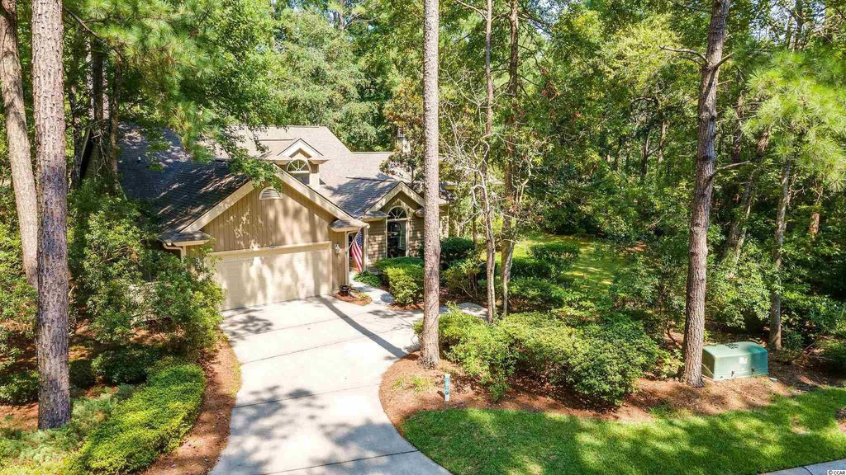
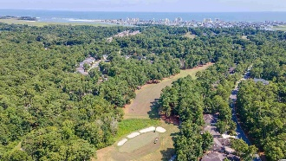
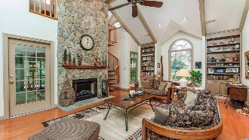
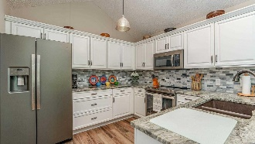
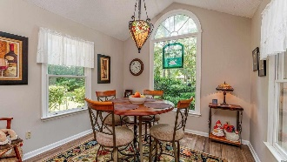
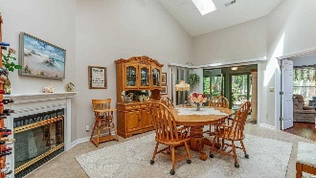
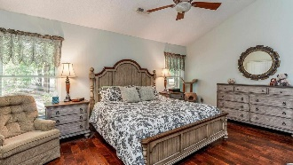
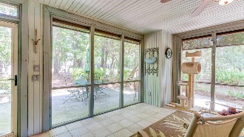
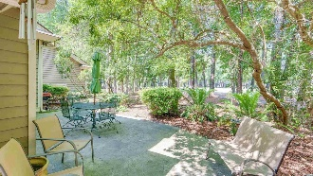
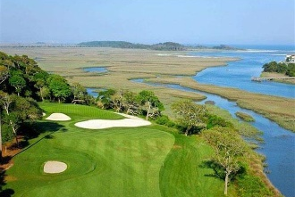
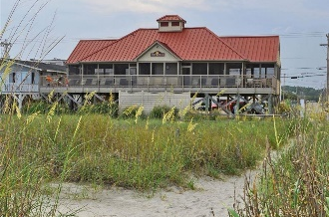



COMPELLING PRICE!
1817 Spinnaker Dr
Tidewater Plantation | North Myrtle Beach SC 29582
MLS# 2117301 | $499,900
With low HOAs & taxes, a homestead exemption when qualified and rich amenities, this home is an excellent investment as well as being highly desirable for a vacation or permanent home. Impressive double Lot 112&113 has a spectacular golf-course panoramic rear view of the 15th hole of world-famous Tidewater Golf Course and a very private park-like setting of mature landscaping and gorgeous flowering plants. This natural enclave is truly breathtaking! It is a very generous .46-acre rectangular lot of about 20,038 sq. ft. with an 129-ft. frontage on Spinnaker Dr. The HOA maintains the grass in the front of the home. The home is sold unfurnished but some furniture is negotiable. All of the 4 bedrooms are grand-sized. The loft is used as an office/den/study. A handsiome spiral stairase leads to the loft! There are 3 full baths. This is a big, beautifu, traditional luxury home with a flex floorplan for easy, fun living and great for entertaining. The home is immaculately maintained inside and out and a pleasure to tour. It is open and incredabily spacious. Noted features include two masters with upscale en suites. The first-floor master enjoys double sink vanities and a whirlpool garden tub. The kitchen, cozy morning room is amazing, too, and completely rennovated just a few months ago with new appliances and wonderful granite solid-surface countertops. There are two wood-burning fireplaces, the one in the great room featuring natural stone from floor to ceiling, and two porches, a Carolina room and screened, with patios. Lots of vaulted ceilings and sky lights add much light and huge perceived roominess. Notice the stunning Tiffany light fixture over the kitchen table, another upscale addition to such a lovely home. The newer washer/dryer convey. There is a separate utility room off the garage, making a convenient entry into the home and then into the large, welcoming foyer encompassing views of the dining area with the second fireplace, great room and the heart of the home. Much can be said about the indoor/outdoor living space. The screend porch is off of the great room amd is a welcome respite to relax, enjoy the beauty of the surroundings and wildlife, particularly the birds, or to watch the golfers. The Carolina room off of the other side of the house is huge, comfortably inviting and can be accessed from the 2nd bedroom or from the dining room. It leads onto another patio and more views...this is a rancher really but with a hideaway second story and dedicated second master/en suite which looks down on the great area from a window in the soaring ceiling! COMPELLING price, also! But see it all for yourself soon. Virtual and real-time video walk-throughs offered of the home & of Tidewater which enjoys many upscale amenities, including owners' beach cabana on the Cherry Grove Beach named the 11th best in the nation, pools & spas, clay- & hard-surface tennis courts, pickle ball, bocce, horseshoes, amenities center, fitness center, driving range and putting green, 24-hour gated & manned security and clubhouse with bar & restaurants. There is even a complimentary gated storage yard for boats, campers, recreational vehicles and the like. The convenient HOA building has rooms for business and other meetings and events and a lending library. Tidewater itself is on a tree-lined road to oceanfront Anne Tilghman Boyce Coastal Reserve, a nature conservancy. It is minutes to the beach, shopping, dining, entertainment, medical services, outstanding schools & parks & access to major highways. It represents a lifestyle, to do as much as you desire or to just relax in the pristine surroundings. The jewel in the crown of the development is that private owners' beach cabana on the wide, white sand of Cherry Grove Beach in popular, safe North Myrtle Beach, a top-5 beach town in the U.S. The jewel in the crown of the Plantation of Tidewater is ths incomparable traditional beauty. Welcome home!
Virtual Tour: https://my.matterport.com/show/?m=oBpLUBDj6sU
Connie Ross-Karl
702-306-2643
conniesross@aol.com
Ronnie Nichols
Realtor
Broker in Charge
NEW WAY PROPERTIES MYRTLE BEACH

