Slide 1
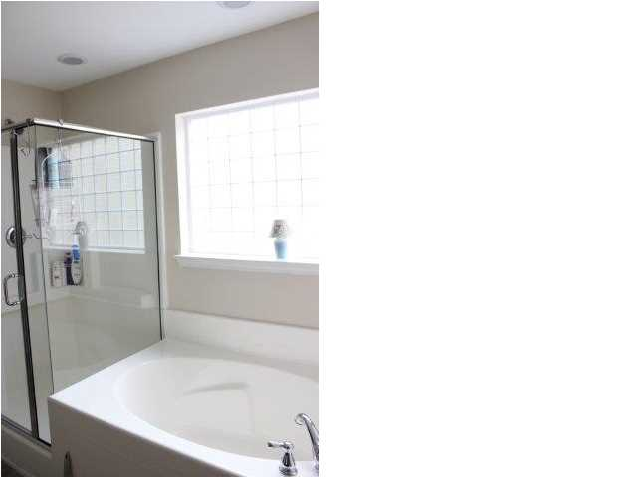
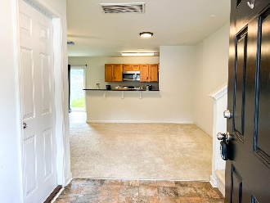
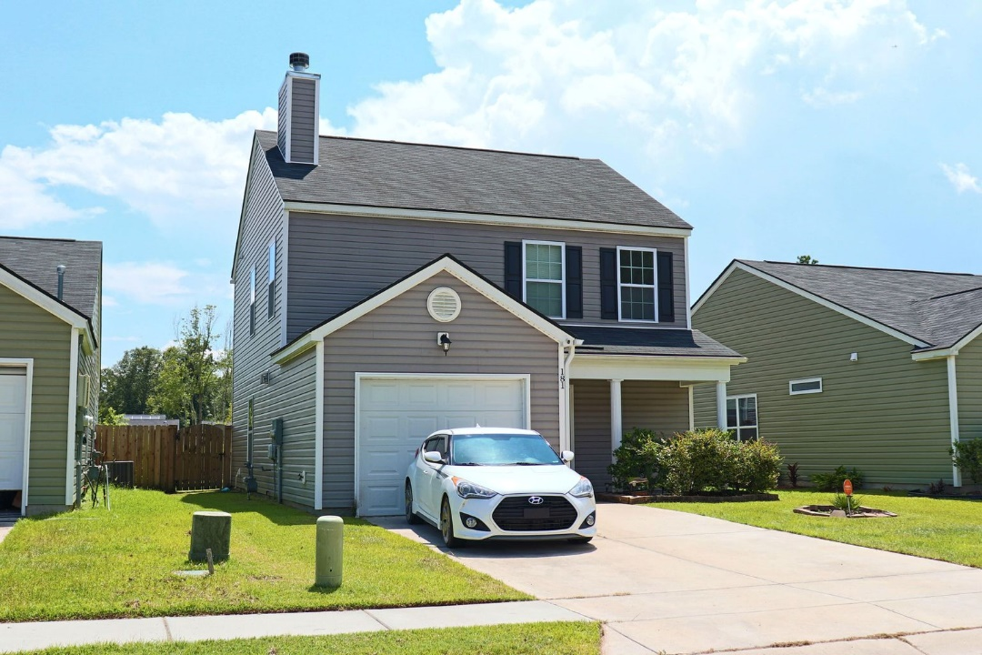
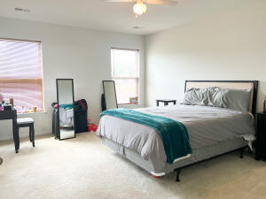
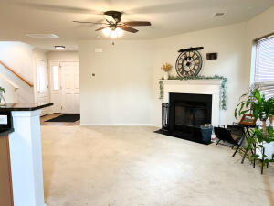
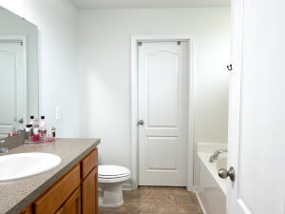
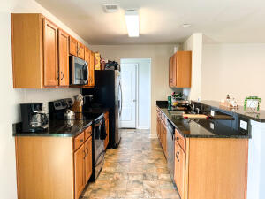
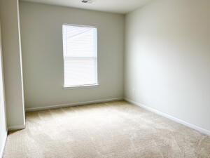
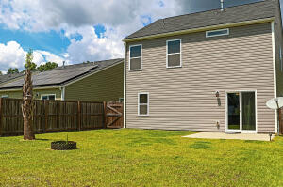
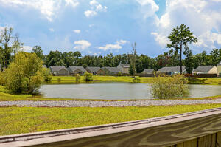

Open House Saturday September 17th 11-2
Free Charleston Print to First 10 Visitors
Register for a Housewarming Gift Basket!
181 Brittondale Road
Lakes of Summerville | Summerville
MLS# 22021095 | $332,000
THIS HOME IS READY FOR YOU!
It features a large pond lot perfect for entertaining or enjoying some time outdoors. Upon entering, you are greeted by lots of natural light and an open floor plan. The living area includes a wood burning fireplace perfect for nights at home. The galley kitchen includes plenty of counter and cabinet space. It leads to the laundry room featuring two large closets — perfect for pantry space or storage. Upstairs, the large master suite includes a garden tub, stand up shower, and walk in closet, as well as two additional bedrooms and a bathroom.
Joanie Rhoten
Office: 843-261-7166 | Mobile: 513-518-7475
joanie.rhoten@agentownedrealty.com
www.agentownedmainst.com
AgentOwned Realty Co. Premier Group | 141 A N. Main Street | Summerville, SC 29483

