Slide 1
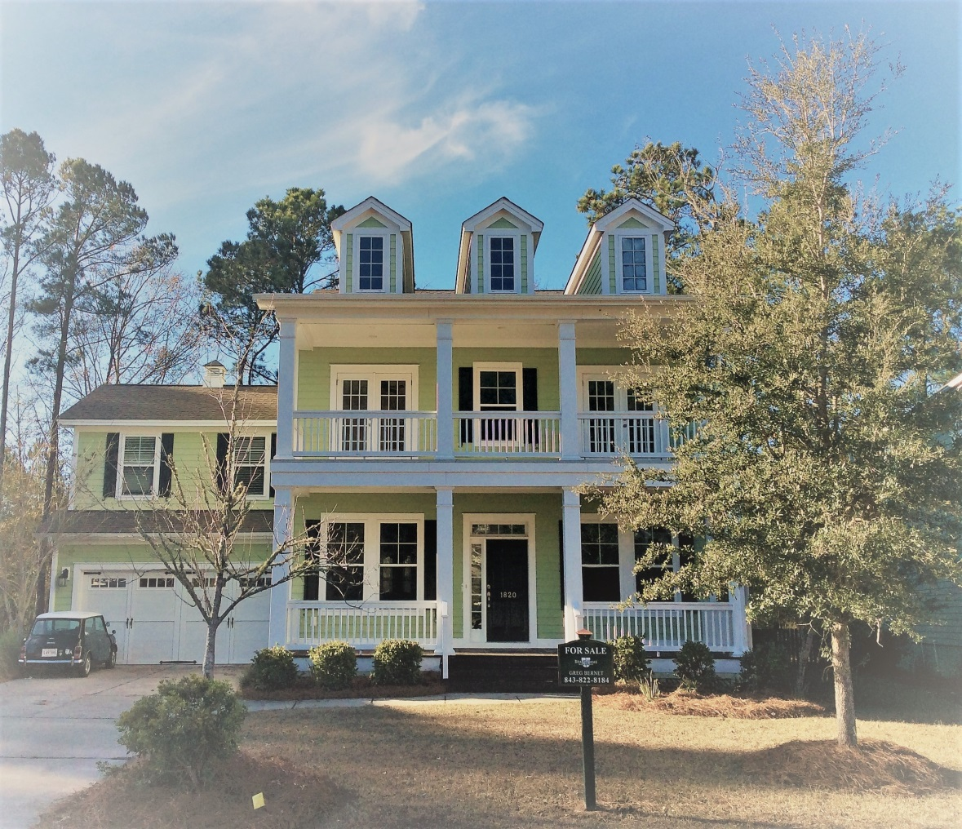
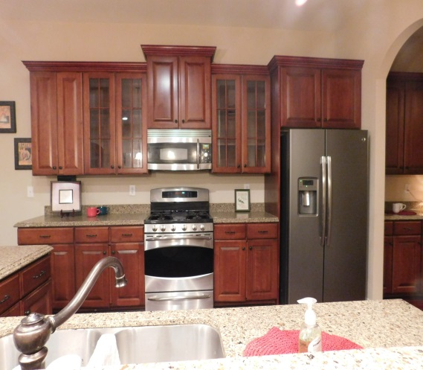
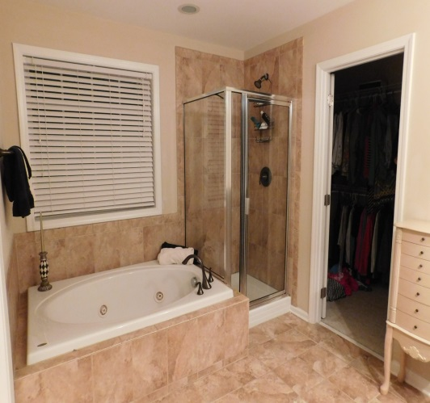
Welcome Home to
1820 Hall Point Road!
Offered @ $540,000
MLS# 17000709
Popular Pembroke Section of Park West
Open House Saturday January 28 from 1-4
For More Information, contact:
Greg Bernet, Agent
843-822-8184
Brand Name Real Estate
Double Front Porch, 2-Car Garage
5 Bedroom
3 Full Bath
3,185 Square Feet
1 Bedroom, Full Bath on First Floor
Open floor Plan w/ Kitchen overlooking Breakfast area &
Great Room
Newly Installed Hardwood Floors
Maple Cabinetry
Stainless Steel Appliances
Granite Countertops
Wooded Backyard
Screened-In Back Porch
Neighborhood Pool & Tennis
Schools:
Laurel Hill Primary
Pinckney Elementary
Cario Middle

