Slide 1
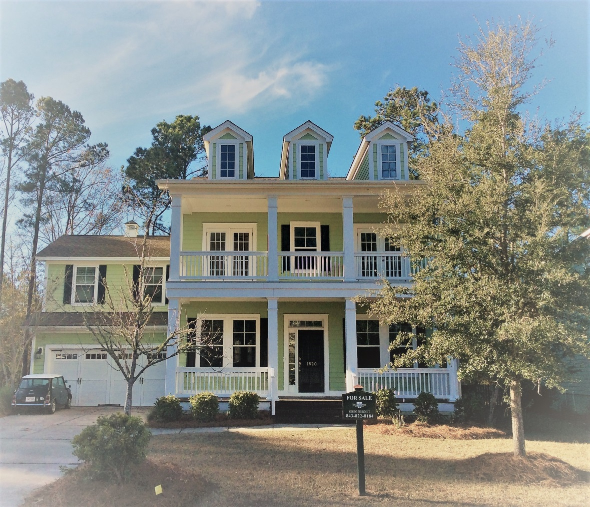
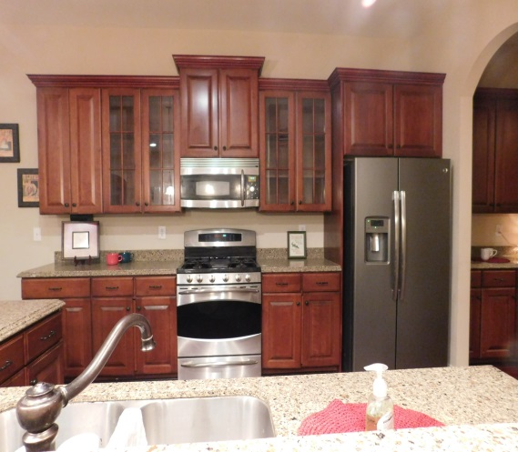
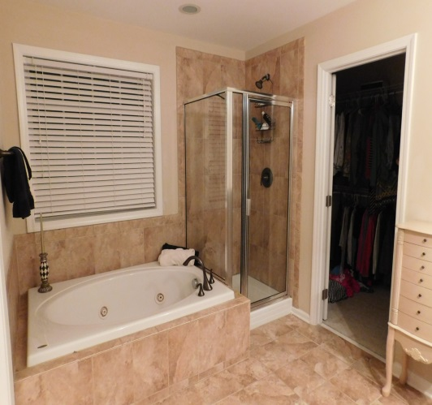
Welcome Home to 1820 Hall Point Road! Offered @ $499,900 MLS# 17000709 Popular Pembroke Section of Park West
For More Information, contact:
Greg Bernet, Agent
843-822-8184
Brand Name Real Estate
Updated Upstairs Floor Plan To Include Fifth Bedroom/Play Room.
Double Front Porch, 2-Car Garage
4 Bedroom
3 Full Bath
3,185 Square Feet
1 Bedroom, Full Bath on First Floor
Open floor Plan w/ Kitchen overlooking Breakfast area &
Great Room
Newly Installed Hardwood Floors
Maple Cabinetry
Stainless Steel Appliances
Granite Countertops
Screened-In Back Porch
Neighborhood Pool & Tennis
Schools:
Laurel Hill Primary
Pinckney Elementary
Cario Middle

