Slide 1
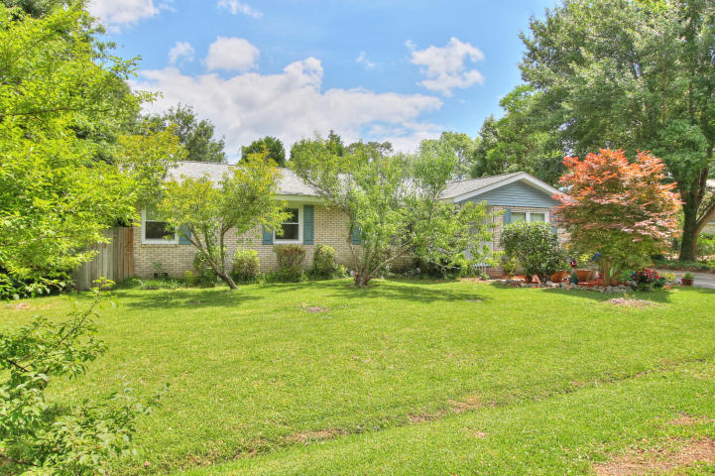
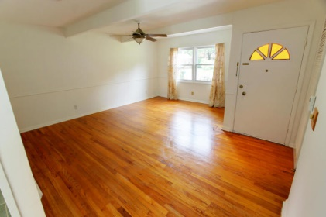
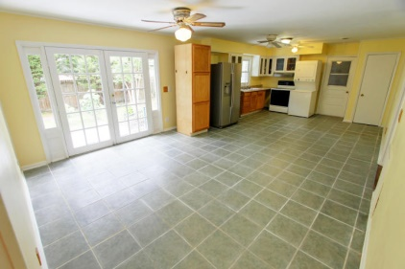
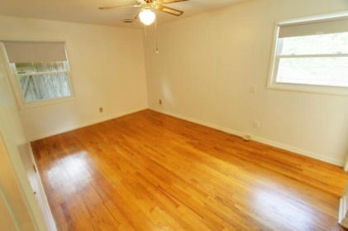
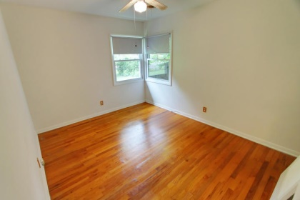

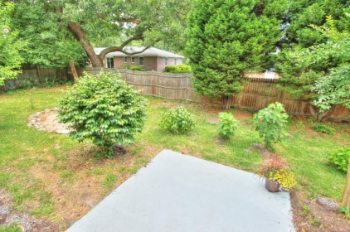
1821 Gippy Lane
West Ashley Plantation
Charleston
MLS# 15013937
$180,000
4 Bedrooms
3 Bathrooms
2,239 Sq Ft
OPEN HOUSE
Sunday 12-3pm
Updated home in the heart of West Ashley just moments away from
I-526 and I-26. The location is a convenient commute everywhere including Downtown Charleston, the beaches, major shopping, the JCC, Post Office, gyms, restaurants and more!
There are 4 bedrooms and 2 full bathrooms in the main portion of the house. The kitchen and dining area are huge with ceramic tile flooring; the rest of the home (less bathrooms) has gorgeous hardwood flooring! You'll find that the interior of the main house was just painted throughout.
This property is unique in that it has a huge addition which is perfect for a home office, art studio, man cave, playroom or an apartment (potentially income generating).There is also a large workshop that was once the garage in addition to a spacious utility room. The yard has several fruit trees (pear, peach, plum, fig) and a bay tree.
Many updates have been done to this home (architectural roof 2008, HVAC 2002, windows 2008, sewer pipes 2012, updated electric 2011, HVAC serviced 2013, water heater 2008). The sellers are very motivated!
Meg Hopkins Kandik
Cell - 843-814-5137
meg@holycityre.com

