Slide 1
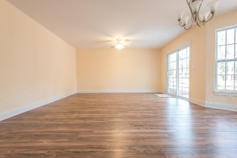
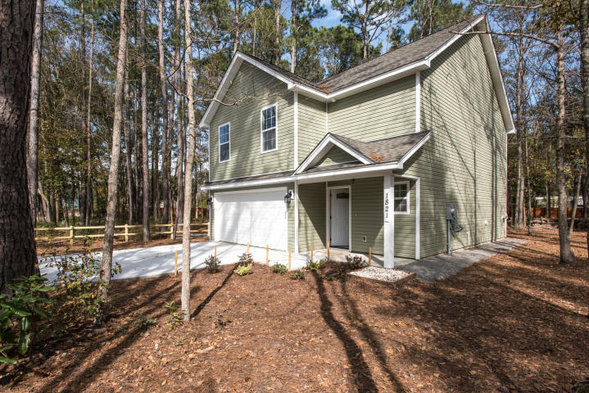
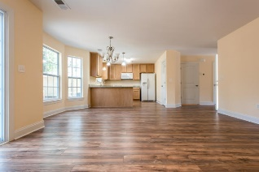
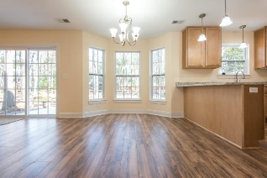
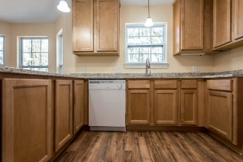
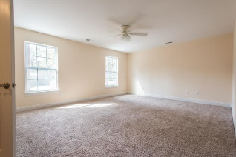
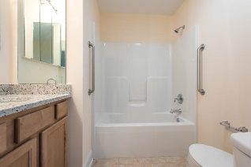
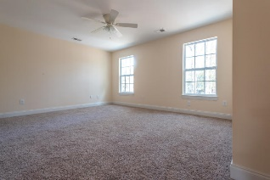
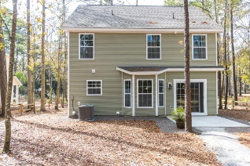
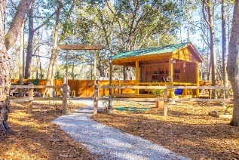


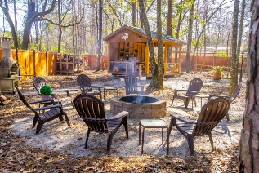
1821 Zelasko Drive
Enclave Park ~ Johns Island
MLS# 19003870 ~ $289,900
OPEN HOUSE SUNDAY
Welcome to Enclave Park. John's Island only 55+ pocket community. This brand new home comes complete with an open floor plan, gorgeous kitchen with 42" cabinets and granite countertops. There is small patio off of the back of the home that leads out to a nice sized yard that then opens onto the wonderful Enclave Park Common Area where residents can enjoy a lovely walking path, a two story pergola, two fire pits, horseshoes and a barbecue pavilion. The upstairs of this home features three bedrooms with a large master bedroom that has an ensuite bathroom, ceiling fan and walk in closet. There is a two car garage and a nice little porch that leads into the home.
Carey Nikonchuk
(843) 276-1701 M
cnikonchuk@gmail.com
www.palmettoproperty.net

