Slide 1


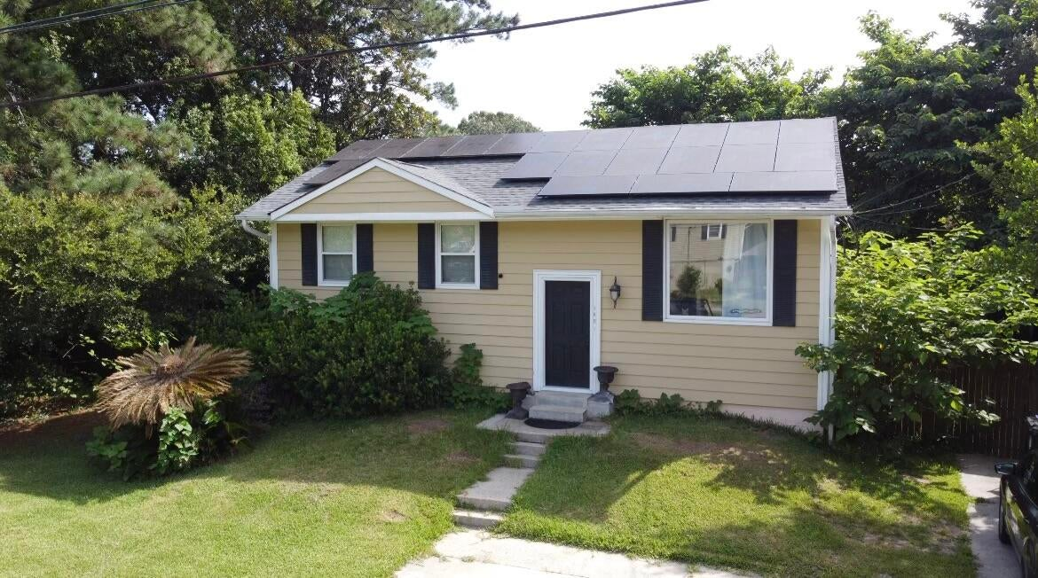
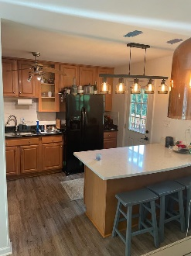
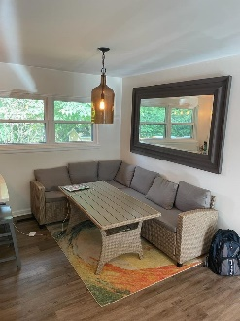
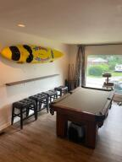
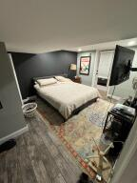
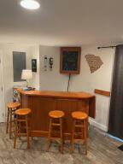
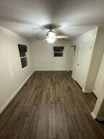
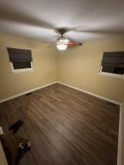
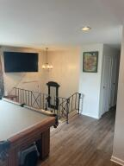
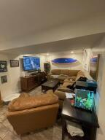
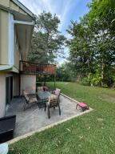
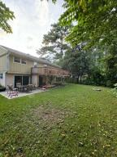
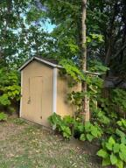
Kim Katich
(843) 754-8060
kimsellschs@gmail.com
Just Listed
1821 Manigault Place
West Ashley Plantation
Charleston, SC 29407
MLS# 23023256
$469,000
3 Bed | 2½ Bath | 1,872 SF
This is a very unique house with a versatile layout, it can make a wonderful family home and also works great as a split living situation. Currently the downstairs has a master suite with bathroom, a large family room, laundry room and half bath with two exterior doors. The upstairs has another two bedrooms, bathroom and family room/kitchen. Some with this layout have made the second family room with bath a fourth bedroom. Huge multi-level deck, big fenced in backyard with a storage shed and NO HOA. The solar panels are paid off and make the utilities very low. The solar panels are attached to a brand-new roof. Other pricey upgrades are all new sewer pipes to the street have been run (this area has a problem with old pipes). In addition, new floors, granite kitchen counters.
For investors... this area accepts ADU (accessory dwelling units) and some in the neighborhood have already built these. This home can create great rental income. The refrigerator, oven, dishwasher and washer and dryer all convey.
Flat Rate Real Estate
1150 Hungryneck Blvd | Ste C314 | Mt. Pleasant, SC 29464

