Slide 1
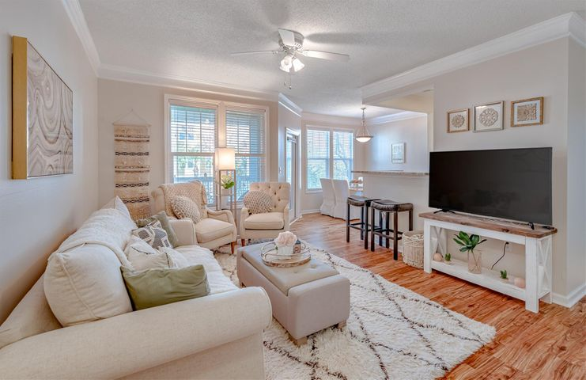
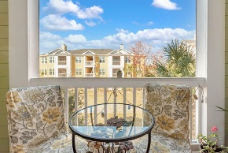

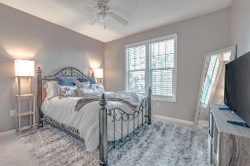
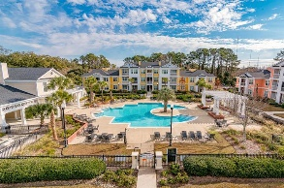
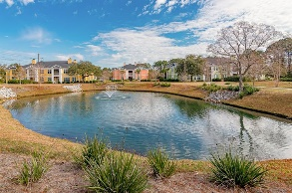
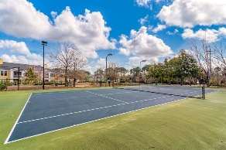


Move-in Ready
1823 Chatelain Way
Southampton Pointe ~ Mount Pleasant, SC 29464
MLS# 21006231 ~ $275,000
Southampton Pointe move-in ready 2 bedroom 2 full bathroom luxurious condo with a screened porch overlooking the courtyard greenspace. This 2nd story condo features a dual master layout with each bedroom having its own private full bathroom and individually located on separate ends of the condo for additional privacy. Upon entering you are greeted with recently updated hardwood style laminate floors which run throughout the main living room, hallway, laundry room and closets. The kitchen features granite countertops with stainless steel appliances and overlooks the large living room. Direct outside access to the screened porch and a wall of windows provides abundant natural sunlight to the main living areas. Valuable updates include a new HVAC unit and new hot water heater in 2020. Southampton Pointe is a gated community with mature landscaping, breathtaking Live Oak trees, and a complete amenity package inclusive of a swimming pool, tennis court, walking/jogging trails, ponds, green space, dog park, car washing station, club house for private events and hanging out, grilling areas, onsite boat/trailer storage, and even a gym with recently updated workout equipment. Easy direct access onto Hwy 17 and I-526 is just around the corner for Daniel Island and I-26 north area commutes. Downtown Charleston is 15 minutes away, and of course Isle of Palms and Sullivan's Island beaches are just minutes away! The Mount Pleasant Towne Center is 2 red lights up the street and provides some of the best shopping around with restaurants, movie theatre, Starbucks, Lowes and much more. This is a turn key 'lock it and leave it' condo conveniently located in the absolute heart of Mount Pleasant!
Jerod Coulter, ABR, REALTOR
(843) 513-3741
jerod@realtor.com | www.HomesOfMountPleasant.com
The Boulevard Company, LLC | 35 Broad Street | Charleston, SC 29401

