Slide 1
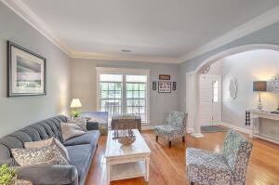
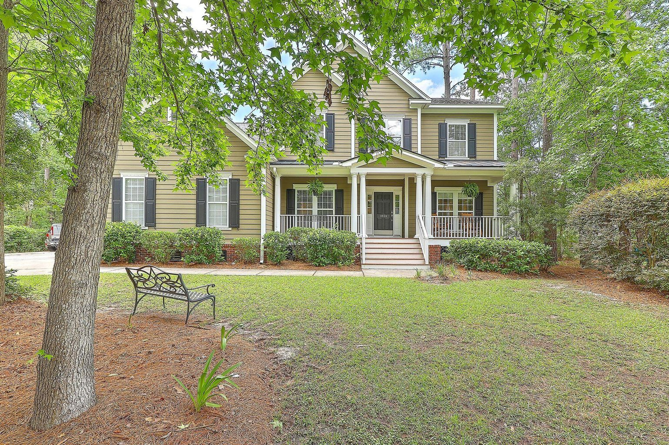
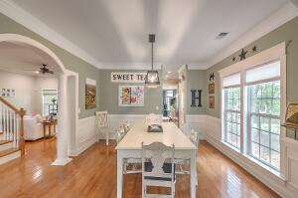
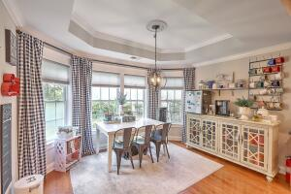
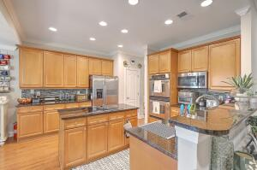
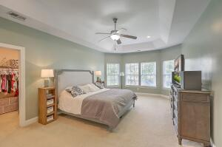
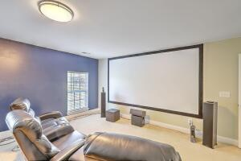
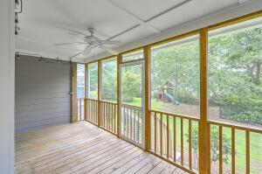
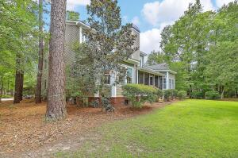


1824 S James Gregarie Road
Park West | Mount Pleasant | MLS# 22015489 | $949,900
6 Bedrooms 4 Full Baths Under $950,000
$1,000 Buyer's Agent Bonus
For Ratified Contract That Can Close By 9/27/2019
Must See! Beautiful multi-generational 6 bedroom, 4 full bath home located on a quiet cul-de-sac in Park West.
Plenty of parking for everyone. Lofted 2 car garage.
FIRST FLOOR
Dining room large enough for entertaining
Family-sized eat-in kitchen open to the family room
Hardwoods in much of the living areas
Crown molding, architectural arches and wainscoting.
Shady, relaxing screen porch
Huge Master suite with sitting area & large bathroom
Secondary bedroom (currently an office) and a second full
SECOND FLOOR
4 generously sized bedrooms
2 full baths
Theater-sized bonus room
Space Galore
Tons of storage
Video Tour:
https://player.vimeo.com/video/719228747?h=144d4ace6b
Maggie Curtis
REALTOR, EPRO, LMC, ABR
(843) 693-8207
maggiecurtis@comcast.net
Bob Curtis
Realtor
(843) 425-1965
thebobcurtis@comcast.net
Coldwell Banker Realty | 1127 Queensborough Blvd. 103 | Mt Pleasant, SC 29464

