Slide 1
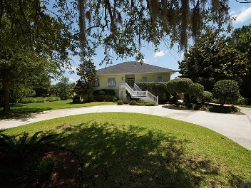
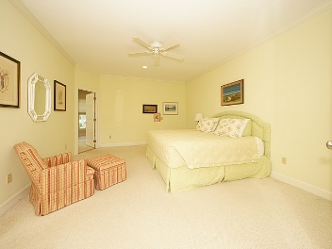
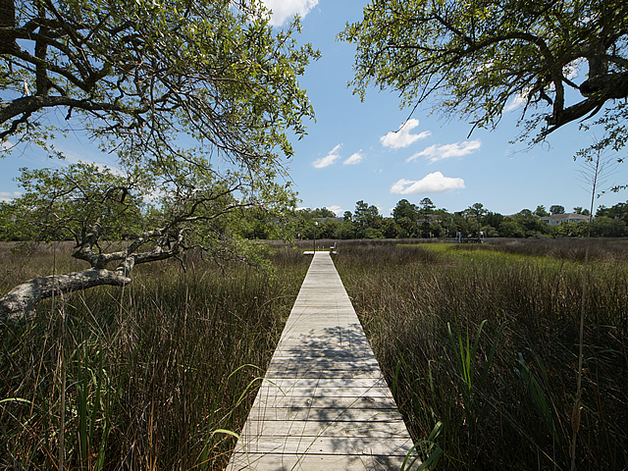
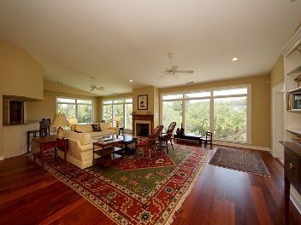
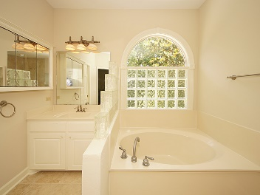
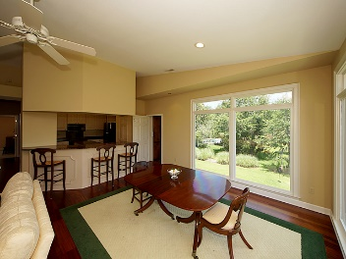
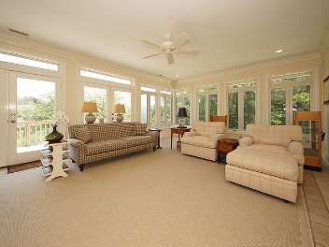
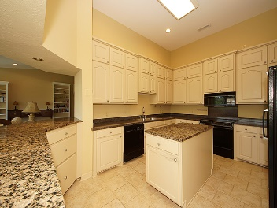
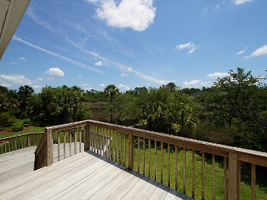


1827 Cherokee Rose Circle Dunes West ~ Mount Pleasant ~ MLS# 17016196 ~ $890,000
Agent Luncheon Open House ~ August 8th ~ 11-1
Panoramic views of the marsh and Toomer Creek beyond welcome you to this raised home with an open floor plan, elevator and dock. With 3 bedrooms and 2.5 baths this cozy home is pure delight.
The wall of windows in the great room and adjoining sunroom bring in the sights and sounds of marsh living in the Lowcountry. The windows have electronic hurricane shutters for storm protection.
Living, dining and room for gatherings come together around an open kitchen with island and breakfast bar. Built-in bookshelves and gas fireplace bring definition to the space.
The master suite has dual walk-in closets and bath includes a garden tub, dual sinks, private commode room and has recently been updated with new floor tile and remodeled shower.
Two other rooms, full bath and powder room give space for guests and an office. One of the rooms has a built in desk and bookshelves. The lower level garage has lots of storage space and an adjoining large screened porch.
Dunes West is Mt. Pleasant's premier gated community with memberships available at the state of the art amenity center including pools, exercise facility, tennis center and the Arthur Hills designed golf course.
Franne Schwarb
843-270-1207
franne@charlestonfinehomes.com
Chari Karinshak
843-810-8287
Chari@CharlestonFineHomes.com
Coldwell Banker Residential Brokerage, 1127 Queensborough Blvd, Mount Pleasant, SC 29464

