Slide 1
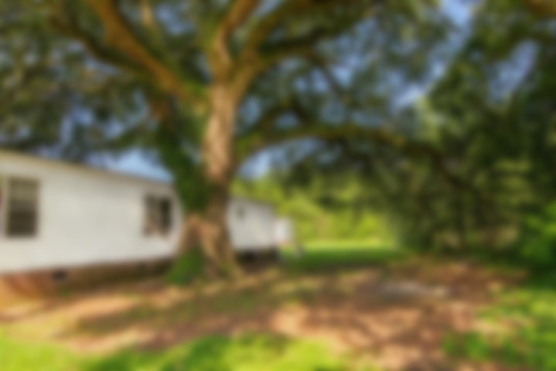
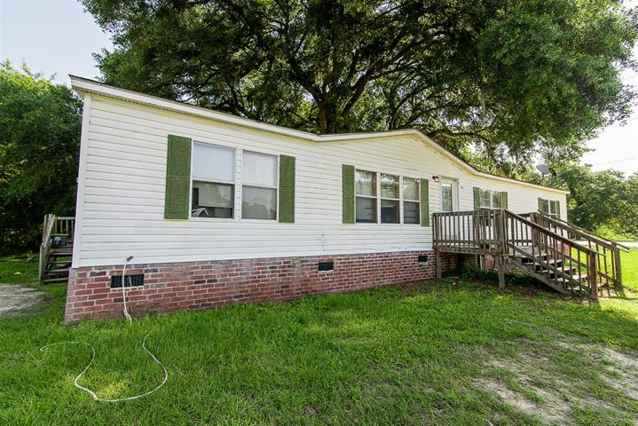
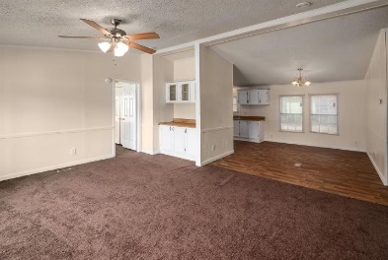
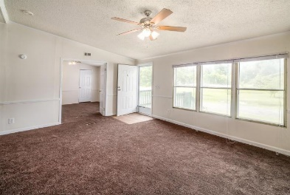
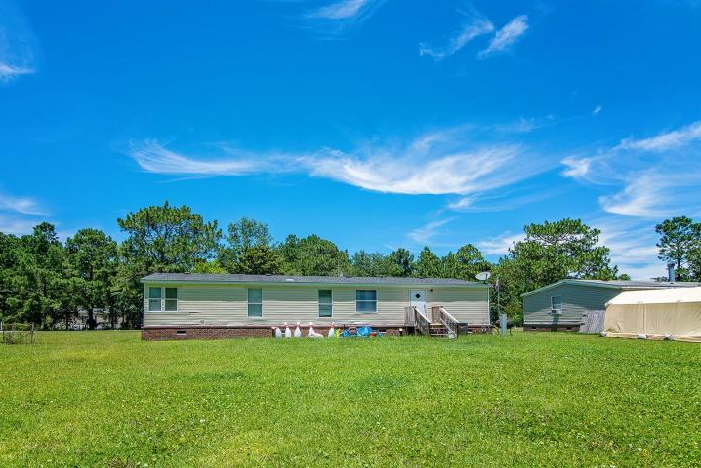
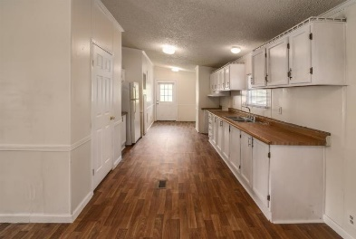
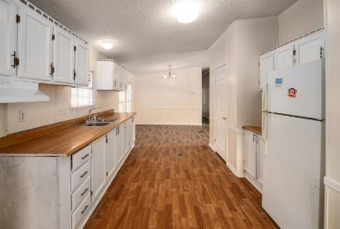
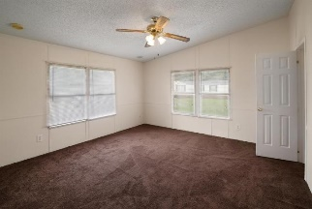
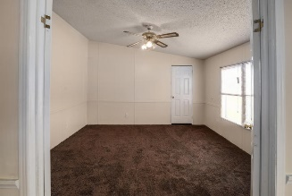
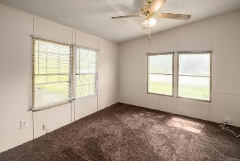
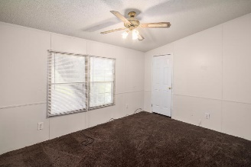



1827 S Live Oak Drive Moncks Corner, SC 29461 ~ MLS# 18021420 ~ $164,900
Just Listed!
Renovated 5 Bedroom 2 Bath on 1/2 an acre
Welcome Home! Wonderful opportunity to own a recently renovated 5 bedroom 2 bath home sitting on half an acre. Upon entering you will find a spacious living room with built in cabinet, separate dining area and a large Kitchen. Kitchen has white cabinetry with lots of counter space and a pantry area with plenty of space to store your favorite foods. The huge den off of the living room has its own closet and double doors, can be used as the 5th bedroom. Master bedroom en-suite has a nice sized walk in closet and attached master bath with a brand new tub (7/18) and vinyl flooring. The 3 secondary bedrooms are all nicely sized with plenty of room for all of your needs. Roof is only about 3 years old, new water heater installed July 2018. New carpet, vinyl flooring and freshly painted.
Enjoy the outdoors while admiring your very own Angel Oak (Live Oak) tree. Conveniently located near shops and restaurants. A Must See! Schedule your appointment today!
Asking $1,200,000
MLS# 17023051
3,692 SqFt
4 Bed/3½ Baths
Short Drive to Historic Downtown Charleston & Beaches
Jacqui Swain (843) 295-9484 jacquiswainc21@gmail.com www.JacquiSwain.c21.com
Century 21 Expert Advisors
100 Seven Oaks Lane
Summerville, SC 29485

