Slide 1
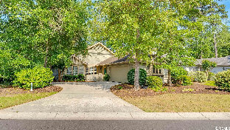
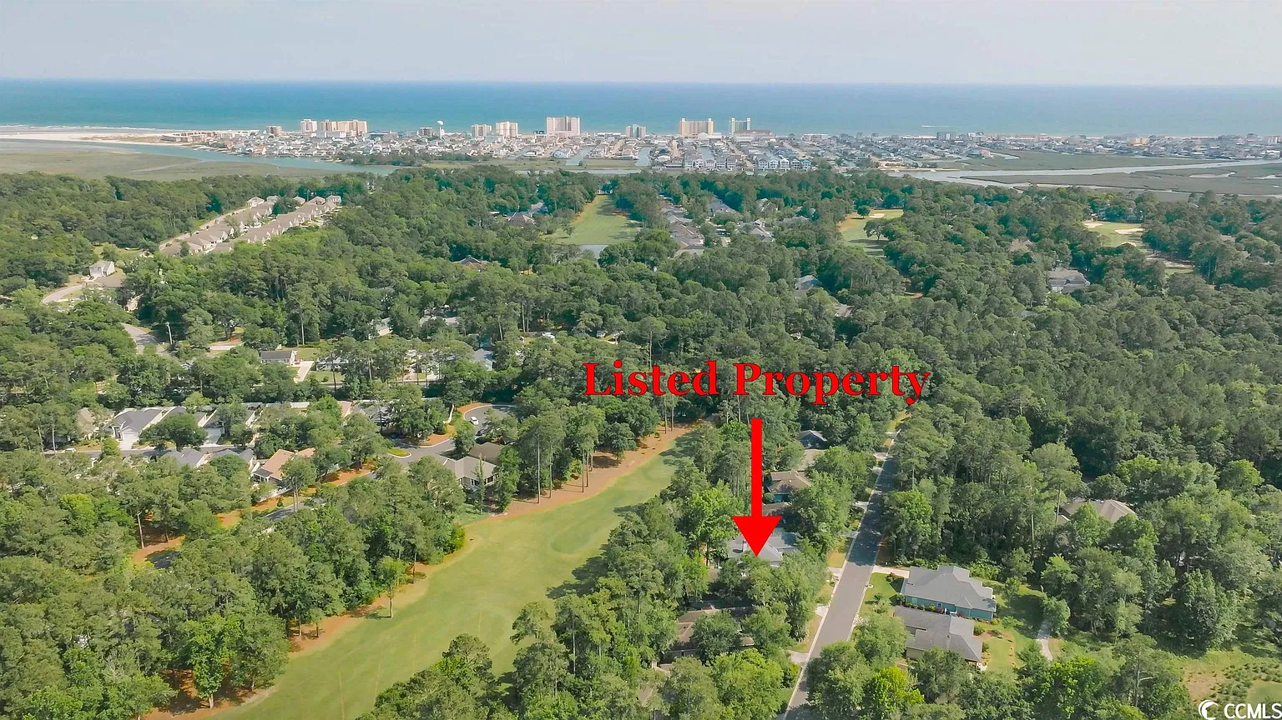
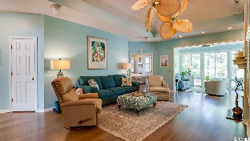
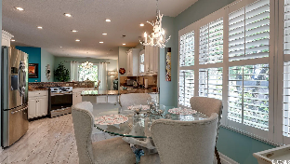
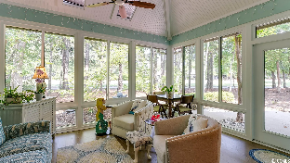
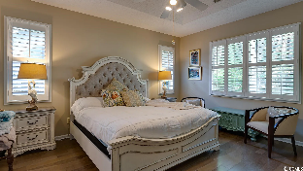
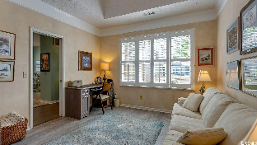
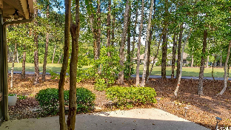
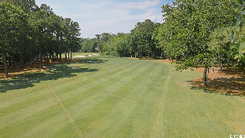
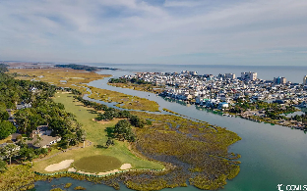
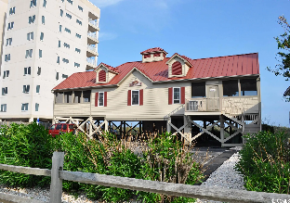



Well Located On The 15th Hole Of Top-rated In The Nation In 2022 Tidewater Golf Course
1827 Spinnaker Dr
Tidewater Plantation | North Myrtle Beach, SC 29582 | MLS# 2310696 | $505,0003
Well maintained home, desirable floor plan & fabulous features! It is well located on the 15th hole of top-rated in the nation in 2022 Tidewater Golf Course. Enter from a small, gated patio into a wide foyer with entry closet and full bath opening up to a beautifully upgraded kitchen with high-end stainless steel appliances and granite counter tops, a formal dining room and living room with fireplace and wet bar. There is also a heated & cooled Carolina room and a nice patio off of it and the dining room. The golf course view of the 15th hole is enjoyed from the patio, Carolina/living, dining, kitchen and master-bed rooms. Skylights & unique ceilings throughout highlight the home. Spacious master with en-suite with separate watercloset and stand-up shower, double sinks and vanity, and his and her spacious closets. The master bedroom has lots of windows and therefore much natural light. The large guest bedrooms are in the popular split-bedroom floor plan adjoining the second full bath, again with roomy hallway and big linen closet. The third bedroom is being used as a study but has a big closet area and two-doored entrances. The third bath is nearby the study which opens to the entry hall as well as to the interior hall. Enjoy wonderful ceiling treatments and unique light fixtures throughout. The open kitchen is the heart of the house, looking out onto the golf course and the side yard from the window above the sink. There is a cheery breakfast nook, walk-in pantry and loads of cabinet space. The double-car garage opens to the laundry room off the kitchen and to that full bath with stand-up shower, perfect to refresh after a day at the beach. Thr garage isd large and has a separate exit to the yard for convenience. Lots of storage space, too.This home has it all, with comfort and elegance, and shows a real pride of ownership in BEAUTIFUL Tidewater Plantation Resort. Outstanding home eatures follow: CONVENIENT STATIONARY STAIRS IN GARAGE TO PARTIALLY FLOORED ATTIC, ALREADY DESIGNED FOR AN ADDITIONAL BUILD-OUT OF A 12' X 13' ROOM UPSTAIRS WITH HIGH CEILINGS FOR A FOURTH BEDROOM OR HOME THEATER WITH PLANNED ½ BATH THAT WOULD TIE INTO THE BATH BELOW, JUST ABOVE THIRD BEDROOM/STUDY. TRANE UNIT IN ATTIC AND HEAT PUMP. WINDOWS OPEN AND ALSO HAVE SCREENS. FRONT WINDOWS WINDOW WORLD, LIFETIME GUARANTEE. CEDAR-LINED CLOSETS, EXCEPT ENTRY. PLENTIFUL STORAGE. ALL APPLIANCES CONVEY RANAII GAS HOT WATER SYSTEM IN GARAGE & ELECTRIC AND GAS HEATER. 5 BOSE SURROUND-SOUND SPEAKERS IN LIVING ROOM. NEW ROOF FEBRUARY 2016. UPGRADED KITCHEN. PLANTATION SHUTTERS. Moreover, Tidewater owners enjoy that NATIONALLY TOP-RATERD GOLF COURSE IN 2022, along with an amenity-rich resort community, boasting an owners' oceanfront beach cabana only minutes away on the wide, white sand beaches of this Cherry Grove neighborhood of popular North Myrtle Beach. North Myrtle Beach is one of the most well-managed cities in the Carolinas and has the lowest tax millage of any such full-service city of its size in South Carolina. The resort features 24-hour gated, manned security. Amenities include that oceanfront beach cabana for owners' use with open/screened porches, bathrooms, showers and kitchen. Other amenities include a driving range, golf shop, clubhouse with bar and dining facilities overlooking the 18th hole, clay and hard surface tennis courts, pickle ball court, fitness center overlooking a pool, and amenity center for public/private events. Other group activities include an outdoor summer concert series, workout classes including water aerobics, weekly art classes, Happy Hours, dinner clubs, book clubs, bridge club, mahjong and holiday events, plus more! In addition, Tidewater boasts a gated storage yard for boats, jet skis, motorcycles and kayaks. Tidewater Plantation and its full range of things to do and to enjoy truly reflects a "way of life" in safe, affordable North Myrtle Beach. Welcome home!
Video Tour: https://youtu.be/eBiZgrsmrt4 | Virtual Tour: https://my.matterport.com/show/?m=3kbtUEAEa3L
Connie Ross-Karl
702-306-2643
conniesross@aol.com
Ronnie Nichols
Realtor / BIC
ronnienichols8@aol.com
NEW WAY PROPERTIES MYRTLE BEACH

