Slide 1
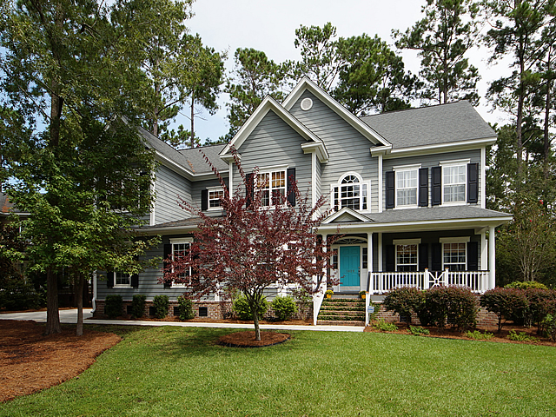
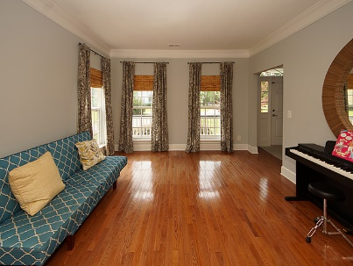
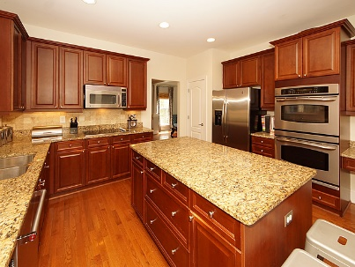
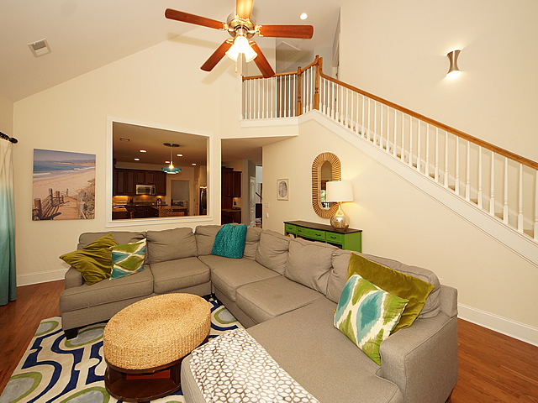
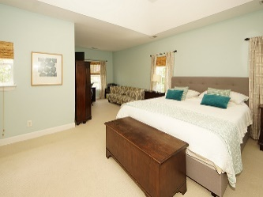
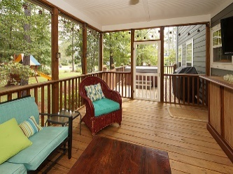
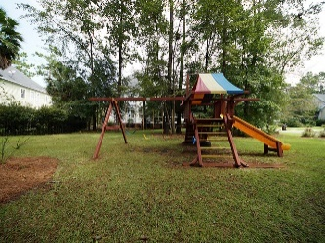
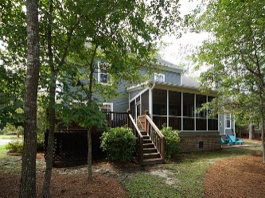


1828 S. James Gregarie Road
Park West :: Mount Pleasant
MLS# 17025249 :: $539,900
Pristine & Ready
for New Owners
Just Reduced!
Welcome home! Enjoy Mount Pleasant living in sought after Park West! This beautifully well maintained home is ready for it's new owners featuring a large kitchen with 42'' cabinets, center island and stainless steel appliances. The private owner's suite is perfect for relaxing in the sitting area or imposing upon the well appointed bathroom. This immaculate home also shows a formal living and dining area, two story family room, home office (or flex space), dual staircases and a tranquil screen porch overlooking the backyard. Take advantage of Park West amenities including two pools (jr olympic pool and zero entry pool), playground, club house, tennis courts, walking and biking trails and convenience to shopping and dining.
Maria Woodul, ABR, CRS, SFR
Broker Associate
843.297.1836
MWoodul@carolinaone.com
www.MariaWoodul.com
Carolina One Real Estate
2713 Highway 17 North
Mt. Pleasant, SC 29466

