Slide 1
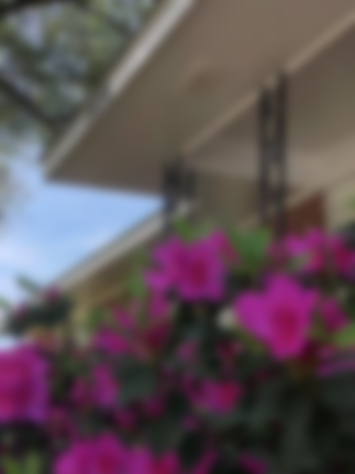
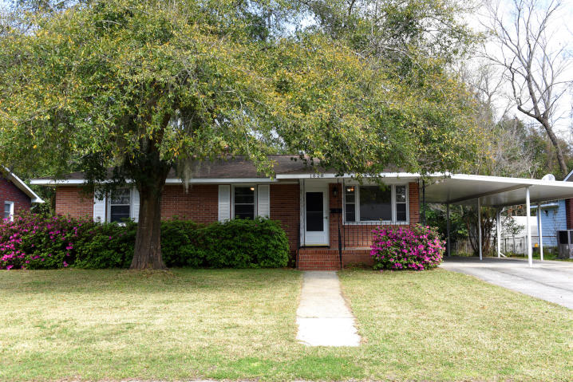
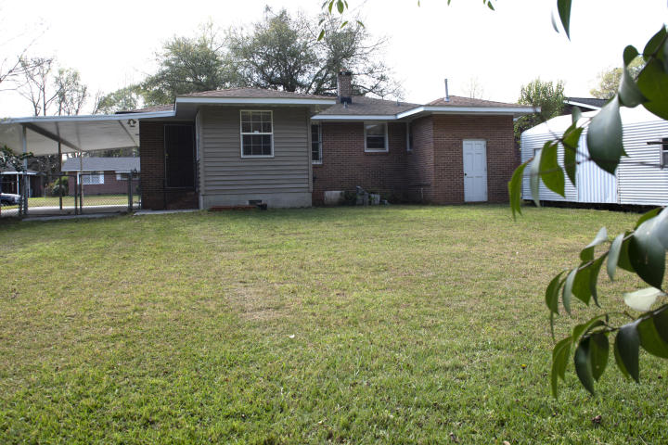
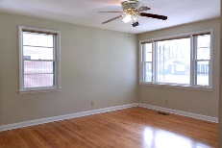
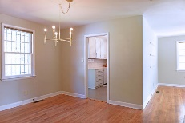
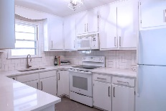
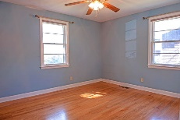
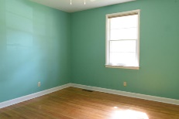

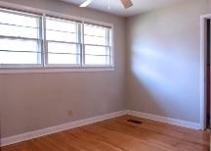
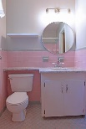
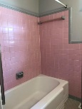
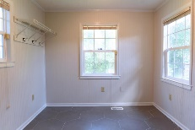
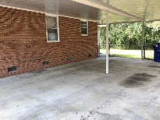
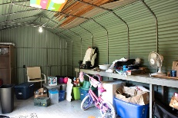
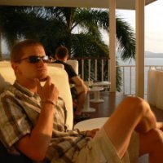


Donation Station & Open House 4/13 2-4pm
1138 Waterfront Dr
Hidden Lakes ~ Mt Pleasant ~ MLS# 16000069 ~ $765,000
1828 Wasp Street
West Cameron Terrace ~ N Charleston ~ MLS# 19007590 ~ $275,000
Tastefully updated brick ranch in desirable Park Circle Area! This home sits on a wonderful lot - backing up to the privacy of woods - and just a short distance from it's elementary school, North Charleston Creative Arts Elementary. The current owner has done a wonderful job of updating the home while keeping much of the original character. Other features include: a two-car wide driveway, carport with room for 2-4 vehicles, fenced-in backyard, large laundry room/mud room off the kitchen, an exterior storage room, and storage shed on the back of the house. The beautiful kitchen includes new tile flooring, updated cabinets, quartz countertops, tile backsplash, updated appliances and much more. Come see it for yourself!
Mark Macpherson
mark@beachbreak-properties.com
843.367.5640 Mobile

