Slide 1
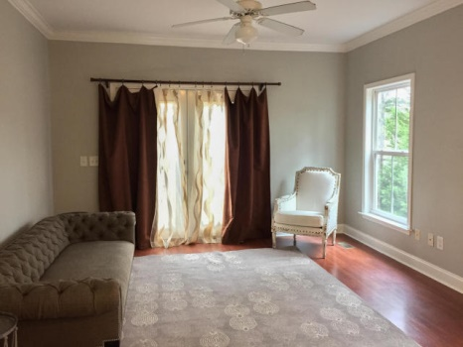
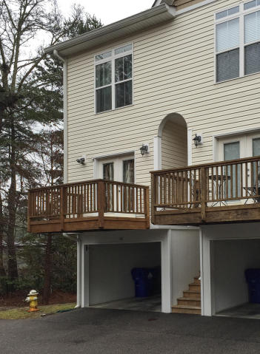
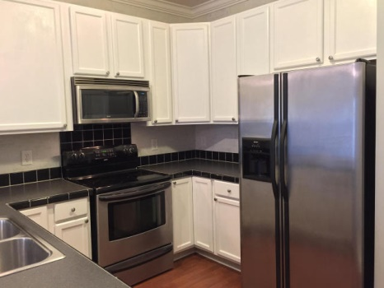
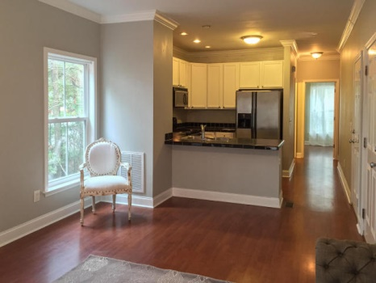
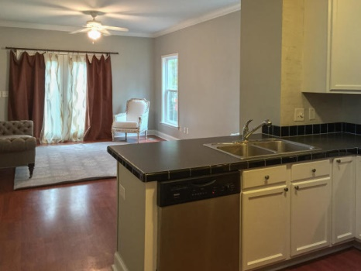
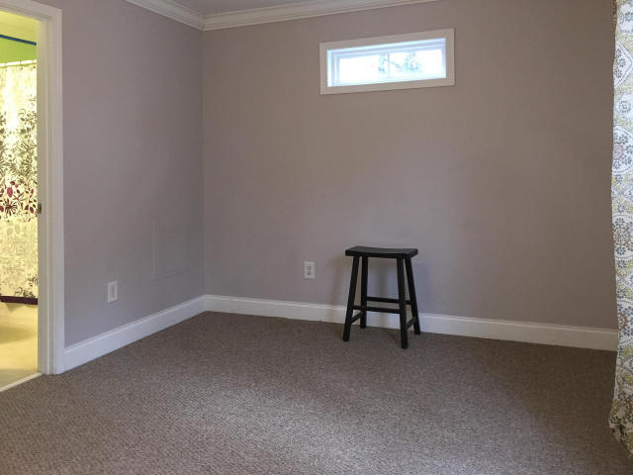
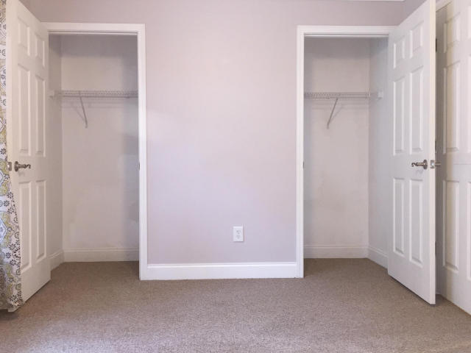
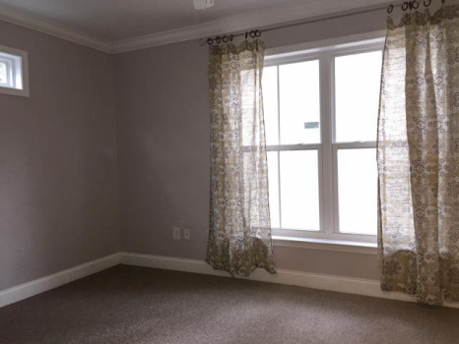
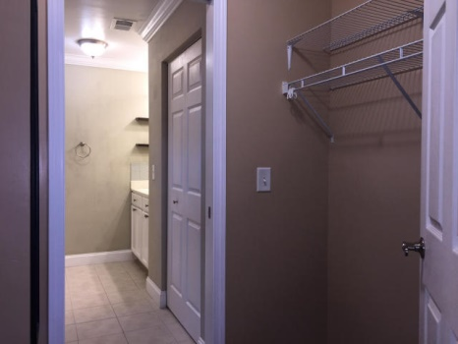

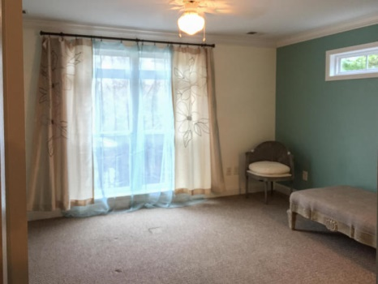

1829 Dogwood Road #401
Charleston ~ MLS# 15001070 ~ $148,000
Open House Wednesday 11-1
$50 Gas Card
Beautiful end unit townhouse located in the heart of West Ashley now available! This unit won't last long and sellers are very motivated. This home has just been freshly painted and shows beautifully. The townhome has a nice open floor plan with large kitchen. With 3 bedrooms and 3 baths this home is perfect for a small family or a young couple just starting out. It also makes for a great investment property. Because this home is elevated with a drive under garage there is storage galore! Don't miss this opportunity to own a great unit in one of the best locations in Charleston!
Carey Nikonchuk
(843) 276-1701 M
cnikonchuk@gmail.com
www.palmettoproperty.net

