Slide 1
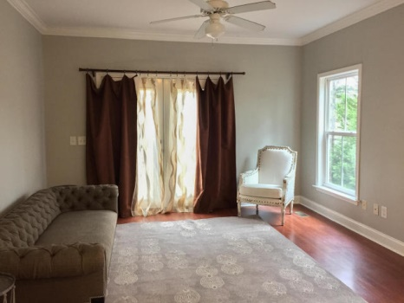
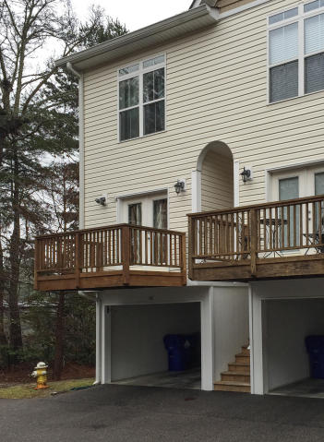
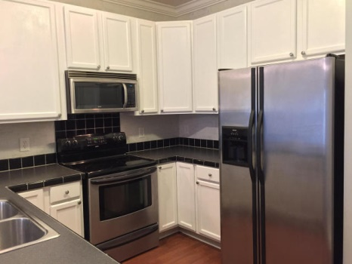
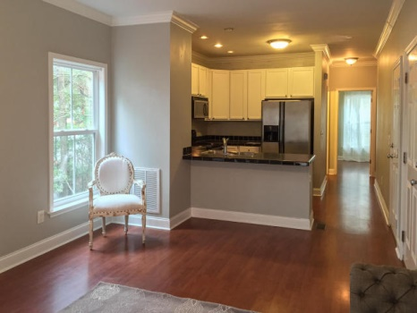
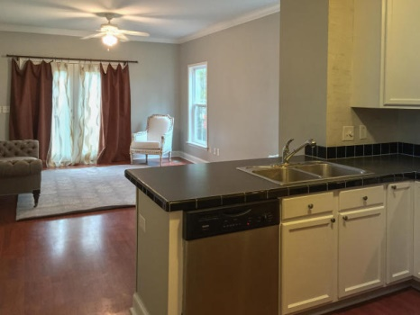
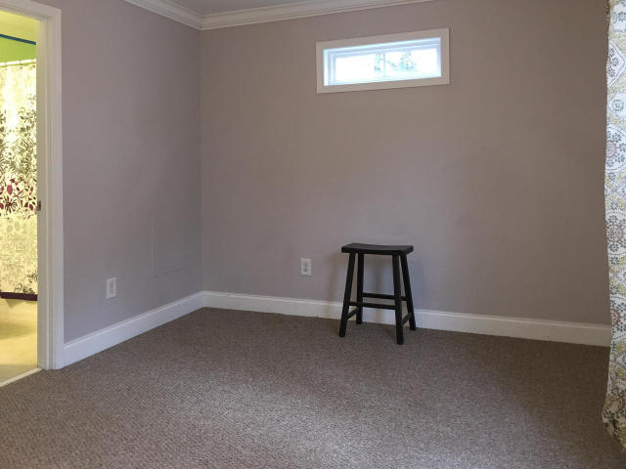
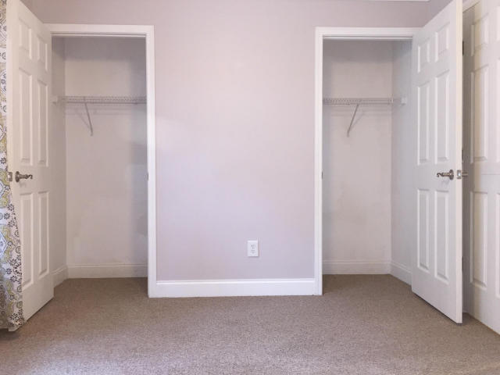
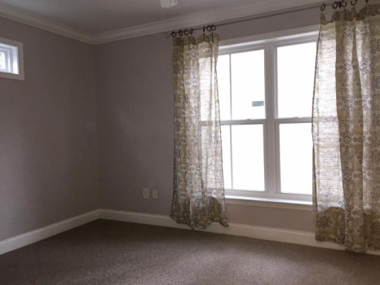
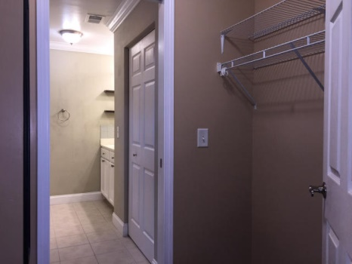

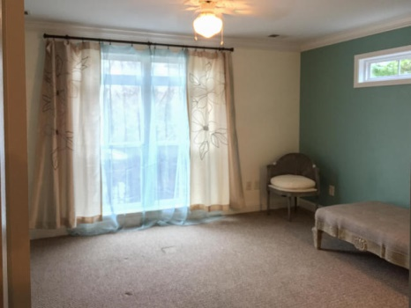

1829 Dogwood Road #401
Charleston ~ MLS# 15014536 ~ $148,000
Financing Available…
Don’t Miss It!!
Don’t miss this opportunity to own a great income property. A beautiful end unit townhouse located in the heart of West Ashley now available! Motivated Sellers! This home has just been freshly painted and shows beautifully. The townhome has a nice open floor plan with large kitchen. With 3 bedrooms and 3 baths this home is perfect for a small family or a young couple just starting out. It also makes for a great investment property. Because this home is elevated with a drive under garage there is storage galore! Don't miss this opportunity to own a great unit in one of the best locations in Charleston!
Carey Nikonchuk
(843) 276-1701 M
cnikonchuk@gmail.com
www.palmettoproperty.net

