Slide 1
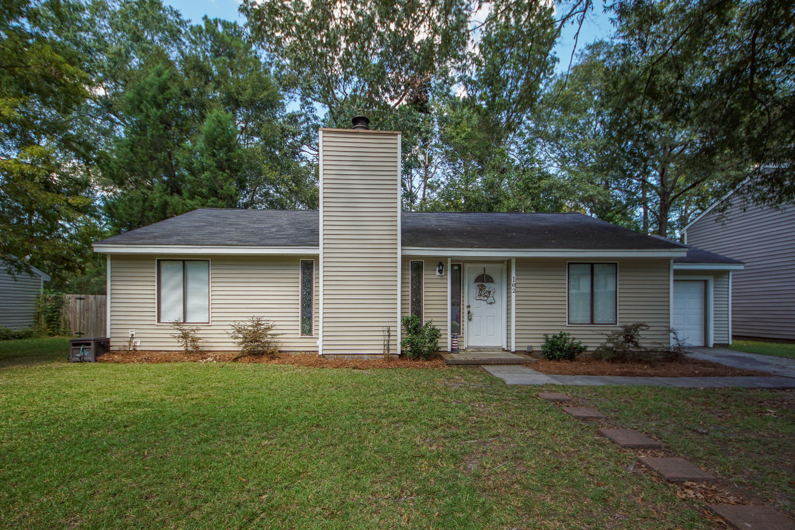
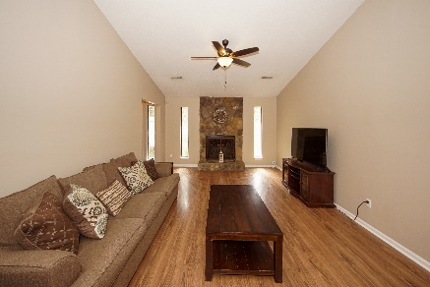
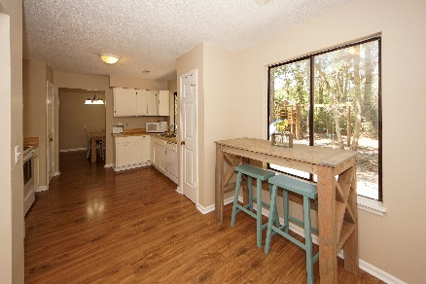
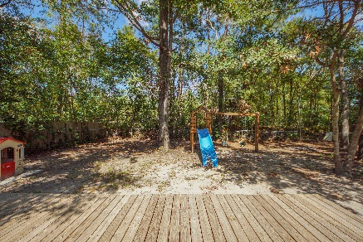


182 Bridgecreek Drive Crowfield Plantation :: Goose Creek, SC 29445 MLS# 19026962 :: $192,000 3 Bed / 2 Bath
Just Reduced!
New Listing In Crowfield Plantation!
Live in desirable Crowfield Plantation in a clean, well maintained 3 bedroom 2 bath home.
New Paint, AC installed 2010 and Roof replaced in 2008.
Laminate flooring, fire place, spacious kitchen and open concept make this home a must see and must own!
Connie White, Broker
843-532-3356
connie@chrepros.com · conniewhiterealestate.com
Charleston Homes · 597 Old Mt. Holly Road · Suite 301 · Goose Creek, SC 29445

