Slide 1
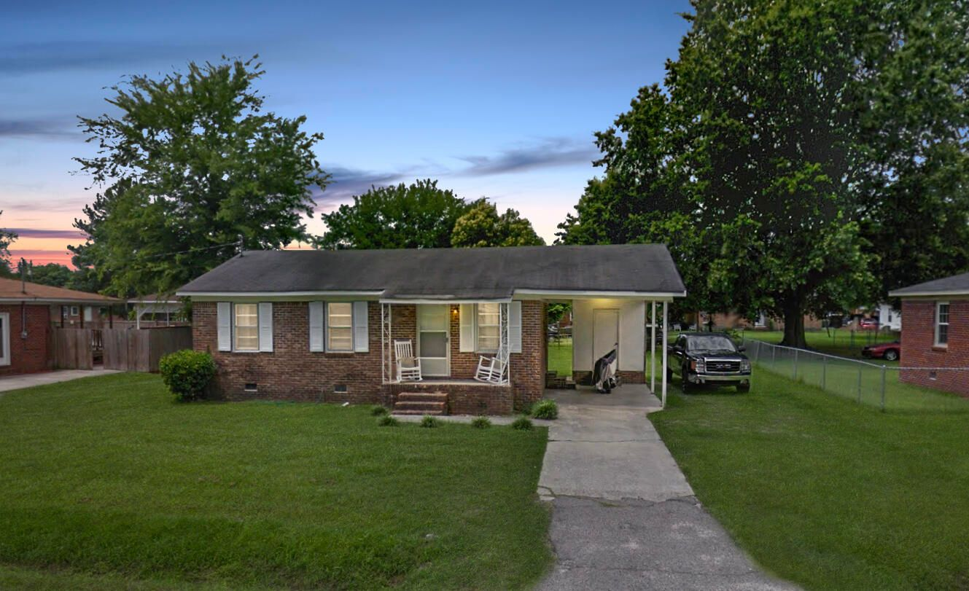
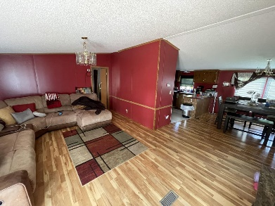
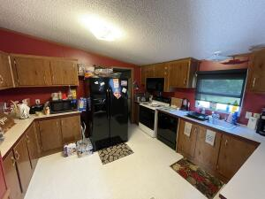
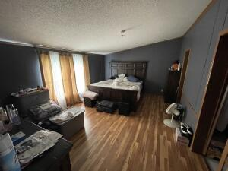
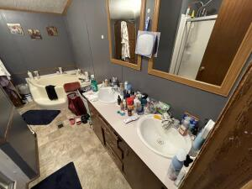
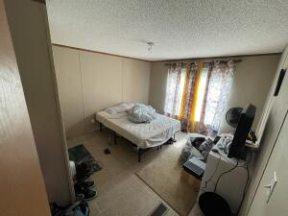
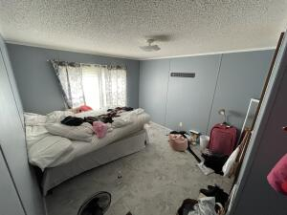
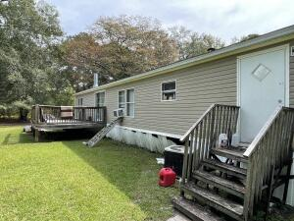
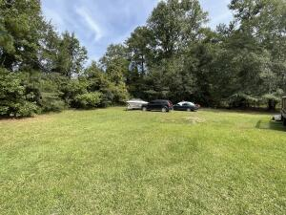



ATTENTION INVESTORS AND HOME BUYERS!
191 Deloach Avenue
Kennedy Park | Allendale, SC 29810
MLS# 22011951 | $65,000
3 Bed | 1 Bath | 945 sf
Located in downtown Allendale, Here's your chance to own an investment property or fixer upper in Allendale! Although the house does need work, it will make a gorgeous finished product when completed. This is a solid, 3 bedroom and 1 bathroom brick ranch that sits on a fifth of an acre of land! Home is being sold in ''as-is'' condition.
More pictures coming soon.
Nick Mazzilli (843) 640-5575
nick@nickmcharleston.com www.mavenrealtysc.com
Maven Realty
2180 McMillan Ave
#71672
Charleston, SC 29405

