Slide 1
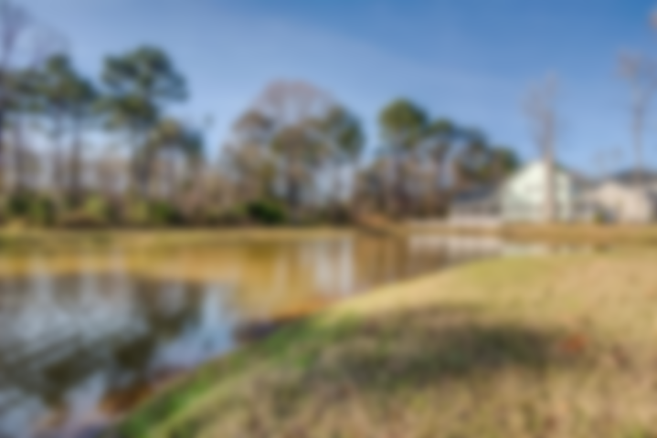
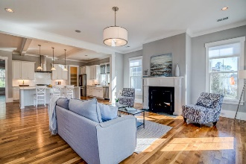
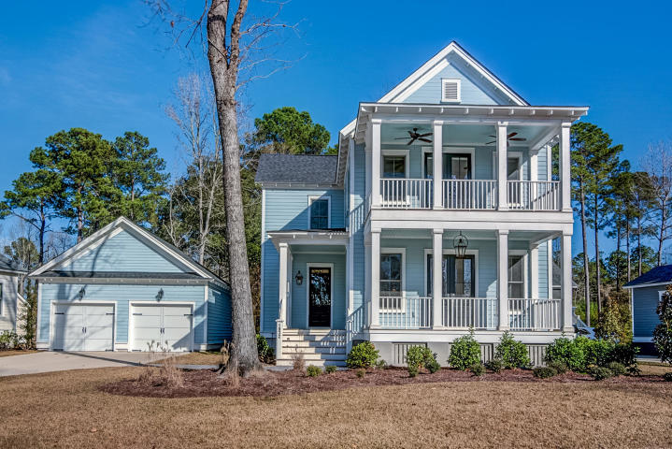
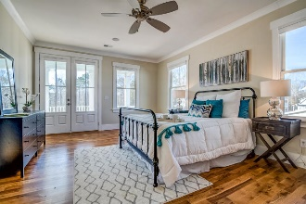
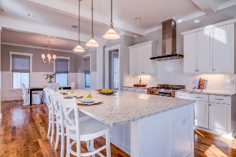
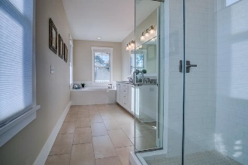
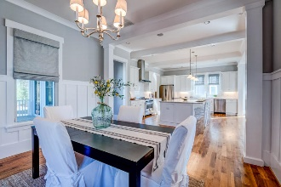
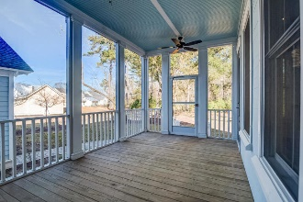
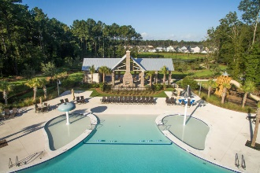
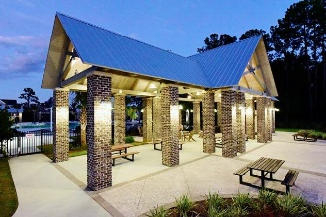
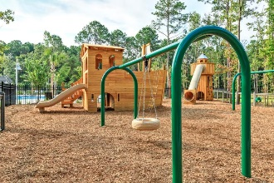
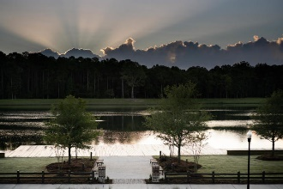

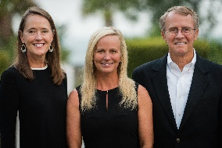

1832 Carolina Park Boulevard Mount Pleasant, SC 29466 | MLS# 19001162 | $799,000
Priced to Sell – Show Ready - Carolina Park
Nestled into a park-like setting in the prestigious Riverside at Carolina Park, this stunning custom home exudes southern charm and refined style. Double stacked piazzas, awash in the soft glow of traditional gas lanterns, beckon you to sit a spell, sip a glass of tea and enjoy the view of egrets and herons fishing in the pond directly across the street. Step through the double, glass inset front doors and you'll be welcomed into an open and expansive main floor. Gorgeous hardwood floors and custom specialty millwork abound including crisp crown moulding, tall baseboards, column framed cased openings and distinguishing ceiling treatments. A casual elegance is achieved in this home's design plan through the use of high end fixtures and finishes all while remaining true to the coastal cottage feel with elements such as clean lines, a crisp neutral color scheme and perfectly placed rustic accents.
Located in desirable Carolina Park, you'll have access to luxury amenities such as a resort style swimming pool, tennis courts, children's play park, dog park, miles of walking/jogging trails, and 20 acre Bolden Lake with boardwalk and kayak launch. The new Carolina Park Elementary opened this year to join Wando High School, Wando Center for Advanced Studies, and Oceanside Academy. In addition, a brand new public library is slated to open later this year. All of this and still close to beaches, dining, shopping and all of the world-class offerings of historic downtown Charleston.
Asking $1,200,000
MLS# 17023051
3,692 SqFt
4 Bed/3½ Baths
Short Drive to Historic Downtown Charleston & Beaches
Don Dawson 843-514-0452 ddawson@carolinaone.com Carolina One Real Estate • 2713 Highway 17 North • Mount Pleasant, SC 29466
www.TeamDawsonSC.com

